Slide 1


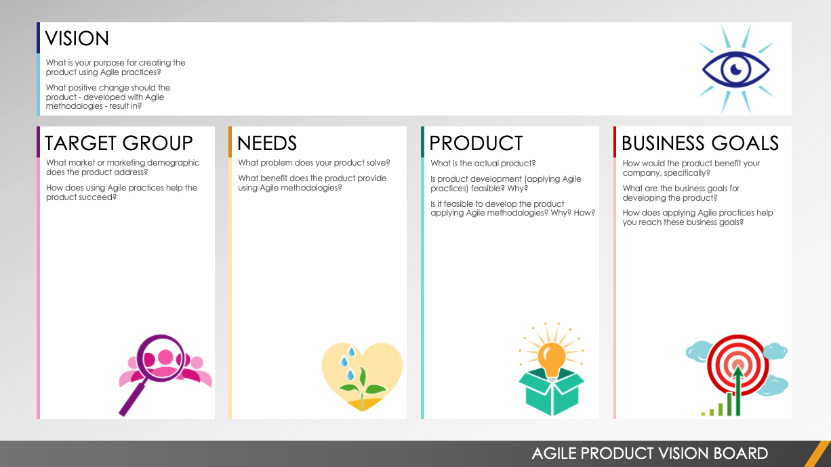
AGILE PRODUCT VISION BOARD TEMPLATE
Editable template can be found on Slide 2.
AGILE PRODUCT VISION BOARD

Slide 2





VISION
What is your purpose for creating the product using agile practices?
What positive change should the product -- developed with agile methodologies -- result in?
Text
TARGET GROUP
NEEDS
PRODUCT
BUSINESS GOALS
What market or marketing demographic does the product address?
How does using agile practices help the product succeed?
What problem does your product solve?
What benefit does the product provide by using agile methodologies?
What is the actual product?
Is product development (applying agile practices) feasible? Why?
Is it feasible to develop the product
applying agile methodologies? Why? How?
How would the product benefit your company, specifically?
What are the business goals for developing the product?
How does applying agile practices help you reach these business goals?
Text
Text
Text
Text
AGILE PRODUCT VISION BOARD

Slide 3
DISCLAIMER Any articles, templates, or information provided by Smartsheet on the website are for reference only. While we strive to keep the information up to date and correct, we make no representations or warranties of any kind, express or implied, about the completeness, accuracy, reliability, suitability, or availability with respect to the website or the information, articles, templates, or related graphics contained on the website. Any reliance you place on such information is therefore strictly at your own risk.

