Slide 1


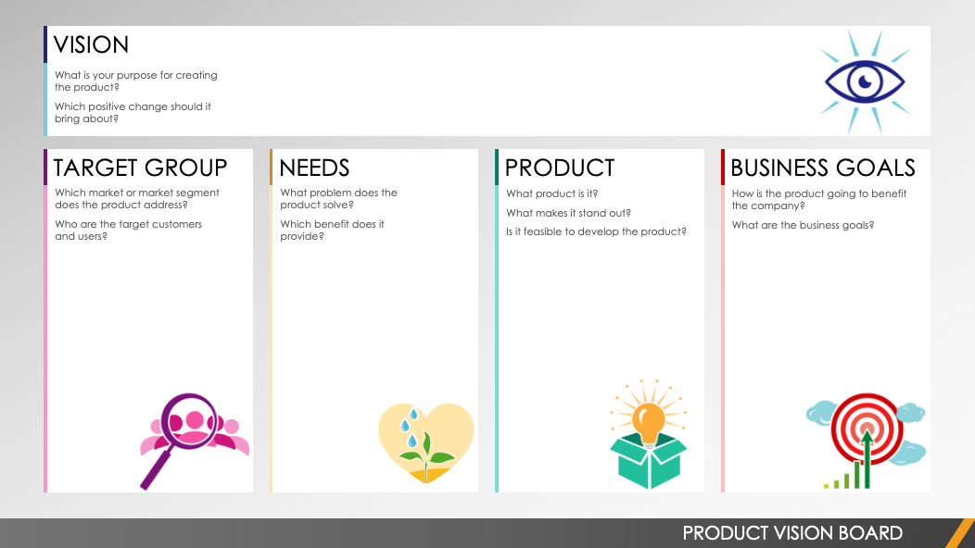
PRODUCT VISION BOARD TEMPLATE
Editable template can be found on Slide 2.
PRODUCT VISION BOARD

Slide 2





VISION
What is your purpose for creating the product?
Which positive change should it bring about?
Text
TARGET GROUP
NEEDS
PRODUCT
BUSINESS GOALS
Which market or market segment does the product address?
Who are the target customers and users?
What problem does the product solve?
Which benefit does it provide?
What product is it?
What makes it stand out?
Is it feasible to develop the product?
How is the product going to benefit the company?
What are the business goals?
Text
Text
Text
Text
PRODUCT VISION BOARD

Slide 3
DISCLAIMER Any articles, templates, or information provided by Smartsheet on the website are for reference only. While we strive to keep the information up to date and correct, we make no representations or warranties of any kind, express or implied, about the completeness, accuracy, reliability, suitability, or availability with respect to the website or the information, articles, templates, or related graphics contained on the website. Any reliance you place on such information is therefore strictly at your own risk.

