Slide 1


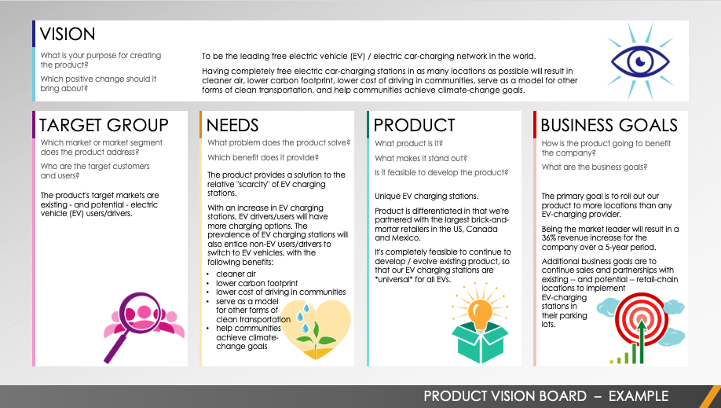
PRODUCT VISION BOARD EXAMPLE TEMPLATE
Editable template can be found on Slide 2.
PRODUCT VISION BOARD – EXAMPLE

Slide 2





VISION
What is your purpose for creating the product?
Which positive change should it bring about?
To be the leading free electric vehicle (EV)-charging network in the world.
Having completely free EV-charging stations in as many locations as possible will result in the following: having cleaner air; lowering the carbon footprint; lowering the cost of driving in general; serving as a model for other forms of clean transportation; and helping communities achieve climate-change goals.
TARGET GROUP
NEEDS
PRODUCT
BUSINESS GOALS
Which market or market segment does the product address?
Who are the target customers and users?
What problem does the product solve?
Which benefit does it provide?
What product is it?
What makes it stand out?
Is it feasible to develop the product?
How is the product going to benefit the company?
What are the business goals?
The product provides a solution concerning the relative scarcity of EV- charging stations.
With an increase in EV-charging stations, EV drivers/users will have more charging options. This newfound prevalence of EV-charging stations will also entice non-EV users/drivers to switch to EV vehicles. Such a change will bring the following benefits:
The product's target markets are existing -- and potential -- EV users/drivers.
Unique EV-charging stations.
The product is different in that we're partnered with the largest brick-and-mortar retailers in the US, Canada, and Mexico.
It's completely feasible to continue to develop / evolve the existing product so that our EV-charging stations become universal for all EVs.
The primary goal is to roll out our product to more locations than any EV-charging provider.
Being the market leader will result in a 36 percent revenue increase for the company over a five-year period.
Additional business goals include continuing sales and partnerships with existing -- and potential -- retail-chain locations in order to implement
EV-charging
stations in
their parking
lots.
Having cleaner air
Lowering the carbon footprint
Lowering the cost of driving in general
Serving as a model
for other forms of
clean transportation
Helping communities
achieve climate-
change goals
PRODUCT VISION BOARD – EXAMPLE

Slide 3
DISCLAIMER Any articles, templates, or information provided by Smartsheet on the website are for reference only. While we strive to keep the information up to date and correct, we make no representations or warranties of any kind, express or implied, about the completeness, accuracy, reliability, suitability, or availability with respect to the website or the information, articles, templates, or related graphics contained on the website. Any reliance you place on such information is therefore strictly at your own risk.

