Slide 1



BRAND STYLE GUIDE EXAMPLE
BRAND STYLE GUIDE
©2022. All Rights Reserved Smartsheet Inc.
BRAND STYLE GUIDE

Slide 2







sales@smartsheet.com
(844) 324-2360
smartsheet.com
/smartsheet
/company/smartsheet-com
/@smartsheet
/smartsheet
/smartsheet
©2022. All Rights Reserved Smartsheet Inc.
PROJECT REPORT
BRAND STYLE GUIDE

Slide 3
TABLE OF CONTENTS
1
5
Usage Guidelines
Colors
2
6
Using Smartsheet Marks DO’s
Logo
3
7
Using Smartsheet Marks DON’Ts
Clearance
4
8
Fonts
Incorrect Usage
PROJECT REPORT
BRAND STYLE GUIDE | TABLE OF CONTENTS

Slide 4
1. USAGE GUIDELINES
Smartsheet Inc. (“Smartsheet”) owns many trademarks, logos, designs, and service marks (“Smartsheet Marks”) that it frequently uses to identify and promote the Smartsheet brand. These terms and guidelines (the “Guide”) govern the use of Smartsheet Marks in promotional, advertising, resale, and similar capacities or as may be alternatively approved by Smartsheet. Unless you have a separate written agreement with Smartsheet that specifies the use of Smartsheet Marks, all use of Smartsheet Marks is subject to this Guide.
Smartsheet grants you a non-transferable, non-exclusive, royalty-free limited license to use Smartsheet Marks as detailed in this Guide. Your uses of Smartsheet Marks, including any license which may have otherwise been agreed to in writing, does not grant you any ownership rights to Smartsheet Marks, including but not limited to, any logos, designs, or other similar materials. Smartsheet retains all right, title, and interest in and to Smartsheet Marks materials, including any intellectual property rights therein. Any use of the Smartsheet Marks must be accompanied by a notice that clearly indicates that Smartsheet Marks are trademarks of Smartsheet Inc.
You will not display Smartsheet Marks in any manner that implies that you are related to, associated or affiliated with, sponsored or endorsed by Smartsheet, or in a manner that could reasonably be interpreted to suggest that your content, website, product or service, has been authored, approved or edited by Smartsheet, or represents Smartsheet’s views or opinions.
You may only use Smartsheet Marks in a manner designed to maintain the highest standard, quality and reputation that is associated with Smartsheet Marks, and in ways that are truthful, accurate, fair, and not misleading. You will not use Smartsheet Marks to disparage Smartsheet or Smartsheet’s products or services.
Smartsheet reserves the right in its sole discretion to terminate or modify your permission to display the Smartsheet Marks and to take action against any use that does not conform to this Guide, infringes any Smartsheet intellectual property or other right, or violates applicable law.
USAGE GUIDELINES
PROJECT REPORT

Slide 5
1. USAGE GUIDELINES continued
You agree not to challenge or assist others to challenge Smartsheet Marks (except to the extent such restriction is prohibited by applicable law), and you agree not to register or attempt to register any domain names, trademarks, trade names, or other distinctive brand features that are confusingly similar to those of Smartsheet.
Smartsheet Marks are provided “as is” and Smartsheet disclaims any warranties either expressed or implied by law regarding Smartsheet Marks, including warranties of noninfringement. In no event shall Smartsheet be liable to you for the subject matter of this Guide under any theory of liability including for any direct, indirect, incidental, special, consequential, punitive, exemplary or other damages arising out of this Guide or the use of the Smartsheet Marks. This limitation shall apply even if Smartsheet was or should have been aware or advised of the possibility of such damages and notwithstanding any failure of essential purpose of any limited remedy stated herein.
You may not assign your rights or delegate your obligations under this Guide without Smartsheet’s prior written consent. This Guide is not intended to benefit, nor shall it be deemed to give rise to, any rights in any third party. This Guide will be governed by and construed in accordance with the laws of the State of Washington, without regard to conflict of law principles. The venue for any dispute or claim arising out of or in connection with this Guide shall be in King County, Washington. The parties are independent contractors. Neither party shall be deemed to be an employee, agent, partner or legal representative of the other for any purpose and neither shall have any right, power or authority to create any obligation or responsibility on behalf of the other. The waiver by Smartsheet of a breach of any provision hereof shall not be taken or held to be a waiver of the provision itself. If any provision of this Guide is held by a court of competent jurisdiction to be contrary to law, such provision shall be changed and interpreted so as to best accomplish the objectives of the original provision to the fullest extent allowed by law and the remaining provisions of this Guide shall remain in full force and effect.
USAGE GUIDELINES
PROJECT REPORT

Slide 6

1. USAGE GUIDELINES continued
Smartsheet appreciates your cooperation with these Smartsheet Branding Guidelines, and your appropriate use of Smartsheet’s intellectual property. If you find a website that uses a Smartsheet trademark inappropriately, please contact Smartsheet. For additional information with respect to Smartsheet Marks or Smartsheet’s intellectual property portfolio, please contact legal@smartsheet.com.
USAGE GUIDELINES
PROJECT REPORT

Slide 7
2. Using Smartsheet Marks DO’s
Do always use proper trademark form and spelling.
Do distinguish trademarks from surrounding text with appropriate capitalization
(initial letters capitalized or all letters capitalized), italics, or quotation marks.
Do always use the trademark as an adjective, not a noun or a verb. For example:
  Proper Use: “Use of the Smartsheet software-as-a-service platform is becoming increasingly adopted company wide.”
  Improper Use: “Smartsheet is becoming increasingly adopted company wide.”
Do include an attribution of Smartsheet’s ownership of its trademarks within the credit notice section of your product, product documentation, or other product communication. For example: “Smartsheet, the Smartsheet logo, and the checkmark, are trademarks or registered trademarks of Smartsheet Inc. in the United States and other countries.”
USING SMARTSHEET MARKS DO’s
PROJECT REPORT

Slide 8
3. Using Smartsheet Marks DON’Ts
Don’t modify a trademark to a plural form.
Don’t translate a trademark into a foreign language.
Don’t alter a trademark in any way, including through visual identifiers or unapproved fonts.
Don’t use or register trademarks that are confusingly similar to Smartsheet trademarks.
Don’t abbreviate a trademark as an acronym except where there may be a Smartsheet authorized acronym.
Don’t use in relation to products or services across any mediums that may be explicit, vulgar, offensive, or that in any way violate applicable law.
USING SMARTSHEET MARKS DON’Ts
PROJECT REPORT

Slide 9
4. Colors
Slate Blue - Dark
Collaboration Blue
Supportive Green
Honest Blue
Hex:
RGB:
CMYK:
Pantone:
#455264
69 / 82 / 100
31 / 18 / 0 / 61
7545 C
Hex:
RGB:
CMYK:
Pantone:
#003059
0 / 48 / 89
100 / 46 / 0 / 65
295 C
Hex:
RGB:
CMYK:
Pantone:
#349D73
52 / 157 / 115
67 / 0 / 27 / 38
2417 C
Hex:
RGB:
CMYK:
Pantone:
#2A75D1
42 / 117 / 209
80 / 44 / 0 / 18
2386 C
COLORS
PROJECT REPORT

Slide 10
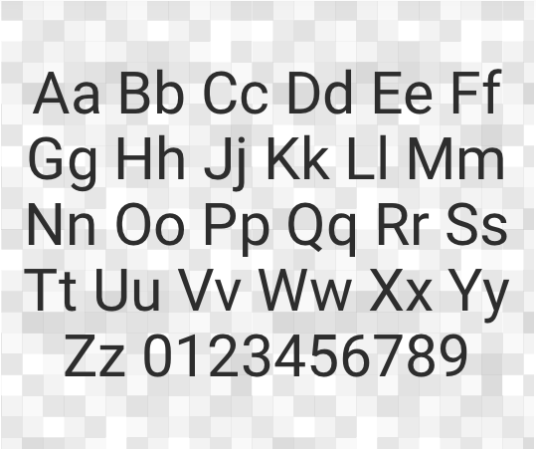
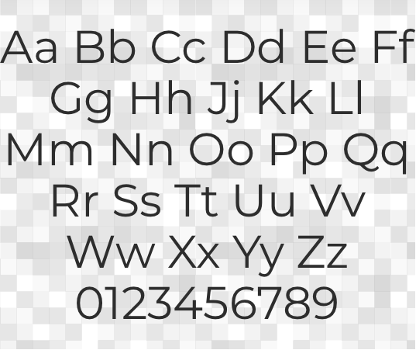
5. Fonts
Montserrat
Roboto
FONTS
PROJECT REPORT

Slide 11






6. Logo
The Smartsheet logo has meaning and purpose. It represents a work tool and accomplishment. It conveys achievement in getting work done, success, and satisfaction. Our logo is our first impression. Below are all the accepted treatments of the logo.
Horizontal Layout
Vertical Layout
Wordmark
The logotype sans logomark is to be used exclusively within the app.
Logomark (icon)
LOGO
PROJECT REPORT

Slide 12

7. Clearance
Give the logo some room to breathe. The logo should be allowed some clear space around the entire lockup. This will provide proper spacing for its character ascenders. Below is the minimum amount of clearance, but more is preferred.
CLEARANCE
PROJECT REPORT

Slide 13

8. Incorrect Usage
Please use the logos as they are provided in these guidelines. Don’t alter the Smartsheet logo.
Skew
Change colors
Recreate
Don’t skew or scale disproportionately
Don’t change the colors
Don’t make alterations, additions, or substitutions
Add effects
Alter orientation
Use busy backgrounds
Don’t add drop shadows, strokes, or bevels
Don’t change the orientation
Don’t place on complicated backgrounds
INCORRECT USAGE
PROJECT REPORT

Slide 14
DISCLAIMER Any articles, templates, or information provided by Smartsheet on the website are for reference only. While we strive to keep the information up to date and correct, we make no representations or warranties of any kind, express or implied, about the completeness, accuracy, reliability, suitability, or availability with respect to the website or the information, articles, templates, or related graphics contained on the website. Any reliance you place on such information is therefore strictly at your own risk.

