Slide 1



BRAND STYLE GUIDE TEMPLATE
YOUR
LOGO
BRAND STYLE GUIDE
©20XX. All Rights Reserved Your Organization.
BRAND STYLE GUIDE

Slide 2
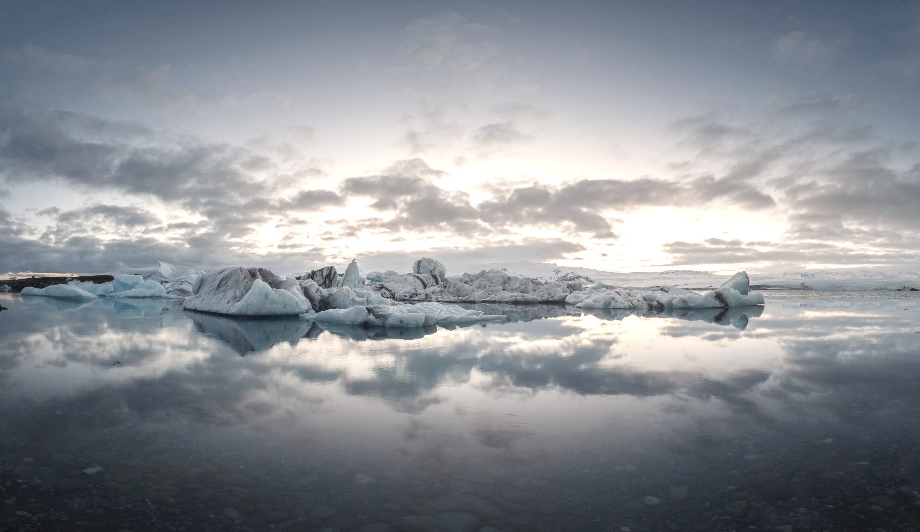






sales@smartsheet.com
(844) 324-2360
smartsheet.com
/smartsheet
/company/smartsheet-com
/@smartsheet
/smartsheet
/smartsheet
©20XX.
All Rights Reserved Your Organization.
PROJECT REPORT
BRAND STYLE GUIDE

Slide 3
TABLE OF CONTENTS
1
5
Usage Guidelines
Colors
2
6
Mark Usage DO’s
Logo
3
7
Mark Usage DON’Ts
Clearance
4
8
Fonts
Incorrect Usage
PROJECT REPORT
BRAND STYLE GUIDE | TABLE OF CONTENTS

Slide 4
1. USAGE GUIDELINES
Description
USAGE GUIDELINES
PROJECT REPORT

Slide 5

2. Mark Usage DO’s
Do always use proper trademark form and spelling.
Do distinguish trademarks from surrounding text with appropriate capitalization
(initial letters capitalized or all letters capitalized), italics, or quotation marks.
MARK USAGE DO’s
PROJECT REPORT

Slide 6

3. Mark Usage DON’Ts
Don’t modify a trademark to a plural form.
Don’t alter a trademark in any way, including through visual identifiers or unapproved fonts.
MARK USAGE DON’Ts
PROJECT REPORT

Slide 7
4. Colors
Bronze Beach
Golden Sun
Lush Green
Power Blue
Hex:
RGB:
CMYK:
Pantone:
#000000
0/ 0 / 0
0 / 0 / 0 / 0
XXXX
Hex:
RGB:
CMYK:
Pantone:
#000000
0/ 0 / 0
0 / 0 / 0 / 0
XXXX
Hex:
RGB:
CMYK:
Pantone:
#000000
0/ 0 / 0
0 / 0 / 0 / 0
XXXX
Hex:
RGB:
CMYK:
Pantone:
#000000
0/ 0 / 0
0 / 0 / 0 / 0
XXXX
COLORS
PROJECT REPORT

Slide 8
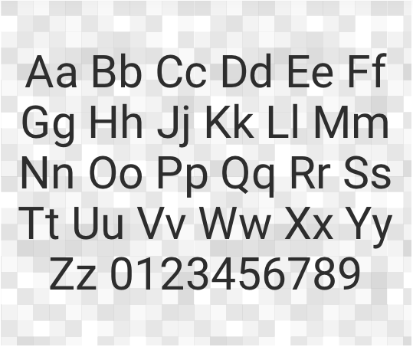
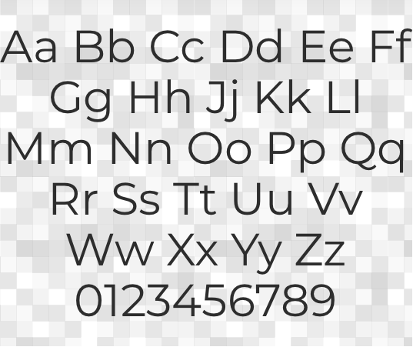
5. Fonts
Montserrat
Roboto
FONTS
PROJECT REPORT

Slide 9








6. Logo
Below are all the accepted treatments of the logo.
Horizontal Layout
Vertical Layout
Wordmark
The logotype sans logomark is to be used exclusively within the app.
Logomark (icon)
LOGO
PROJECT REPORT

Slide 10
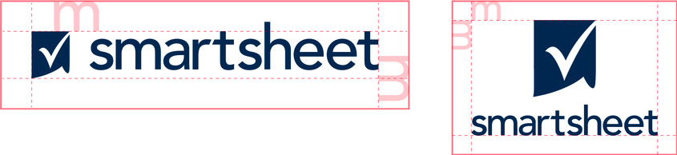
7. Clearance
Give the logo some room to breathe. The logo should be allowed some clear space around the entire lockup. This will provide proper spacing for its character ascenders. Below is the minimum amount of clearance, but more is preferred.
CLEARANCE
PROJECT REPORT

Slide 11

8. Incorrect Usage
Please use the logos as they are provided in these guidelines. Don’t alter the logo.
Skew
Change colors
Recreate
Don’t skew or scale disproportionately
Don’t change the colors
Don’t make alterations, additions, or substitutions
Add effects
Alter orientation
Use busy backgrounds
Don’t add drop shadows, strokes, or bevels
Don’t change the orientation
Don’t place on complicated backgrounds
INCORRECT USAGE
PROJECT REPORT

Slide 12
DISCLAIMER Any articles, templates, or information provided by Smartsheet on the website are for reference only. While we strive to keep the information up to date and correct, we make no representations or warranties of any kind, express or implied, about the completeness, accuracy, reliability, suitability, or availability with respect to the website or the information, articles, templates, or related graphics contained on the website. Any reliance you place on such information is therefore strictly at your own risk.

