Slide 1



LOGO USAGE GUIDELINES PRESENTATION TEMPLATE
LOGO USAGE GUIDELINES
YOUR
LOGO
©20XX. All Rights Reserved Your Organization.
LOGO USAGE GUIDELINES

Slide 2
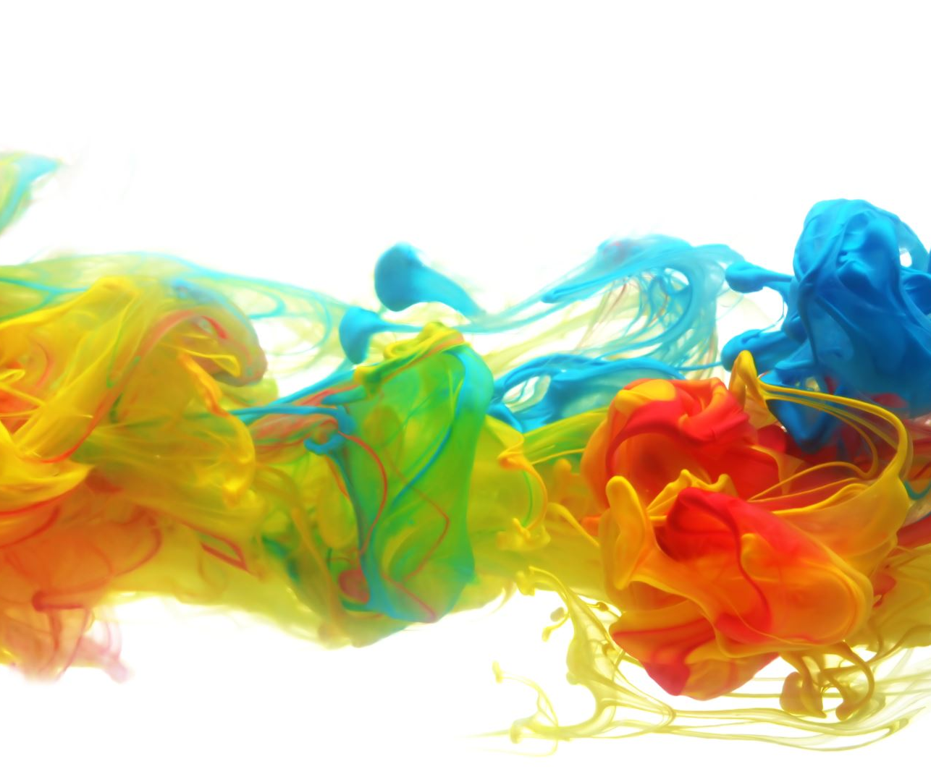






sales@smartsheet.com
(844) 324-2360
smartsheet.com
/smartsheet
/company/smartsheet-com
/@smartsheet
/smartsheet
/smartsheet
©20XX. All Rights Reserved Your Organization.
PROJECT REPORT
LOGO USAGE GUIDELINES

Slide 3
TABLE OF CONTENTS
1
5
Logo
Mark Usage DO’s
2
6
Clearance
Mark Usage DON’Ts
3
7
Incorrect Usage
Colors
4
8
Usage Guidelines
Typography
PROJECT REPORT
BRAND STYLE GUIDE | TABLE OF CONTENTS

Slide 4








1. Logo
Below are all the accepted treatments of the logo.
Horizontal Layout
Vertical Layout
Wordmark
The logotype sans logomark is to be used exclusively within the app.
Logomark (icon)
LOGO
PROJECT REPORT

Slide 5
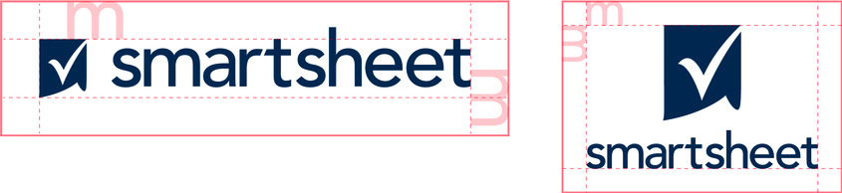
2. Clearance
Give the logo some room to breathe. The logo should be allowed some clear space around the entire lockup. This will provide proper spacing for its character ascenders. Below is the minimum amount of clearance, but more is preferred.
CLEARANCE
PROJECT REPORT

Slide 6

3. Incorrect Usage
Please use the logos as they are provided in these guidelines. Don’t alter the logo.
Skew
Change colors
Recreate
Don’t skew or scale disproportionately
Don’t change the colors
Don’t make alterations, additions, or substitutions
Add effects
Alter orientation
Use busy backgrounds
Don’t add drop shadows, strokes, or bevels
Don’t change the orientation
Don’t place on complicated backgrounds
INCORRECT USAGE
PROJECT REPORT

Slide 7
4. USAGE GUIDELINES
Smartsheet Inc. (“Smartsheet”) owns many trademarks, logos, designs, and service marks (“Smartsheet Marks”) that it frequently uses to identify and promote the Smartsheet brand. These terms and guidelines (the “Guide”) govern the use of Smartsheet Marks in promotional, advertising, resale, and similar capacities or as may be alternatively approved by Smartsheet. Unless you have a separate written agreement with Smartsheet that specifies the use of Smartsheet Marks, all use of Smartsheet Marks is subject to this Guide.
Smartsheet grants you a non-transferable, non-exclusive, royalty-free limited license to use Smartsheet Marks as detailed in this Guide. Your uses of Smartsheet Marks, including any license which may have otherwise been agreed to in writing, does not grant you any ownership rights to Smartsheet Marks, including, but not limited to, any logos, designs, or other similar materials. Smartsheet retains all right and title to as well as interest in Smartsheet Marks materials, including any intellectual property rights therein. Any use of the Smartsheet Marks must be accompanied by a notice that clearly indicates that Smartsheet Marks are trademarks of Smartsheet Inc.
You will not display Smartsheet Marks in any manner that implies that you are related to, associated or affiliated with, or sponsored or endorsed by Smartsheet or in any manner that could reasonably be interpreted to suggest that your content represents Smartsheet’s views or opinions or suggest that Smartsheet has authored, approved, or edited your content, website, product, or service.
USAGE GUIDELINES
PROJECT REPORT

Slide 8

5. Mark Usage DO’s
Do always use proper trademark form and spelling.
Do distinguish trademarks from surrounding text with appropriate capitalization (initial letters capitalized or all letters capitalized), italics, or quotation marks.
MARK USAGE DO’s
PROJECT REPORT

Slide 9

6. Mark Usage DON’Ts
Don’t modify a trademark to create a plural form.
Don’t alter a trademark in any way, including through visual identifiers or unapproved fonts.
MARK USAGE DON’Ts
PROJECT REPORT

Slide 10
7. Colors: Primary
Bronze Beach
Golden Sun
Lush Green
Power Blue
Hex:
RGB:
CMYK:
Pantone:
#000000
0/ 0 / 0
0 / 0 / 0 / 0
XXXX
Hex:
RGB:
CMYK:
Pantone:
#000000
0/ 0 / 0
0 / 0 / 0 / 0
XXXX
Hex:
RGB:
CMYK:
Pantone:
#000000
0/ 0 / 0
0 / 0 / 0 / 0
XXXX
Hex:
RGB:
CMYK:
Pantone:
#000000
0/ 0 / 0
0 / 0 / 0 / 0
XXXX
COLORS: Primary
PROJECT REPORT

Slide 11
7. Colors: Secondary
Strawberry
Cantaloupe
Lemon
Kiwi
Hex:
RGB:
CMYK:
Pantone:
#000000
0/ 0 / 0
0 / 0 / 0 / 0
XXXX
Hex:
RGB:
CMYK:
Pantone:
#000000
0/ 0 / 0
0 / 0 / 0 / 0
XXXX
Hex:
RGB:
CMYK:
Pantone:
#000000
0/ 0 / 0
0 / 0 / 0 / 0
XXXX
Hex:
RGB:
CMYK:
Pantone:
#000000
0/ 0 / 0
0 / 0 / 0 / 0
XXXX
COLORS: Secondary
PROJECT REPORT

Slide 12
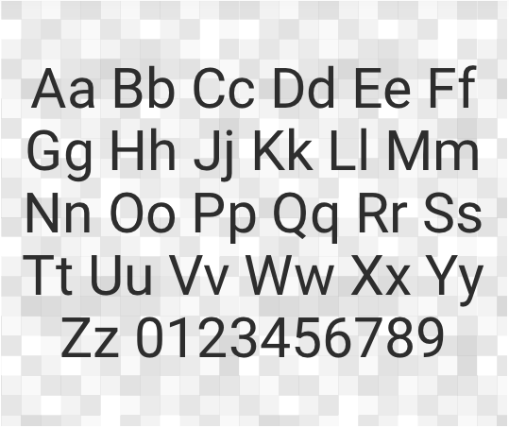
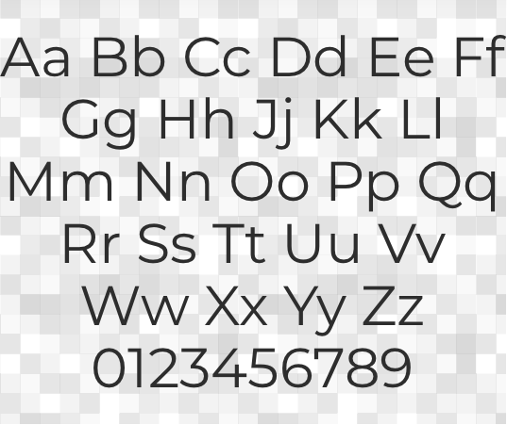
8. Typography
Montserrat
Roboto
TYPOGRAPHY
PROJECT REPORT

Slide 13
Typography: Formatting
HEADLINES
Font:
Style:
Size:
Line Height:
Tracking:
Century Gothic
Regular
32pt
1
Normal
Aa
Paragraph
Font:
Style:
Size:
Line Height:
Tracking:
Century Gothic
Regular
11pt
1.5
Normal
TYPOGRAPHY: FORMATTING
PROJECT REPORT

Slide 14
DISCLAIMER Any articles, templates, or information provided by Smartsheet on the website are for reference only. While we strive to keep the information up to date and correct, we make no representations or warranties of any kind, express or implied, about the completeness, accuracy, reliability, suitability, or availability with respect to the website or the information, articles, templates, or related graphics contained on the website. Any reliance you place on such information is therefore strictly at your own risk.

