Slide 1


PROJECT TIMELINE PRESENTATION TEMPLATE
PROJECT NAME
To use the Project Timeline Template, review the example timeline on the following slide. Next, enter project data, dates and information, and manipulate fields on the Timeline Template to build your Project Timeline.
PROJECT TIMELINE PRESENTATION

Slide 2
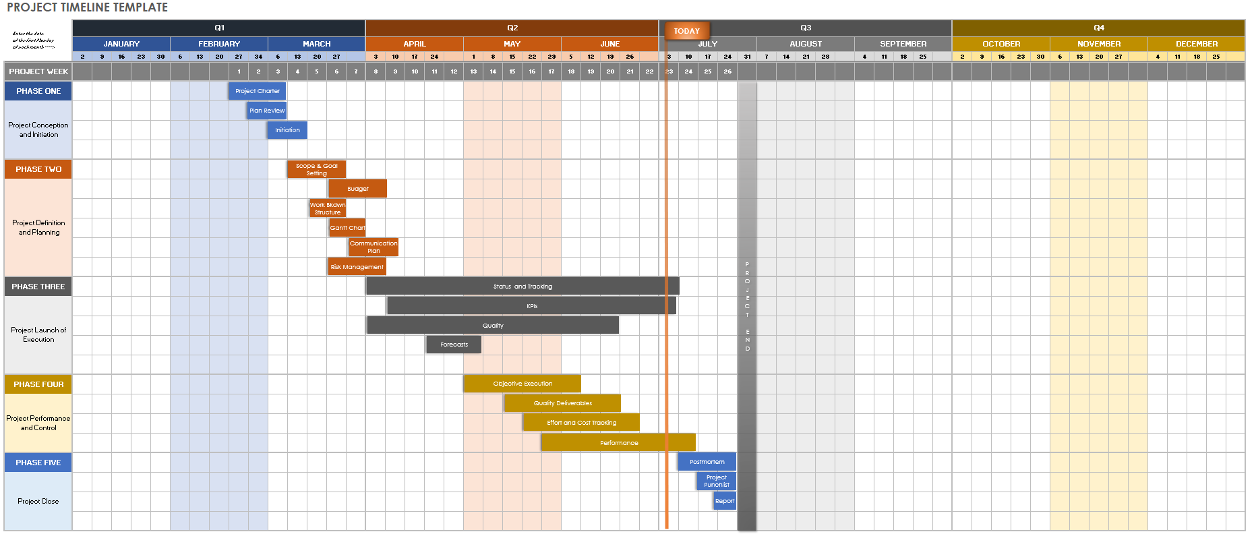
PROJECT TIMELINE PRESENTATION EXAMPLE
PROJECT REPORT
PROJECT TIMELINE PRESENTATION | EXAMPLE

Slide 3
PROJECT TIMELINE PRESENTATION TEMPLATE
Enter the date of the first Monday of each month ----> | Q1 |  |  |  |  |  |  |  |  |  |  |  |  |  |  | Q2 |  |  |  |  |  |  |  |  |  |  |  |  |  |  | Q3 |  |  |  |  |  |  |  |  |  |  |  |  |  |  | Q4
 | JANUARY |  |  |  |  | FEBRUARY |  |  |  |  | MARCH |  |  |  |  | APRIL |  |  |  |  | MAY |  |  |  |  | JUNE |  |  |  |  | JULY |  |  |  |  | AUGUST |  |  |  |  | SEPTEMBER |  |  |  |  | OCTOBER |  |  |  |  | NOVEMBER |  |  |  |  | DECEMBER
 | 2 | 9 | 16 | 23 | 30 | 6 | 13 | 20 | 27 | 34 | 6 | 13 | 20 | 27 |  | 3 | 10 | 17 | 24 |  | 1 | 8 | 15 | 22 | 29 | 5 | 12 | 19 | 26 |  | 3 | 10 | 17 | 24 | 31 | 7 | 14 | 21 | 28 |  | 4 | 11 | 18 | 25 |  | 2 | 9 | 16 | 23 | 30 | 6 | 13 | 20 | 27 |  | 4 | 11 | 18 | 25
PROJECT WEEK | 1 | 2 | 3 | 4 | 5 | 6 | 7 | 8 | 9 | 10 | 11 | 12 | 13 | 14 | 15 | 16 | 17 | 18 | 19 | 20 | 21 | 22 | 23 | 24 | 25 | 26
PHASE ONE
Project Conception and Initiation
PHASE TWO
Project Definition and Planning
PHASE THREE
Project Launch of Execution
PHASE FOUR
Project Performance and Control
PHASE FIVE
Project Close
TODAY
Project Charter
PROJECT END
Plan Review
Initiation
Scope & Goal Setting
Budget
Work Bkdwn Structure
Gantt Chart
Communication Plan
Risk Management
Status and Tracking
KPIs
Quality
Forecasts
Objective Execution
Quality Deliverables
Effort & Cost Tracking
Performance
Post Mortem
Project Punchlist
Report
PROJECT TIMELINE PRESENTATION | TEMPLATE
PROJECT REPORT

Slide 4
DISCLAIMER Any articles, templates, or information provided by Smartsheet on the website are for reference only. While we strive to keep the information up to date and correct, we make no representations or warranties of any kind, express or implied, about the completeness, accuracy, reliability, suitability, or availability with respect to the website or the information, articles, templates, or related graphics contained on the website. Any reliance you place on such information is therefore strictly at your own risk.

