Slide 1

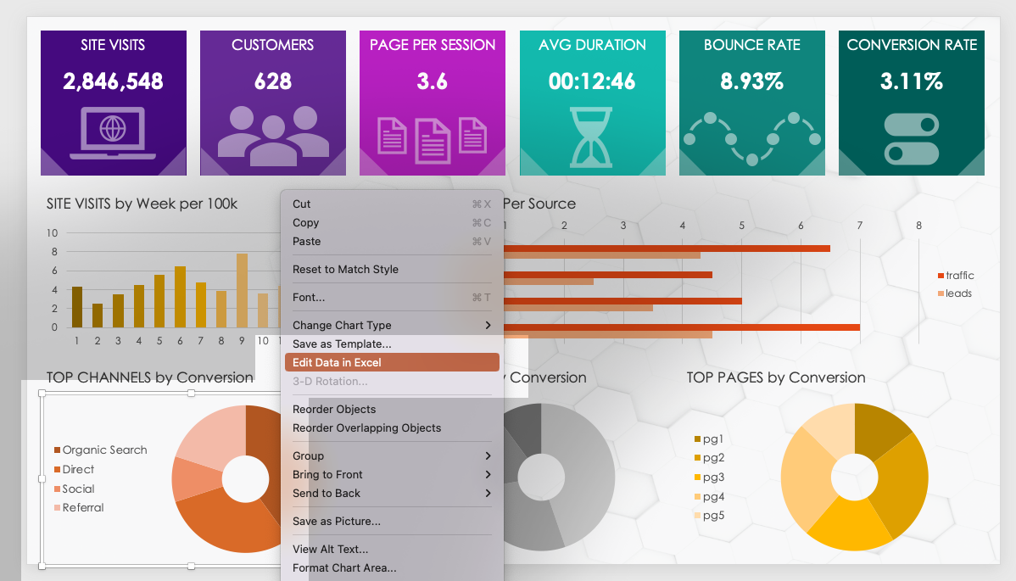
MARKETING DASHBOARD PRESENTATION SLIDE TEMPLATE
Input values to populate the chart data by highlighting a chart and right-clicking to select:
Edit Data in Excel …

Slide 2





SITE VISITS
CUSTOMERS
PAGE PER SESSION
AVG DURATION
BOUNCE RATE
CONVERSION RATE
2,846,548
628
3.6
00:12:46
8.93%
3.11%
SITE VISITS by Week per 100k
TRAFFIC and LEADS Per Source
TOP CHANNELS by Conversion
TOP CAMPAIGNS by Conversion
TOP PAGES by Conversion

Slide 3
NOTES
summary information / comments

Slide 4
DISCLAIMER Any articles, templates, or information provided by Smartsheet on the website are for reference only. While we strive to keep the information up to date and correct, we make no representations or warranties of any kind, express or implied, about the completeness, accuracy, reliability, suitability, or availability with respect to the website or the information, articles, templates, or related graphics contained on the website. Any reliance you place on such information is therefore strictly at your own risk.

