Slide 1


CRITICAL SUCCESS FACTORS FOR PROJECTS PRESENTATION TEMPLATE
PRODUCT LAUNCH
CRITICAL SUCCESS FACTORS
NAME
PROJECT MANAGER
00/00/0000

Slide 2

TABLE OF CONTENTS
PROJECT SPONSOR / CLIENT / STAKEHOLDERS
STRATEGY & PROJECT DESCRIPTION
TIMING
WHAT WE’VE LEARNED FROM PAST PROJECTS
CRITICAL SUCCESS FACTORS
  Factor 1
  Factor 2
  Factor 3
  Factor 4
  Factor 5
RISK FACTORS
METRICS
PROJECT MANAGER
PROJECT TEAM
COMMUNICATION & TRACKING TOOLS
Q&A

Slide 3

PROJECT SPONSOR / CLIENT / STAKEHOLDERS
Krista Ahmed, Director of Product Development - Internal Sponsor
Melissa Brundige, Engineering
Paul Finley, Marketing

Slide 4

STRATEGY & PROJECT DESCRIPTION
COMPANY STRATEGY
The Introduction of New Products Every Fiscal Year
PROJECT DESCRIPTION
The Creation of a Handheld Widget Based on the Results of Competitive Research That Indicate a Need for Such a Product

Slide 5

TIMING
The Fast-Tracking of Priority Tasks
The Completion of the Project by June 20XX
The Delivery of the Final Product to the Consumer Electronics Show in September 20XX

Slide 6

WHAT WE’VE LEARNED FROM PAST PROJECTS
That Smaller Prototyping Teams Are More Effective
That the Development Budget Should Not Exceed $200K
That We Should Have Mandatory Biweekly Stand-Up Meetings, Including All Team Members

Slide 7

CRITICAL SUCCESS FACTORS

Slide 8
CSF
CRITICAL SUCCESS FACTOR 1
The Commitment of Senior Management
Monthly Signoff by Management
1

Slide 9
CSF
CRITICAL SUCCESS FACTOR 2
The Achievement of a Milestone
A Weekly Metric Report
2

Slide 10
CSF
CRITICAL SUCCESS FACTOR 3
Customer Involvement
A Ranking of Two Hundred User Test Results/Inputs
3

Slide 11
CSF
CRITICAL SUCCESS FACTOR 4
The Satisfaction of All Financial Requirements
A Weekly Report on the Status of the Budget
4

Slide 12
CSF
CRITICAL SUCCESS FACTOR 5
Transparent Communication
Monthly Feedback and Reporting from Team Members
5

Slide 13


RISK FACTORS
One
Two
Three

Slide 14
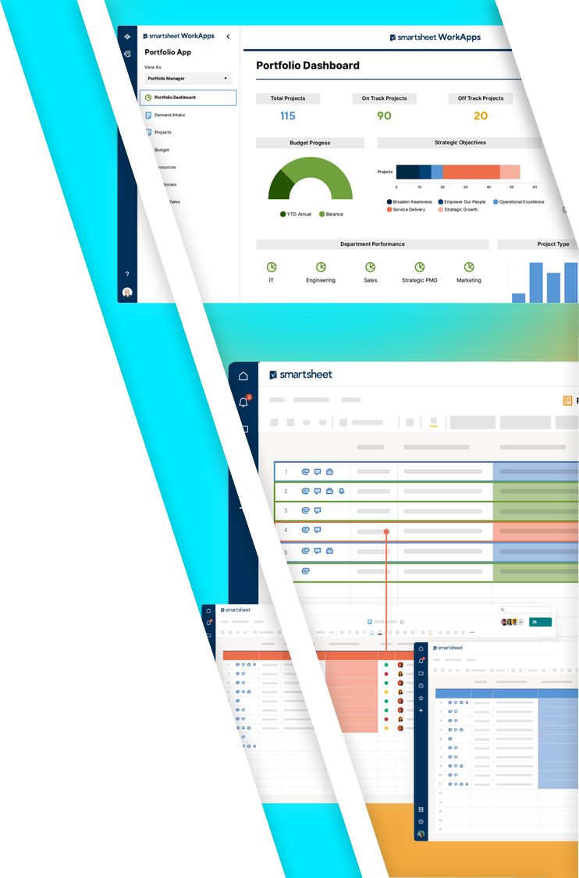
METRICS
One
Two
Three

Slide 15

PROJECT MANAGER
AGNES JONES
Senior Project Manager
222.222.2222
ajones@email.com

Slide 16

PROJECT TEAM
TEAM MEMBER NAME
Area of Responsibility
222.222.2222 • email@email.com
TEAM MEMBER NAME
Area of Responsibility
222.222.2222 • email@email.com
TEAM MEMBER NAME
Area of Responsibility
222.222.2222 • email@email.com

Slide 17
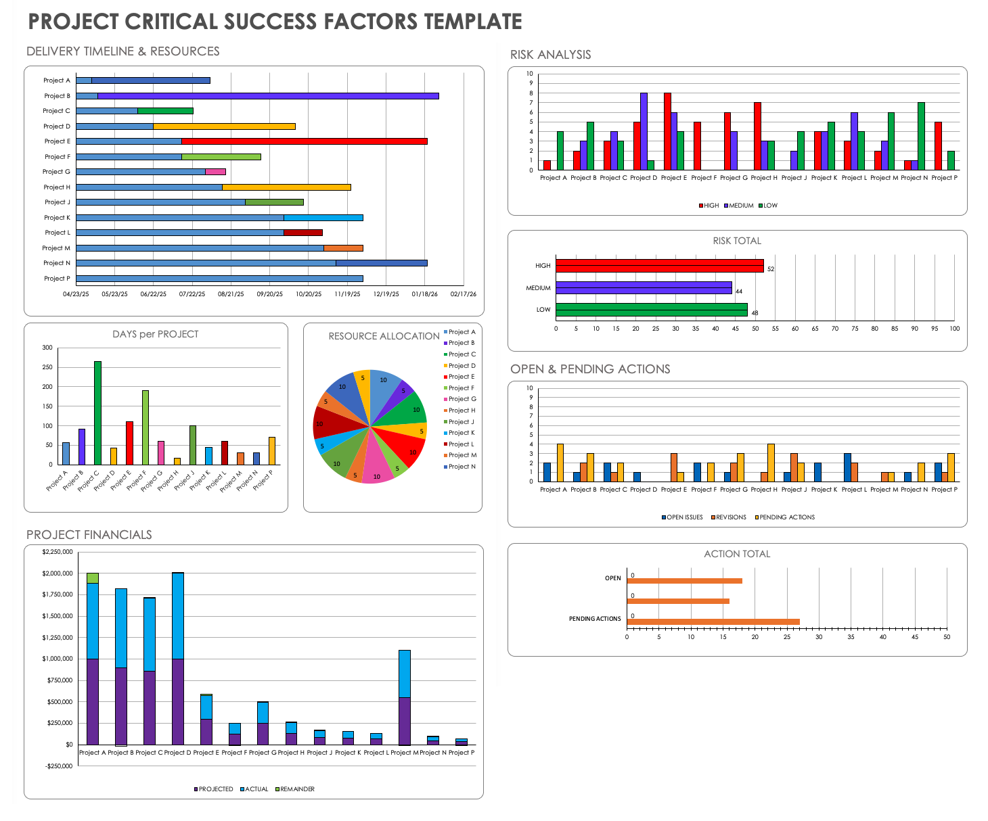
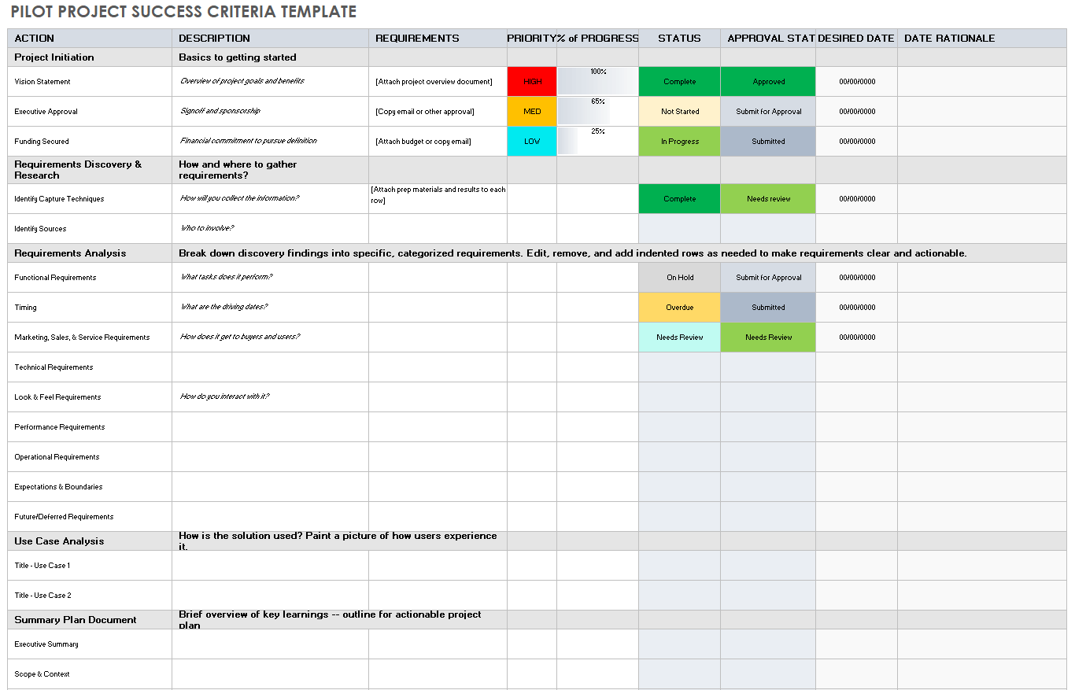
COMMUNICATION & TRACKING TOOLS

Slide 18

Q&A
One
Two
Three
Four
Five
?

Slide 19
DISCLAIMER Any articles, templates, or information provided by Smartsheet on the website are for reference only. While we strive to keep the information up to date and correct, we make no representations or warranties of any kind, express or implied, about the completeness, accuracy, reliability, suitability, or availability with respect to the website or the information, articles, templates, or related graphics contained on the website. Any reliance you place on such information is therefore strictly at your own risk.

