Slide 1

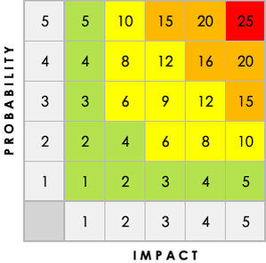
ISO RISK AND OPPORTUNITIES REGISTER TEMPLATE
RISK ID NO. | RISK DESCRIPTION | PROCESS | ISO 27001 | IMPACT DESCRIPTION | IMPACT LEVEL | PROBABILITY LEVEL | PRIORITY LEVEL
 | Give a brief summary of the risk. | Which process is this risk a part of? | Which of the 14 ISO 27001 Information Security Standards steps does this cyber security risk relate to? | What will happen if the risk is not mitigated or eliminated? | Rate 1 (LOW) to 5 (HIGH) | Rate 1 (LOW) to 5 (HIGH) | ( IMPACT X PROBABILITY ) Address highest first.
1.1 |  |  |  |  | 5 | 2 | 10
RISK ELIMINATED? | EXISTING CONTROLS? | MITIGATION OR CONTROL STRATEGY | OPPORTUNITIES | OWNER
Can the following step in the process eliminate the risk? YES or NO | If the risk will be eliminated or mitigated by existing processes, list them here. | What can be done to lower or eliminate the impact or probability? | What opportunities do we have to lower or eliminate the impact or probability? | Who’s responsible?

Slide 2
ISO RISK AND OPPORTUNITIES REGISTER
Duplicate this slide to create individual listings for each Risk ID in the register.
RISK ID NO. | RISK DESCRIPTION | PROCESS | ISO 27001 | IMPACT DESCRIPTION | IMPACT LEVEL | PROBABILITY LEVEL | PRIORITY LEVEL
 | Give a brief summary of the risk. | Which process is this risk a part of? | Which of the 14 ISO 27001 Information Security Standards steps does this cyber security risk relate to? | What will happen if the risk is not mitigated or eliminated? | Rate 1 (LOW) to 5 (HIGH) | Rate 1 (LOW) to 5 (HIGH) | ( IMPACT X PROBABILITY ) Address highest first.
RISK ELIMINATED? | EXISTING CONTROLS? | MITIGATION OR CONTROL STRATEGY | OPPORTUNITIES | OWNER
Can the following step in the process eliminate the risk? YES or NO | If the risk will be eliminated or mitigated by existing processes, list them here. | What can be done to lower or eliminate the impact or probability? | What opportunities do we have to lower or eliminate the impact or probability? | Who’s responsible?

Slide 3
DISCLAIMER Any articles, templates, or information provided by Smartsheet on the website are for reference only. While we strive to keep the information up to date and correct, we make no representations or warranties of any kind, express or implied, about the completeness, accuracy, reliability, suitability, or availability with respect to the website or the information, articles, templates, or related graphics contained on the website. Any reliance you place on such information is therefore strictly at your own risk.

