Slide 1

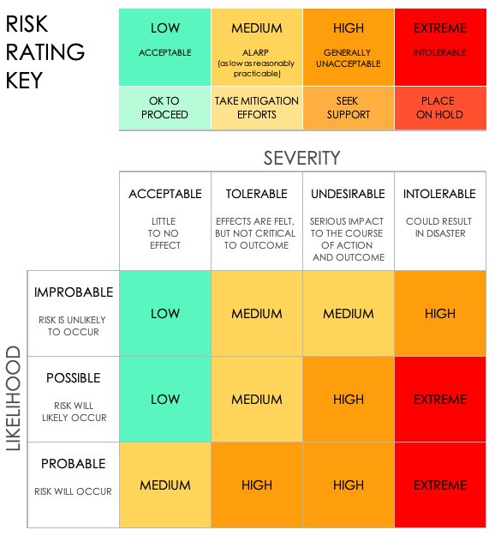
RISK AND OPPORTUNITY MATRIX TEMPLATE
RISK SEVERITY | RISK LIKELIHOOD | RISK LEVEL
INTOLERABLE | POSSIBLE | EXTREME
RISK AND IMPACT
Shortage of eye protection: – Increase in injuries – Production delayed – Increased premiums
OPPORTUNITIES
– Increase supply – Low inventory warnings – Find alternative suppliers

Slide 2
RISK AND OPPORTUNITY MATRIX
RISK SEVERITY | RISK LIKELIHOOD | RISK LEVEL
RISK AND IMPACT
OPPORTUNITIES

Slide 3
DISCLAIMER Any articles, templates, or information provided by Smartsheet on the website are for reference only. While we strive to keep the information up to date and correct, we make no representations or warranties of any kind, express or implied, about the completeness, accuracy, reliability, suitability, or availability with respect to the website or the information, articles, templates, or related graphics contained on the website. Any reliance you place on such information is therefore strictly at your own risk.

