Slide 1





ANNUAL SOCIAL MEDIA REPORT TEMPLATE
PLATFORM | NAME
DATE OF ANNUAL REPORT | MM/DD/YY
ANNUAL SOCIAL MEDIA REPORT PRESENTATION
PROJECT REPORT

Slide 2

ANNUAL REPORT
0
NUMBER OF FOLLOWERS
GAINED | 0
LOST | 0
0
PAGE VIEWS
GAINED | 0
LOST | 0
0
TOTAL ACTIONS
GAINED | 0
LOST | 0
0
POST LIKES
GAINED | 0
LOST | 0
PROJECT REPORT
ANNUAL SOCIAL MEDIA REPORT

Slide 3
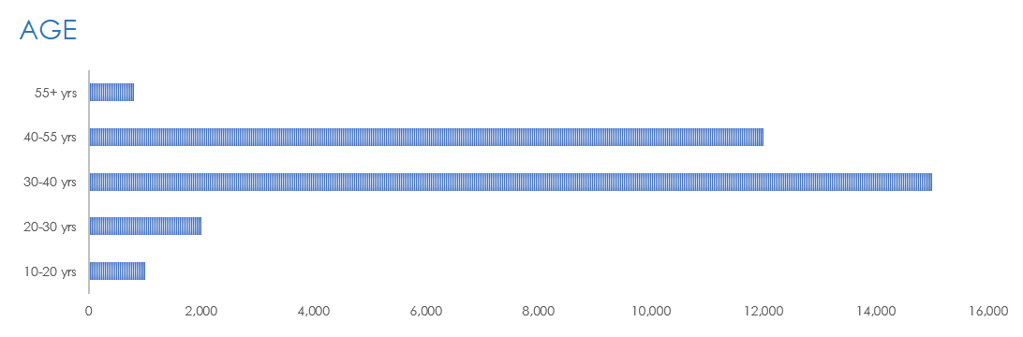
ANNUAL REPORT ANALYTICS
Users are to take a screenshot of the Social Media Analytics charts in the Excel version of this template to illustrate the following slides.
PROJECT REPORT
REPORT ANALYTICS

Slide 4
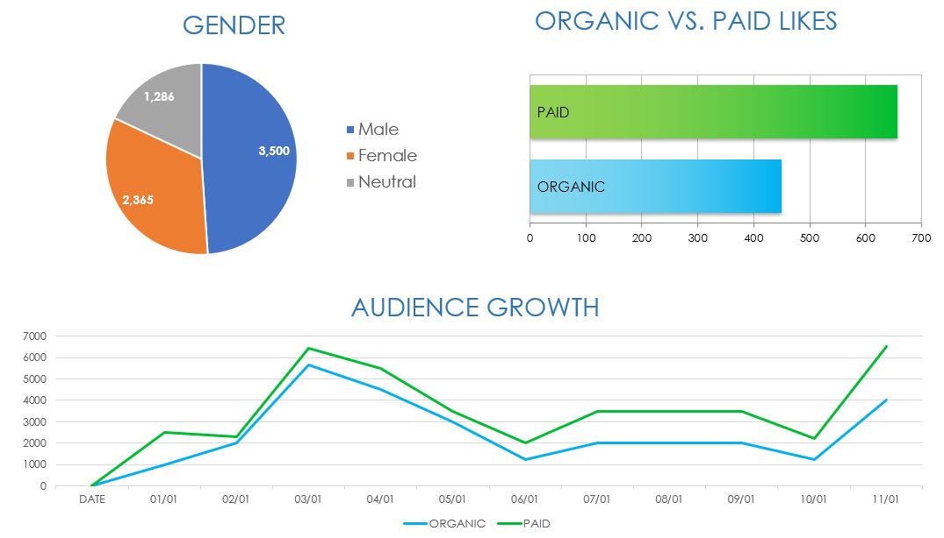
ANNUAL REPORT ANALYTICS
PROJECT REPORT
REPORT ANALYTICS

Slide 5
ANNUAL REPORT ANALYTICS
PROJECT REPORT
REPORT ANALYTICS

Slide 6
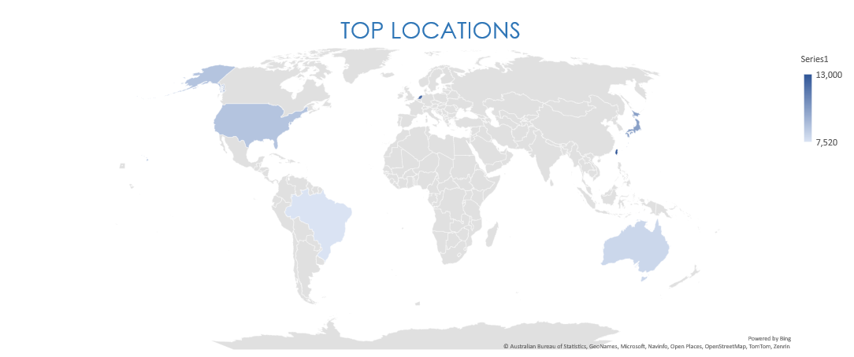
ANNUAL REPORT ANALYTICS
PROJECT REPORT
REPORT ANALYTICS

Slide 7
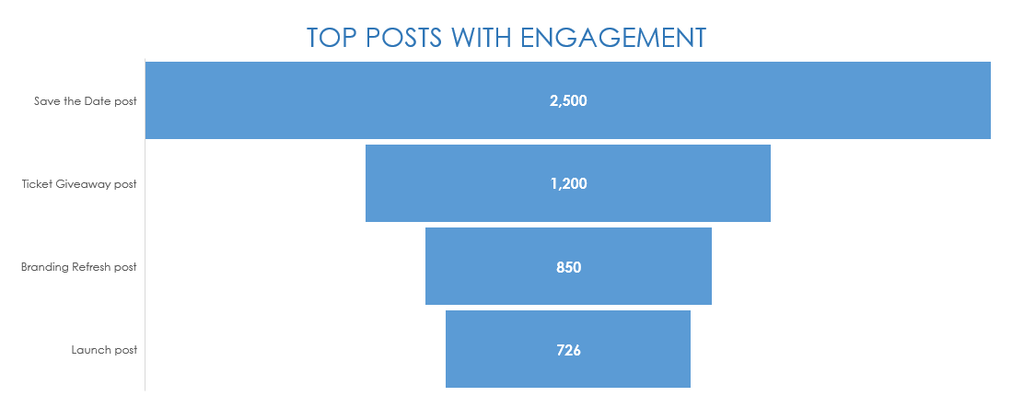
ANNUAL REPORT ANALYTICS
PROJECT REPORT
REPORT ANALYTICS

Slide 8
DISCLAIMER Any articles, templates, or information provided by Smartsheet on the website are for reference only. While we strive to keep the information up to date and correct, we make no representations or warranties of any kind, express or implied, about the completeness, accuracy, reliability, suitability, or availability with respect to the website or the information, articles, templates, or related graphics contained on the website. Any reliance you place on such information is therefore strictly at your own risk.
PROJECT REPORT

