Slide 1


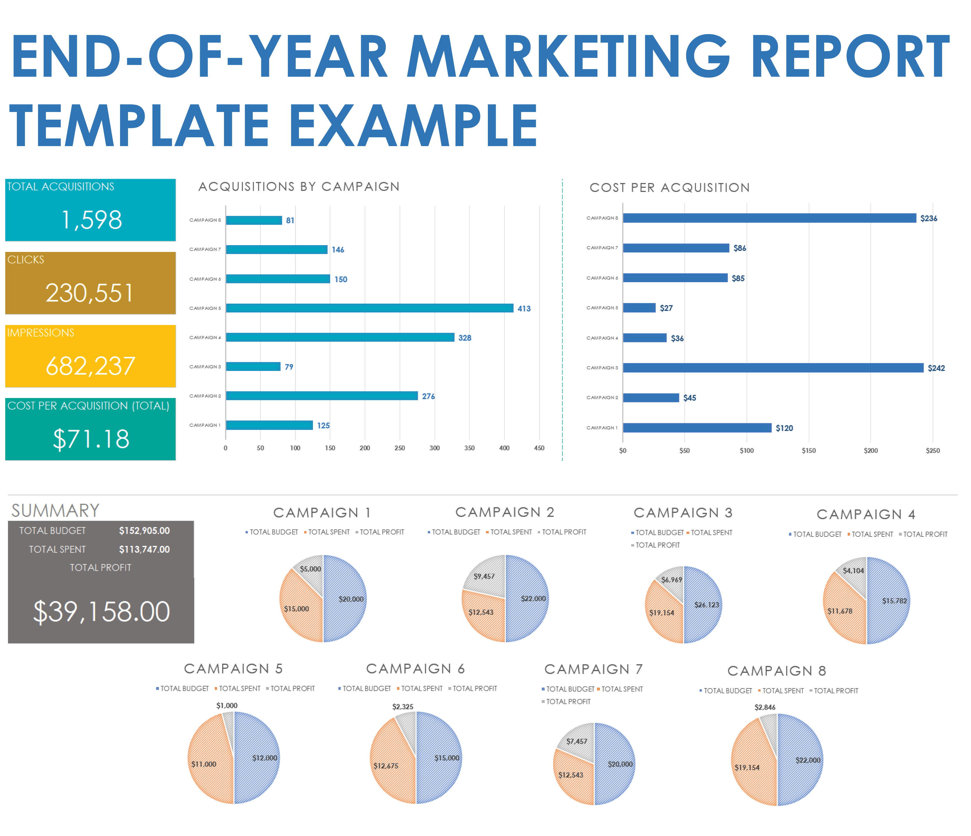
END-OF-YEAR MARKETING REPORT TEMPLATE EXAMPLE
Use the End-of-Year Marketing Report Template in Excel to enter data that will populate the charts and graphs for your presentation. Place screenshots of each element on the following slides to build out your End-of-Year Marketing Report Presentation.
END-OF-YEAR MARKETING REPORT EXAMPLE PRESENTATION
PROJECT REPORT

Slide 2
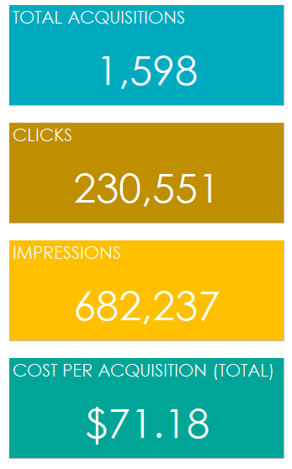
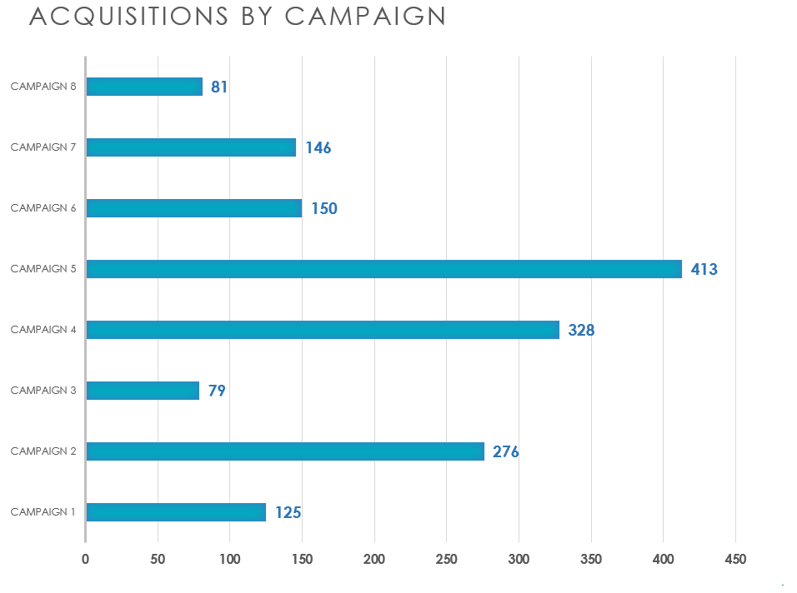
END-OF-YEAR MARKETING REPORT EXAMPLE PRESENTATION
PROJECT REPORT

Slide 3
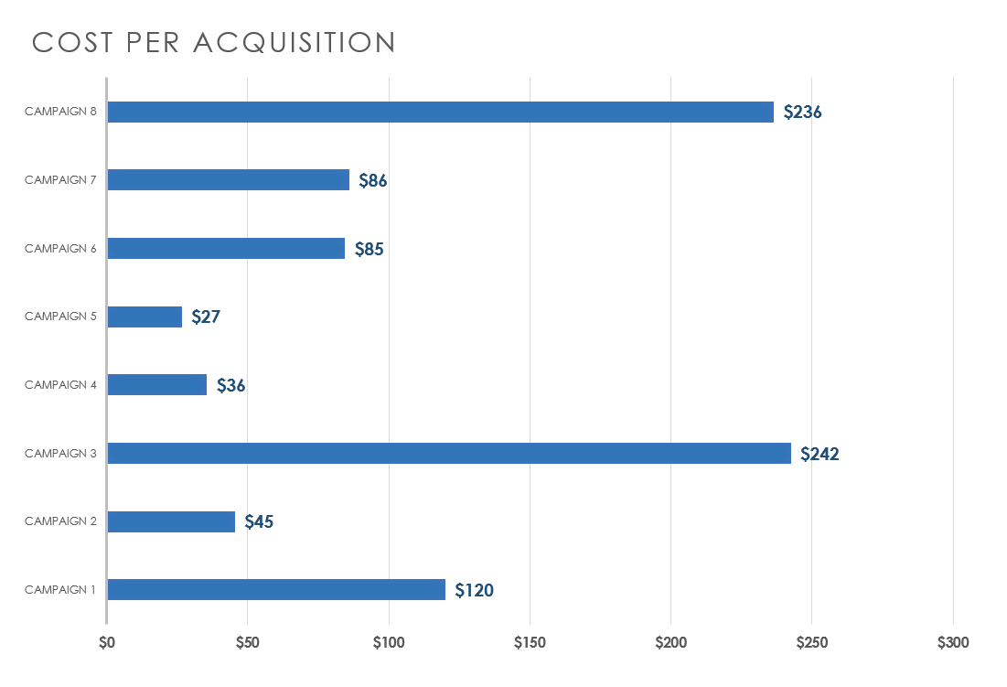
END-OF-YEAR MARKETING REPORT EXAMPLE PRESENTATION
PROJECT REPORT

Slide 4
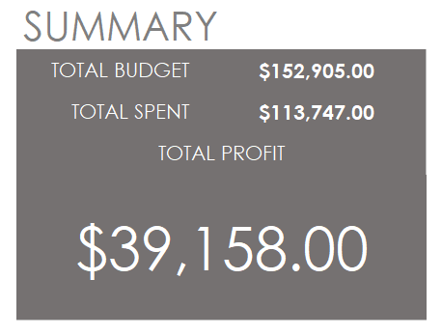
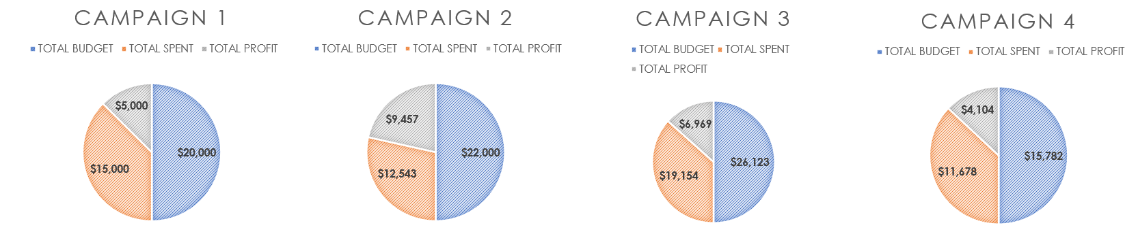
END-OF-YEAR MARKETING REPORT EXAMPLE PRESENTATION
PROJECT REPORT

Slide 5
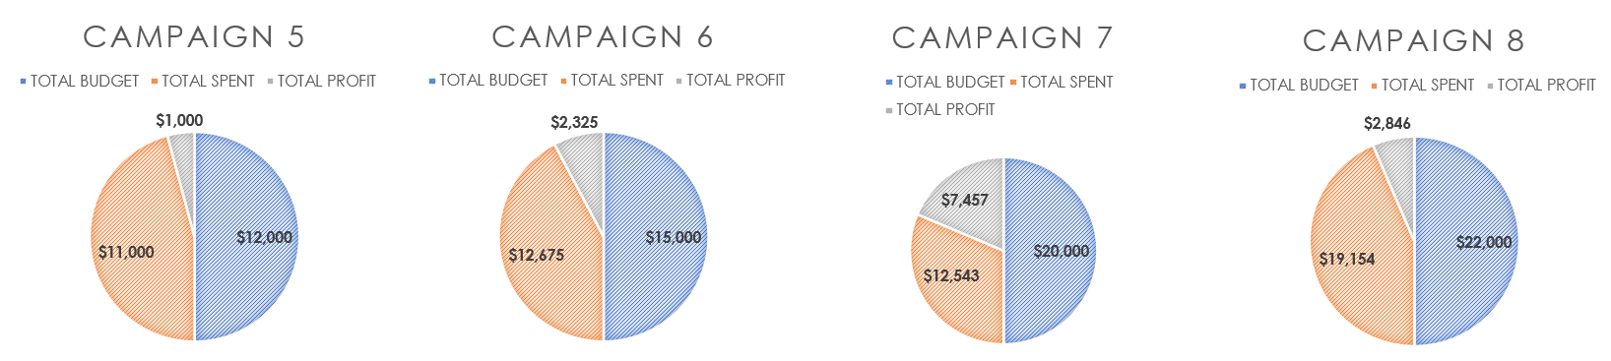
END-OF-YEAR MARKETING REPORT EXAMPLE PRESENTATION
PROJECT REPORT

Slide 6
DISCLAIMER Any articles, templates, or information provided by Smartsheet on the website are for reference only. While we strive to keep the information up to date and correct, we make no representations or warranties of any kind, express or implied, about the completeness, accuracy, reliability, suitability, or availability with respect to the website or the information, articles, templates, or related graphics contained on the website. Any reliance you place on such information is therefore strictly at your own risk.
PROJECT REPORT

