Slide 1


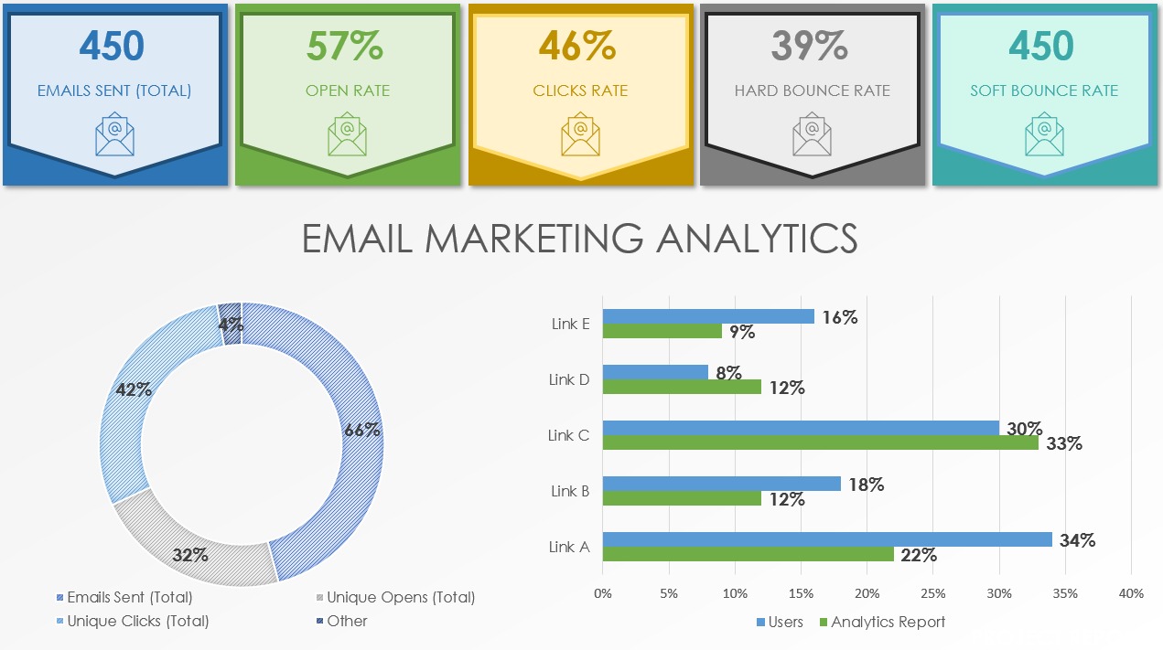
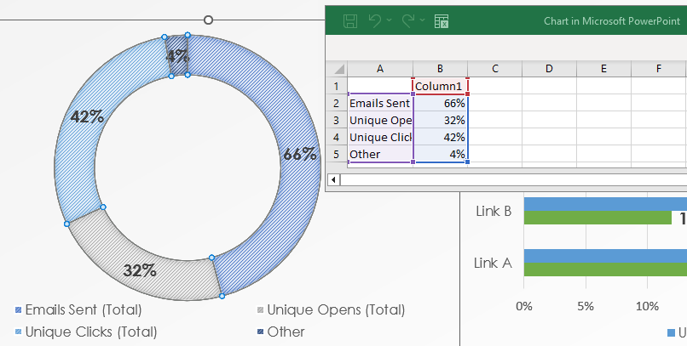
EMAIL MARKETING ANALYTICS REPORT TEMPLATE FOR POWERPOINT
To use this template, click on the tables on Slide 2 and choose “edit data” and “edit data in Excel” to update your unique data.
REPORT DATE | MM/DD/YY
REPORT PREPARED BY | Name, Title
REPORT APPROVED BY | Name, Title
EMAIL MARKETING ANALYTICS REPORT PRESENTATION
PROJECT REPORT

Slide 2





450
57%
46%
39%
450
EMAILS SENT (TOTAL)
OPEN RATE
CLICKS RATE
HARD BOUNCE RATE
SOFT BOUNCE RATE
EMAIL MARKETING ANALYTICS
PROJECT REPORT

Slide 3
DISCLAIMER Any articles, templates, or information provided by Smartsheet on the website are for reference only. While we strive to keep the information up to date and correct, we make no representations or warranties of any kind, express or implied, about the completeness, accuracy, reliability, suitability, or availability with respect to the website or the information, articles, templates, or related graphics contained on the website. Any reliance you place on such information is therefore strictly at your own risk.
PROJECT REPORT

