Slide 1

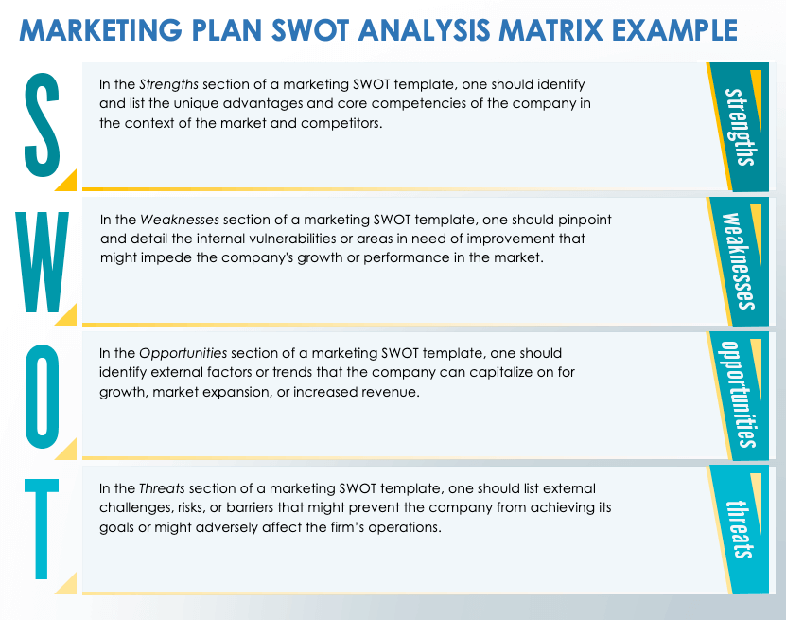
MARKETING PLAN SWOT ANALYSIS MATRIX TEMPLATE
This marketing plan SWOT analysis matrix template helps you plan for future initiatives and campaigns by offering a structured, systematic evaluation of your company's internal strengths and weaknesses and external opportunities and threats. This tool fosters alignment among team members, driving cohesive strategies that capitalize on strengths and address vulnerabilities.

Slide 2
Enter Text
Enter Text
Enter Text
Enter Text

Slide 3
In the Strengths section of a marketing SWOT template, one should identify and list the unique advantages and core competencies of the company in the context of the market and competitors.
In the Weaknesses section of a marketing SWOT template, one should pinpoint and detail the internal vulnerabilities or areas in need of improvement that might impede the company's growth or performance in the market.
In the Opportunities section of a marketing SWOT template, one should identify external factors or trends that the company can capitalize on for growth, market expansion, or increased revenue.
In the Threats section of a marketing SWOT template, one should list external challenges, risks, or barriers that might prevent the company from achieving its goals or might adversely affect the firm’s operations.

Slide 4
DISCLAIMER Any articles, templates, or information provided by Smartsheet on the website are for reference only. While we strive to keep the information up to date and correct, we make no representations or warranties of any kind, express or implied, about the completeness, accuracy, reliability, suitability, or availability with respect to the website or the information, articles, templates, or related graphics contained on the website. Any reliance you place on such information is therefore strictly at your own risk.

