Slide 1

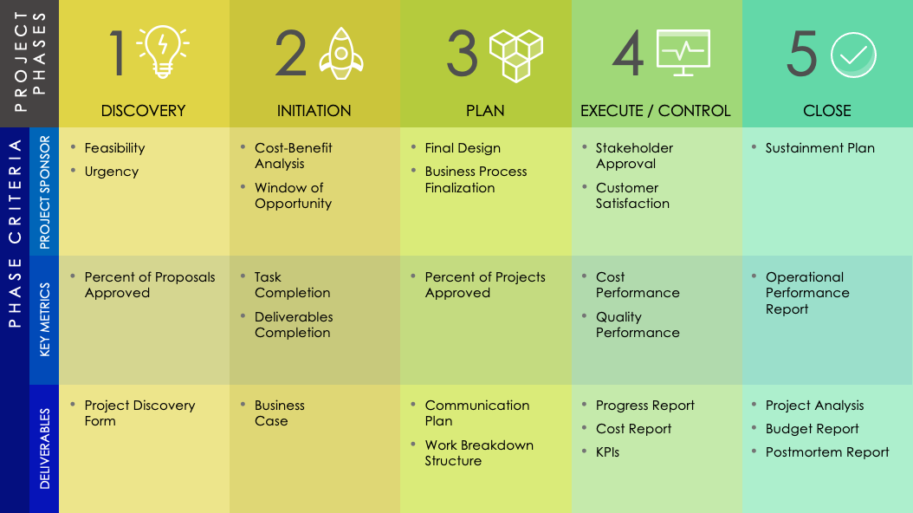
PHASED PROJECT PLAN TEMPLATE
This phased project plan template provides a detailed overview of your project’s process, including the five phases of project management.
Use the existing deliverables or customize them to accurately represent your project goals. This template is an excellent tool for sharing the transparency of your project’s workload and expectations.

Slide 2



1
2
3
4
5
PROJECT PHASES
DISCOVERY
INITIATION
PLAN
EXECUTE / CONTROL
CLOSE
Feasibility
Urgency
Cost-Benefit
Analysis
Window of Opportunity
Final Design
Business Process Finalization
Stakeholder
Approval
Customer
Satisfaction
Sustainment Plan
PROJECT SPONSOR
Percent of Proposals Approved
Task
Completion
Deliverables Completion
Percent of Projects Approved
Cost
Performance
Quality
Performance
Operational Performance
Report
KEY METRICS
PHASE CRITERIA
Project Discovery Form
Business
Case
Communication
Plan
Work Breakdown Structure
Progress Report
Cost Report
KPIs
Project Analysis
Budget Report
Postmortem Report
DELIVERABLES

Slide 3
DISCLAIMER Any articles, templates, or information provided by Smartsheet on the website are for reference only. While we strive to keep the information up to date and correct, we make no representations or warranties of any kind, express or implied, about the completeness, accuracy, reliability, suitability, or availability with respect to the website or the information, articles, templates, or related graphics contained on the website. Any reliance you place on such information is therefore strictly at your own risk.

