Slide 1

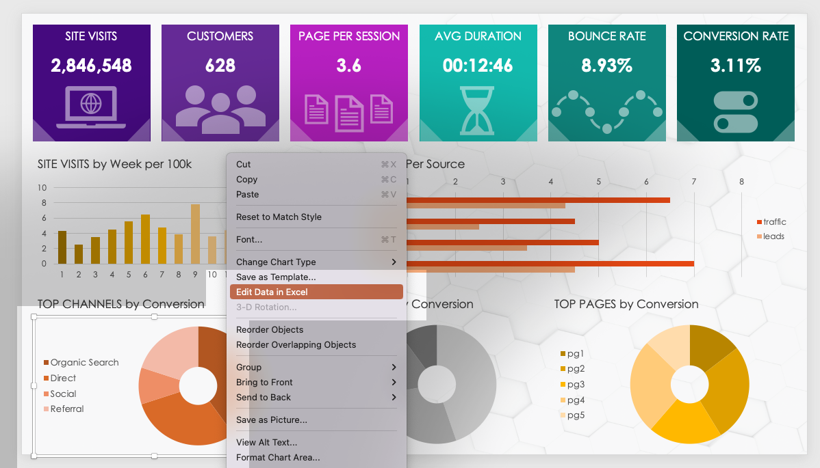
QUARTERLY MARKETING REVIEW PRESENTATION TEMPLATE
Input values to populate the chart data by highlighting a chart and right-clicking to select:
Edit Data in Excel …

Slide 2





SITE VISITS
CUSTOMERS
PAGE PER SESSION
AVG DURATION
BOUNCE RATE
CONVERSION RATE
0
0
0
0:00
0%
0%
QX SITE VISITS by Week per 100k
QX TRAFFIC and LEADS Per Source
QX TOP CHANNELS by Conversion
QX TOP CAMPAIGNS by Conversion
QX TOP PAGES by Conversion

Slide 3
NOTES
summary information / comments

Slide 4
DISCLAIMER Any articles, templates, or information provided by Smartsheet on the website are for reference only. While we strive to keep the information up to date and correct, we make no representations or warranties of any kind, express or implied, about the completeness, accuracy, reliability, suitability, or availability with respect to the website or the information, articles, templates, or related graphics contained on the website. Any reliance you place on such information is therefore strictly at your own risk.

