Slide 1

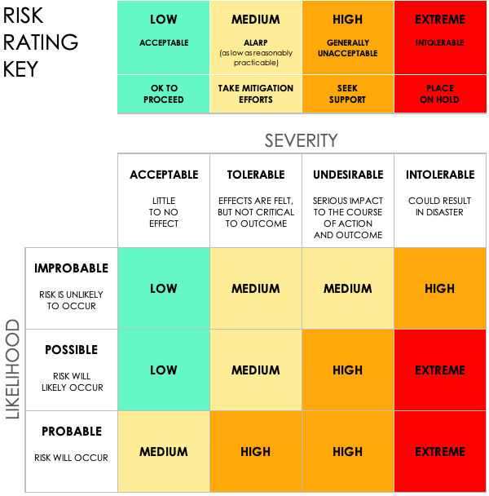
SIMPLE COMPLIANCE RISK ASSESSMENT TEMPLATE EXAMPLE
PROJECT OMEGA
PROJECT ID | 123.A
PROJECT MANAGER | LORI GARCIA
SIMPLE COMPLIANCE RISK ASSESSMENT TEMPLATE PRESENTATION EXAMPLE
PROJECT REPORT

Slide 2
COMPLIANCE RISK ASSESSMENT EXAMPLE
 |  |  |  |  | RISK ASSESSMENT |  |  |  |  |  | POST-MITIGATION |  |  | JUDGEMENT
REF / ID | TOPIC | RISK | CONTROL ENVIRONMENT | CONTROL ACTIVITIES | RISK SEVERITY | RISK LIKELIHOOD | RISK LEVEL | MITIGATIONS / WARNINGS / REMEDIES | INFORMATION AND COMMUNICATIONS | CONTROLS PRESENT? | RISK SEVERITY | RISK LIKELIHOOD | RISK LEVEL | ACCEPTABLE TO PROCEED? | COMMENTS AND NOTES
1.1 | Disaster Recovery (DR) | Not having data backup and verification capabilities physically on the premises in the event of a disaster. | Duplicate off-premises data center so that one is on site, and we have an accurate and reliable data redundancy between the two, in the event of a natural disaster. | Set recovery plan objectives | ACCEPTABLE | POSSIBLE | LOW | Distinct data center redundancy testing. | IT departmental meeting on PII and GDPR standards | YES | ACCEPTABLE | IMPROBABLE | LOW | YES | Notes
1.2 | Data Integration |  |  |  | TOLERABLE | POSSIBLE | MEDIUM |  |  | NO | ACCEPTABLE | IMPROBABLE | LOW | YES | Notes
1.3 | Access Risk |  |  |  | UNDESIRABLE | PROBABLE | HIGH |  |  | YES | TOLERABLE | POSSIBLE | MEDIUM | YES | Notes
2.1 | Monitor regulatory compliance |  |  |  | INTOLERABLE | PROBABLE | EXTREME |  |  | YES | UNDESIRABLE | PROBABLE | HIGH | NO | Notes
PROJECT REPORT

Slide 3
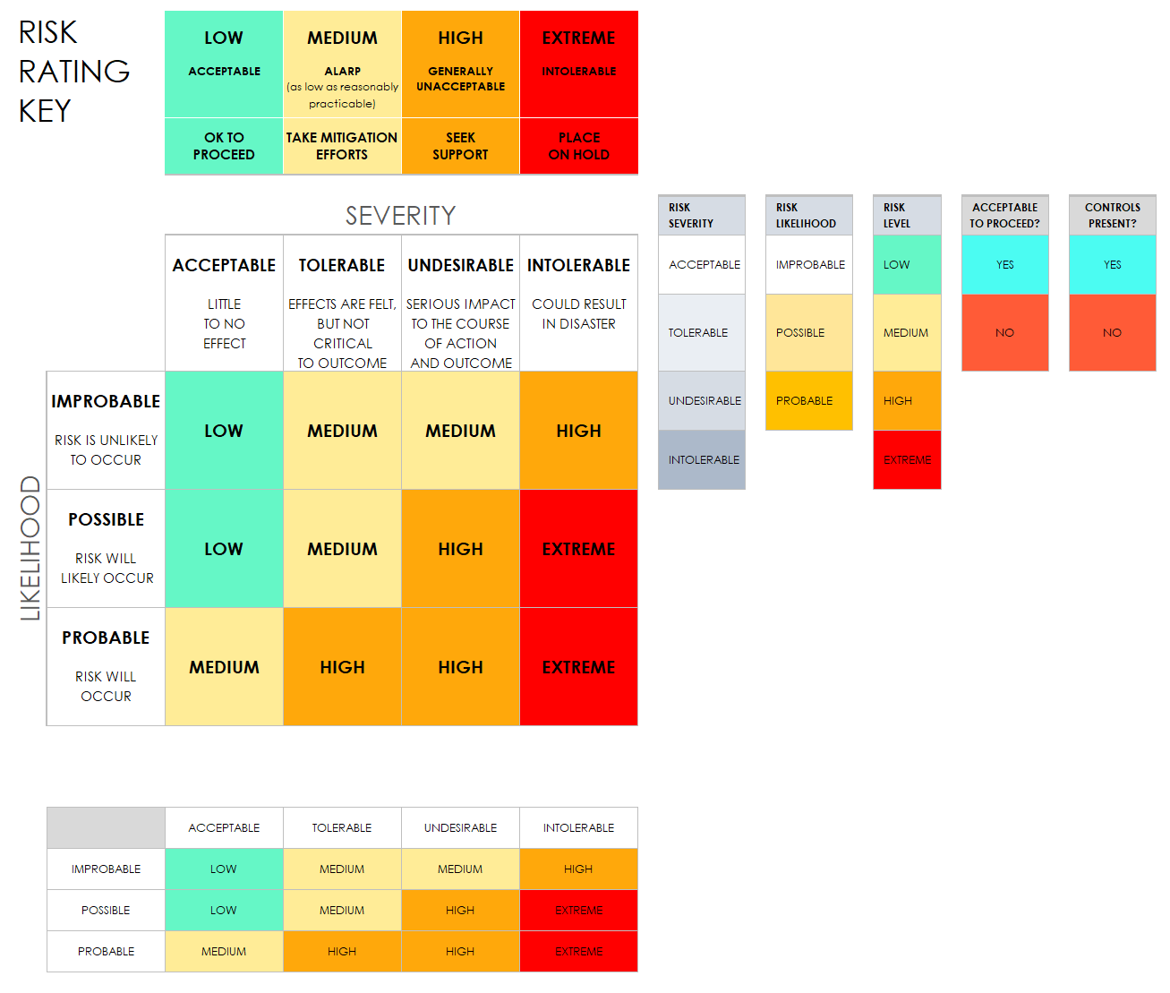
RISK MATRIX - RATING KEY
PROJECT REPORT

Slide 4
DISCLAIMER Any articles, templates, or information provided by Smartsheet on the website are for reference only. While we strive to keep the information up to date and correct, we make no representations or warranties of any kind, express or implied, about the completeness, accuracy, reliability, suitability, or availability with respect to the website or the information, articles, templates, or related graphics contained on the website. Any reliance you place on such information is therefore strictly at your own risk.
PROJECT REPORT

