Slide 1

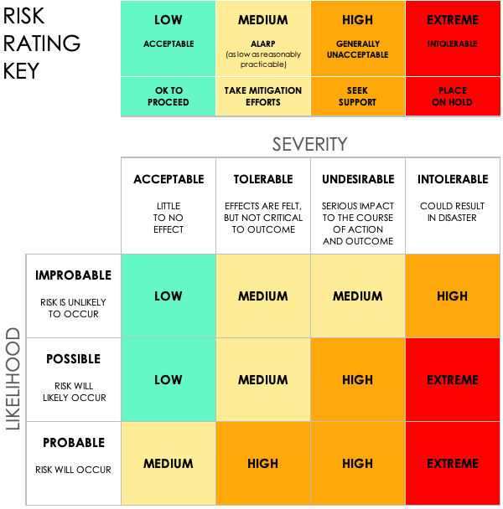
SIMPLE COMPLIANCE RISK ASSESSMENT TEMPLATE
PROJECT NAME
PROJECT ID | 001
PROJECT MANAGER | Name
SIMPLE COMPLIANCE RISK ASSESSMENT TEMPLATE
PROJECT REPORT

Slide 2
COMPLIANCE RISK ASSESSMENT
 |  |  |  |  | RISK ASSESSMENT |  |  |  |  |  | POST-MITIGATION |  |  | JUDGEMENT
REF / ID | TOPIC | RISK | CONTROL ENVIRONMENT | CONTROL ACTIVITIES | RISK SEVERITY | RISK LIKELIHOOD | RISK LEVEL | MITIGATIONS / WARNINGS / REMEDIES | INFORMATION AND COMMUNICATIONS | CONTROLS PRESENT? | RISK SEVERITY | RISK LIKELIHOOD | RISK LEVEL | ACCEPTABLE TO PROCEED? | COMMENTS AND NOTES
 |  |  |  |  | ACCEPTABLE | POSSIBLE | LOW |  |  | YES | ACCEPTABLE | IMPROBABLE | LOW | YES | Notes
 |  |  |  |  | TOLERABLE | POSSIBLE | MEDIUM |  |  | NO | ACCEPTABLE | IMPROBABLE | LOW | YES | Notes
 |  |  |  |  | UNDESIRABLE | PROBABLE | HIGH |  |  | YES | TOLERABLE | POSSIBLE | MEDIUM | YES | Notes
 |  |  |  |  | INTOLERABLE | PROBABLE | EXTREME |  |  | YES | UNDESIRABLE | PROBABLE | HIGH | NO | Notes
 |  |  |  |  |  |  |  |  |  | YES
 |  |  |  |  |  |  |  |  |  | YES
 |  |  |  |  |  |  |  |  |  | YES
PROJECT REPORT

Slide 3
COMPLIANCE RISK ASSESSMENT (continued)
 |  |  |  |  | RISK ASSESSMENT |  |  |  |  |  | POST-MITIGATION |  |  | JUDGEMENT
REF / ID | TOPIC | RISK | CONTROL ENVIRONMENT | CONTROL ACTIVITIES | RISK SEVERITY | RISK LIKELIHOOD | RISK LEVEL | MITIGATIONS / WARNINGS / REMEDIES | INFORMATION AND COMMUNICATIONS | CONTROLS PRESENT? | RISK SEVERITY | RISK LIKELIHOOD | RISK LEVEL | ACCEPTABLE TO PROCEED? | COMMENTS AND NOTES
 |  |  |  |  | ACCEPTABLE | POSSIBLE | LOW |  |  | YES | ACCEPTABLE | IMPROBABLE | LOW | YES | Notes
 |  |  |  |  | TOLERABLE | POSSIBLE | MEDIUM |  |  | NO | ACCEPTABLE | IMPROBABLE | LOW | YES | Notes
 |  |  |  |  | UNDESIRABLE | PROBABLE | HIGH |  |  | YES | TOLERABLE | POSSIBLE | MEDIUM | YES | Notes
 |  |  |  |  | INTOLERABLE | PROBABLE | EXTREME |  |  | YES | UNDESIRABLE | PROBABLE | HIGH | NO | Notes
 |  |  |  |  |  |  |  |  |  | YES
 |  |  |  |  |  |  |  |  |  | YES
 |  |  |  |  |  |  |  |  |  | YES
PROJECT REPORT

Slide 4
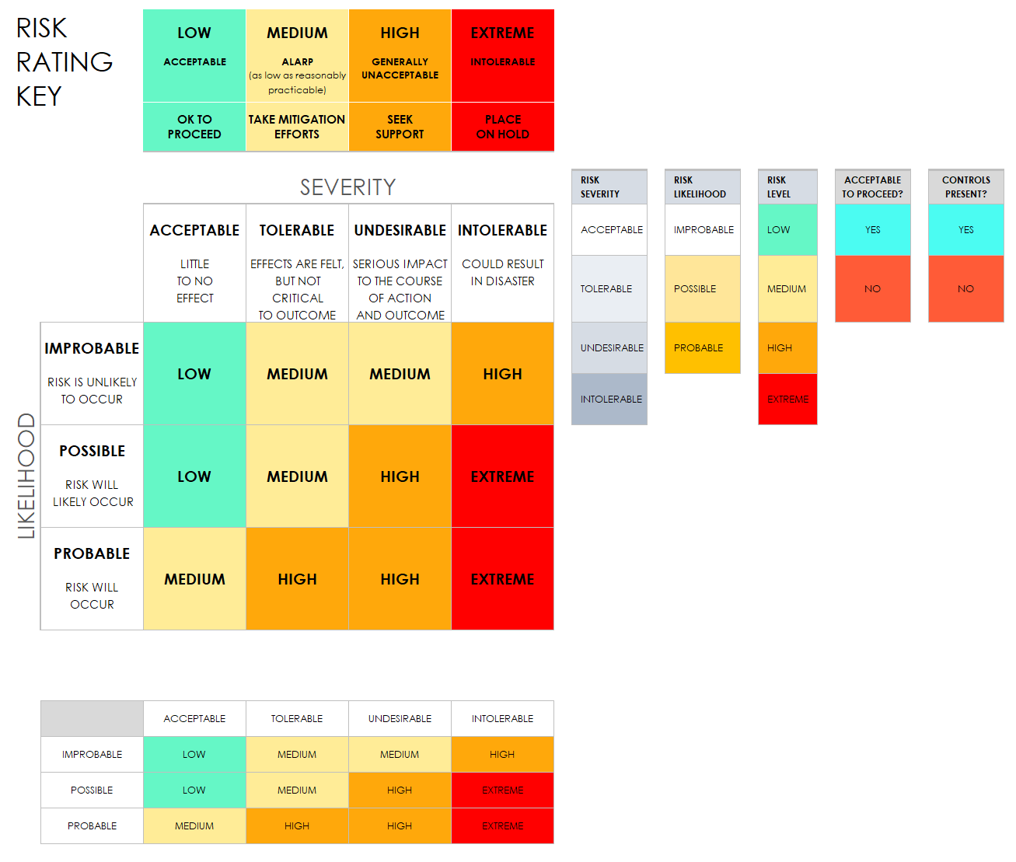
RISK MATRIX - RATING KEY
PROJECT REPORT

Slide 5
DISCLAIMER Any articles, templates, or information provided by Smartsheet on the website are for reference only. While we strive to keep the information up to date and correct, we make no representations or warranties of any kind, express or implied, about the completeness, accuracy, reliability, suitability, or availability with respect to the website or the information, articles, templates, or related graphics contained on the website. Any reliance you place on such information is therefore strictly at your own risk.
PROJECT REPORT

