Slide 1
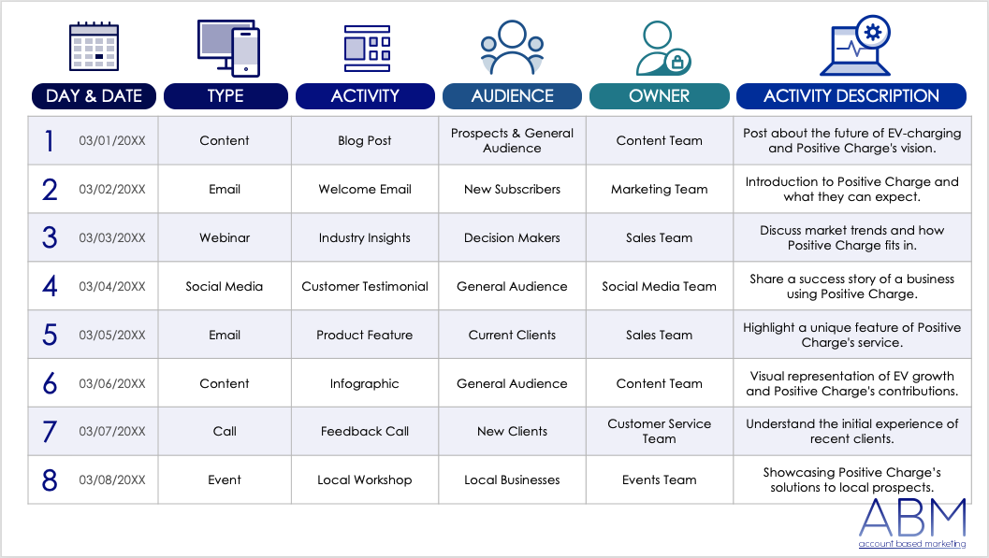
ACCOUNT-BASED MARKETING (ABM) LEAD NURTURING TEMPLATE – EXAMPLE
Lead nurturing requires marketing teams to consistently provide relevant content, information, and engagement opportunities to important leads. To use this ABM lead nurturing template, marketing team members should start by identifying the type of each lead, such as new or returning contacts, to tailor their approach. Next, enter the activity, target audience, task owner, and activity description in the provided sections. This template will help your marketing team organize and track tailored engagement strategies for different leads, ensuring focused and effective follow-up actions.

Slide 2
DAY & DATE
TYPE
ACTIVITY
AUDIENCE
OWNER
ACTIVITY DESCRIPTION
1 | 03/01/20XX | Content | Blog Post | Prospects & General Audience | Content Team | Posting about the future of EV charging and Positive Charge's vision.
2 | 03/02/20XX | Email | Welcome Email | New Subscribers | Marketing Team | Introducing new users to Positive Charge and telling them what they can expect.
3 | 03/03/20XX | Webinar | Industry Insights | Decision-Makers | Sales Team | Discussing market trends and how Positive Charge fits in.
4 | 03/04/20XX | Social Media | Customer Testimonial | General Audience | Social Media Team | Sharing a success story of a business that's using Positive Charge.
5 | 03/05/20XX | Email | Product Feature | Current Clients | Sales Team | Highlighting a unique feature of Positive Charge's service.
6 | 03/06/20XX | Content | Infographic | General Audience | Content Team | Providing a visual of EV growth and Positive Charge's contributions.
7 | 03/07/20XX | Call | Feedback Call | New Clients | Customer Service Team | Understanding the initial experience of recent clients.
8 | 03/08/20XX | Event | Local Workshop | Local Businesses | Events Team | Showcasing Positive Charge’s solutions for local prospects.

Slide 3
DAY & DATE
TYPE
ACTIVITY
AUDIENCE
OWNER
ACTIVITY DESCRIPTION
9 | 03/09/20XX | Content | Video Post | General Audience | Content Team | Giving users a behind-the-scenes look at Positive Charge's operations.
10 | 03/10/20XX | Email | Newsletter | Subscribers | Marketing Team | Updating subscribers on Positive Charge's products and industry news.
11 | 03/11/20XX | Social Media | Live Q&A | Prospects & Clients | Social Media Team | Addressing common questions about EV charging.
12 | 03/12/20XX | Email | Case Study Highlight | Decision-Makers | Sales Team | Showcasing a detailed success story of a major client.
13 | 03/13/20XX | Content | How-To Guide | New Users | Content Team | Guiding new users on maximizing the benefits of Positive Charge's services.
14 | 03/14/20XX | Call | Onboarding Call | New Sign-Ups | Sales Team | Guiding new clients through the setup process.
15 | 03/15/20XX | Social Media | Poll | General Audience | Social Media Team | Understanding audience preferences for EV charging.
16 | 03/16/20XX | Event | Online Workshop | International Prospects | Events Team | Introducing international prospects to Positive Charge's global solutions.

Slide 4
DAY & DATE
TYPE
ACTIVITY
AUDIENCE
OWNER
ACTIVITY DESCRIPTION
17 | 03/17/20XX | Content | Whitepaper | Industry Professionals | Content Team | Performing a detailed analysis of the EV charging landscape.
18 | 03/18/20XX | Email | Exclusive Offer | Loyal Clients | Sales Team | Offering a special discount on Positive Charge's advanced solutions.
19 | 03/19/20XX | Social Media | Trivia Quiz | General Audience | Social Media Team | Engaging the audience with EV-related questions.
20 | 03/20/20XX | Content | Guest Post | Wider Audience | Content Team | Collaborating with a renowned industry expert for insights.
21 | 03/21/20XX | Call | Client Appreciation Call | Long-Term Clients | Customer Service Team | Thanking clients for their continued trust in Positive Charge.
22 | 03/22/20XX | Email | Feedback Request | All Clients | Marketing Team | Collecting feedback for continual improvement.
23 | 03/23/20XX | Social Media | Feature Friday | General Audience | Social Media Team | Showcasing the latest technology addition at Positive Charge.
24 | 03/24/20XX | Event | Networking Event | Potential Partners | Business Development Team | Meeting industry peers and potential collaborators.

Slide 5
DAY & DATE
TYPE
ACTIVITY
AUDIENCE
OWNER
ACTIVITY DESCRIPTION
25 | 03/25/20XX | Email | Update Notification | All Users | IT Team | Informing all users about system upgrades and enhancements.
26 | 03/26/20XX | Social Media | Announcement | General Audience | Marketing Team | Teasing a new product launch.
27 | 03/27/20XX | Content | Tutorial Video | Users | Content Team | Helping users navigate the new features of Positive Charge's services.
28 | 03/28/20XX | Call | Retention Call | Inactive Users | Sales Team | Addressing concerns and winning back inactive users.
29 | 03/29/20XX | Social Media | Stories Highlight | General Audience | Social Media Team | Showing a day in the life at Positive Charge.
30 | 03/30/20XX | Email | Monthly Recap | Subscribers | Marketing Team | Sharing highlights and updates from the month.
31 | 03/31/20XX | Content | Expert Interview | General Audience | Content Team | Hosting an industry expert who's discussing the future of EV charging.

Slide 6
DISCLAIMER Any articles, templates, or information provided by Smartsheet on the website are for reference only. While we strive to keep the information up to date and correct, we make no representations or warranties of any kind, express or implied, about the completeness, accuracy, reliability, suitability, or availability with respect to the website or the information, articles, templates, or related graphics contained on the website. Any reliance you place on such information is therefore strictly at your own risk.

