Slide 1

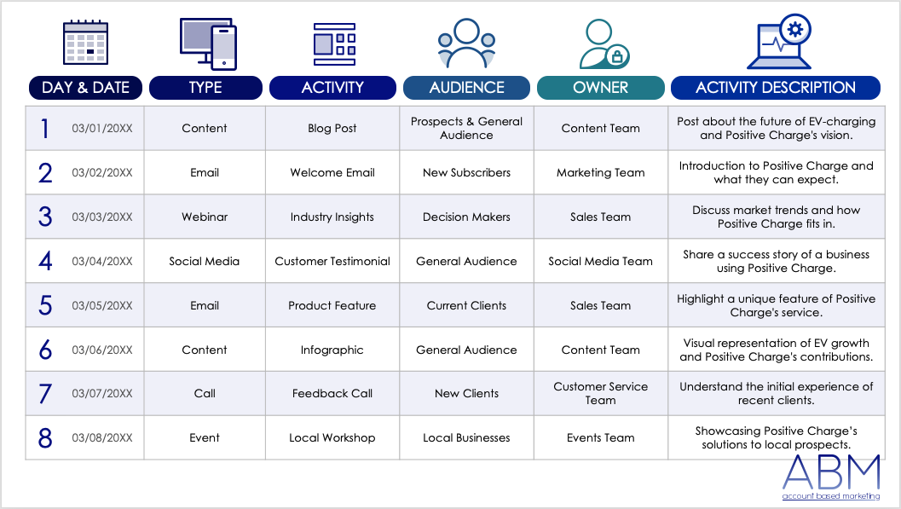



ACCOUNT-BASED MARKETING (ABM) LEAD NURTURING TEMPLATE
Lead nurturing requires marketing teams to consistently provide relevant content, information, and engagement opportunities to important leads. To use this ABM lead nurturing template, marketing team members should start by identifying the type of each lead, such as new or returning contacts, to tailor their approach. Next, enter the activity, target audience, task owner, and activity description in the provided sections. This template will help your marketing team organize and track tailored engagement strategies for different leads, ensuring focused and effective follow-up actions.

Slide 2
DAY & DATE
TYPE
ACTIVITY
AUDIENCE
OWNER
ACTIVITY DESCRIPTION
1 | 00/00/0000
2
3
4
5
6
7
8

Slide 3
DAY & DATE
TYPE
ACTIVITY
AUDIENCE
OWNER
ACTIVITY DESCRIPTION
9 | 00/00/0000
10
11
12
13
14
15
16

Slide 4
DAY & DATE
TYPE
ACTIVITY
AUDIENCE
OWNER
ACTIVITY DESCRIPTION
17 | 00/00/0000
18
19
20
21
22
23
24

Slide 5
DAY & DATE
TYPE
ACTIVITY
AUDIENCE
OWNER
ACTIVITY DESCRIPTION
25 | 00/00/0000
26
27
28
29
30
31

Slide 6
DISCLAIMER Any articles, templates, or information provided by Smartsheet on the website are for reference only. While we strive to keep the information up to date and correct, we make no representations or warranties of any kind, express or implied, about the completeness, accuracy, reliability, suitability, or availability with respect to the website or the information, articles, templates, or related graphics contained on the website. Any reliance you place on such information is therefore strictly at your own risk.

