Slide 1

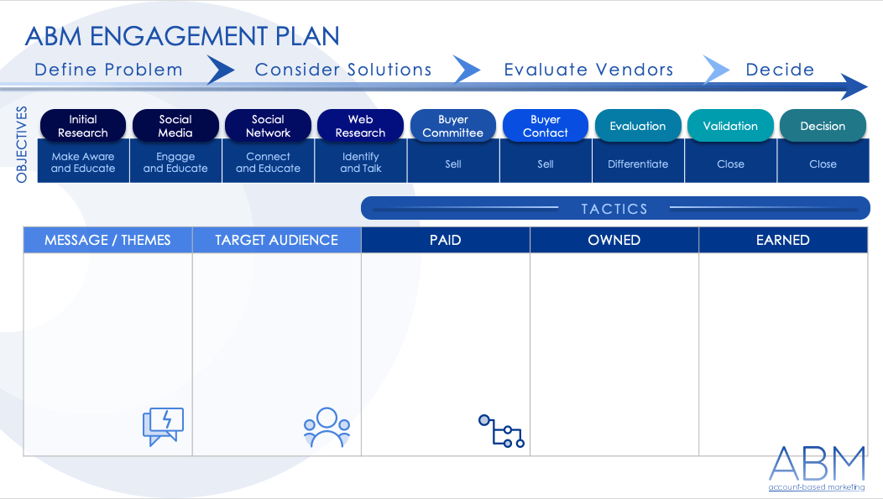
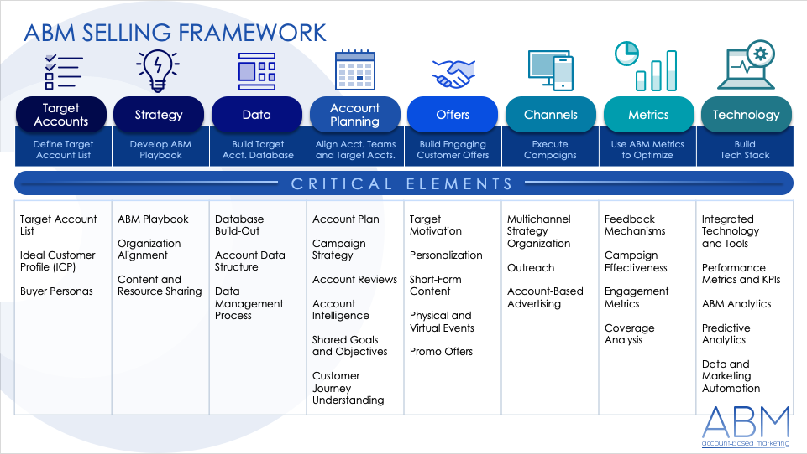
ACCOUNT-BASED MARKETING (ABM) PLANNING TEMPLATE for PowerPoint
This ABM planning template provides a comprehensive guide that ensures your marketing team is aligned with clear objectives and precise target accounts, allowing you to execute focused and impactful campaigns. To use the template, start by defining the campaign's overarching objective, identifying and prioritizing the target accounts, and then formulating a tailored strategy. This template not only brings clarity and structure to your ABM initiatives but also enhances collaboration, efficiency, and ROI.

Slide 2

ABM ENGAGEMENT PLAN
Define Problem Consider Solutions Evaluate Vendors Decide
Initial Research
Social Media
Social Network
Web Research
Buyer Committee
Buyer Contact
Evaluation
Validation
Decision
OBJECTIVES
Make Aware and Educate | Engage and Educate | Connect and Educate | Identify and Talk | Sell | Sell | Differentiate | Close | Close
TACTICS
MESSAGE / THEMES | TARGET AUDIENCE | PAID | OWNED | EARNED

Slide 3

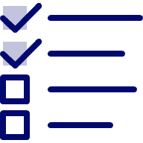




ABM SELLING FRAMEWORK
Target Accounts
Strategy
Data
Account Planning
Offers
Channels
Metrics
Technology
Define Target Account List | Develop ABM Playbook | Build Target Acct. Database | Align Acct. Teams and Target Accts. | Build Engaging Customer Offers | Execute Campaigns | Use ABM Metrics to Optimize | Build Tech Stack
CRITICAL ELEMENTS
Target Account List Ideal Customer Profile (ICP) Buyer Personas | ABM Playbook Organization Alignment Content and Resource Sharing | Database Build-Out Account Data Structure Data Management Process | Account Plan Campaign Strategy Account Reviews Account Intelligence Shared Goals and Objectives Customer Journey Understanding | Target Motivation Personalization Short-Form Content Physical and Virtual Events Promo Offers | Multichannel Strategy Organization Outreach Account-Based Advertising | Feedback Mechanisms Campaign Effectiveness Engagement Metrics Coverage Analysis | Integrated Technology and Tools Performance Metrics and KPIs ABM Analytics Predictive Analytics Data and Marketing Automation

Slide 4
DISCLAIMER Any articles, templates, or information provided by Smartsheet on the website are for reference only. While we strive to keep the information up to date and correct, we make no representations or warranties of any kind, express or implied, about the completeness, accuracy, reliability, suitability, or availability with respect to the website or the information, articles, templates, or related graphics contained on the website. Any reliance you place on such information is therefore strictly at your own risk.

