Slide 1

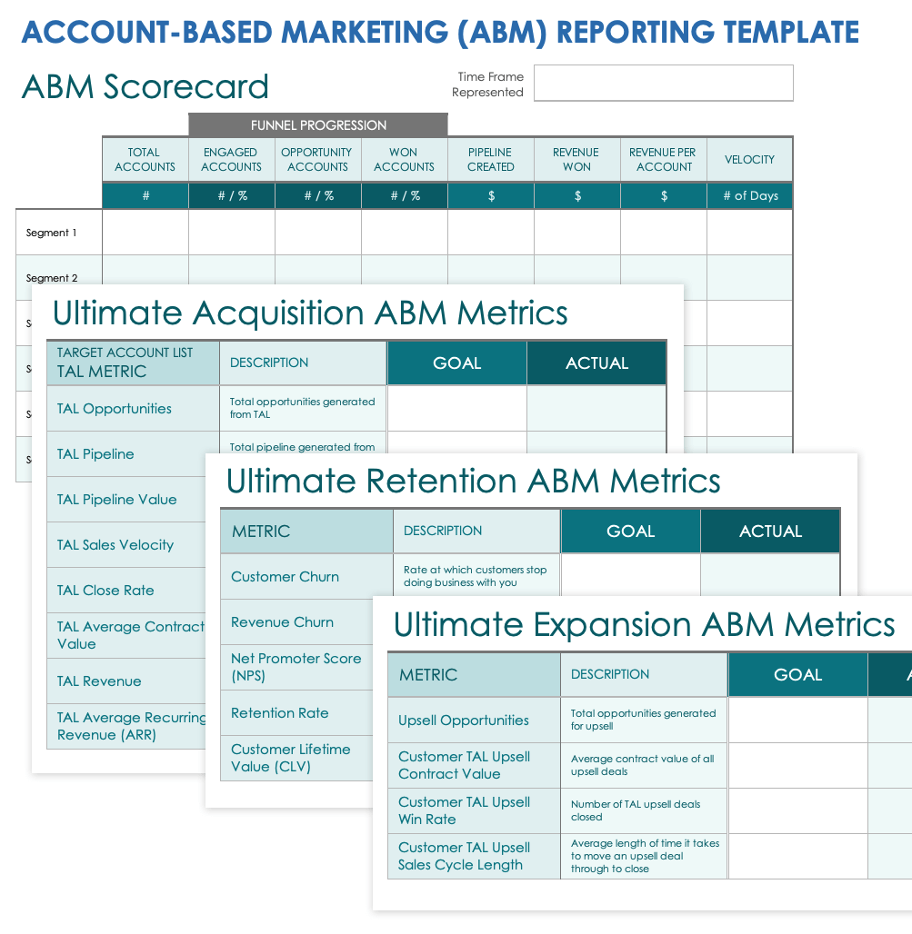
ACCOUNT-BASED MARKETING (ABM) REPORTING TEMPLATE
Streamline the assessment of account-specific campaigns with this ABM reporting template. Simply fill in the template’s ABM scorecard to get a high-level view of campaign performance. Then delve into the finer details of your target account list's profitability with specific metrics. Enter account-specific data into the Funnel Progression section, where you can see how customers move through sales steps, and TAL Pipeline, which shows potential sales. This template helps marketing teams clearly understand and measure the success of their ABM efforts by tracking how well they're doing in turning potential leads into actual sales.

Slide 2
ABM Scorecard
Time Frame
Represented
 |  | FUNNEL PROGRESSION
 | TOTAL ACCOUNTS | ENGAGED ACCOUNTS | OPPORTUNITY ACCOUNTS | WON ACCOUNTS | PIPELINE CREATED | REVENUE WON | REVENUE PER ACCOUNT | VELOCITY
 | # | # / % | # / % | # / % | $ | $ | $ | # of Days
Segment 1
Segment 2
Segment 3
Segment 4
Segment 5
Segment 6

Slide 3
Ultimate Acquisition ABM Metrics
Time Frame
Represented
TARGET ACCOUNT LIST TAL METRIC | DESCRIPTION | GOAL | ACTUAL
TAL Opportunities | Total opportunities generated from TAL
TAL Pipeline | Total pipeline generated from TAL
TAL Pipeline Value | Dollar value of net new opportunities generated
TAL Sales Velocity | Average speed at which an account moves through the pipeline to generate revenue
TAL Close Rate | Rate at which open deals are converting to won
TAL Average Contract Value | Average contract value of all deals
TAL Revenue | Total revenue earned on all accounts
TAL Average Recurring Revenue (ARR) | Total revenue recurring from accounts

Slide 4
Ultimate Retention ABM Metrics
Time Frame
Represented
METRIC | DESCRIPTION | GOAL | ACTUAL
Customer Churn | Rate at which customers stop doing business with you
Revenue Churn | Percentage of revenue lost from existing customers in a given time period
Net Promoter Score (NPS) | Quantitative measure of general satisfaction and brand loyalty
Retention Rate | Ratio of customers that return to do business
Customer Lifetime Value (CLV) | Measure of how much revenue is generated by a single customer over time

Slide 5
Ultimate Expansion ABM Metrics
Time Frame
Represented
METRIC | DESCRIPTION | GOAL | ACTUAL
Upsell Opportunities | Total opportunities generated for upsell
Customer TAL Upsell Contract Value | Average contract value of all upsell deals
Customer TAL Upsell Win Rate | Number of TAL upsell deals closed
Customer TAL Upsell Sales Cycle Length | Average length of time it takes to move an upsell deal through to close

Slide 6
DISCLAIMER Any articles, templates, or information provided by Smartsheet on the website are for reference only. While we strive to keep the information up to date and correct, we make no representations or warranties of any kind, express or implied, about the completeness, accuracy, reliability, suitability, or availability with respect to the website or the information, articles, templates, or related graphics contained on the website. Any reliance you place on such information is therefore strictly at your own risk.

