Slide 1

ACCOUNT-BASED MARKETING (ABM) STRATEGY TEMPLATE
Use this account-based marketing (ABM) strategy blueprint to home in on top-tier accounts and ensure consistency in your account-based marketing initiatives. Fill in key areas such as aims and aspirations, priority accounts, customer profiles, content blueprints, media approaches, interaction methods, collaboration blueprints, financial allocations and assets, key performance indicators, schedules, and evaluation and feedback cycles. By integrating this framework, your marketing team can align their objectives with sales and boost conversion rates, thereby elevating company revenue and enhancing brand prestige.

Slide 2
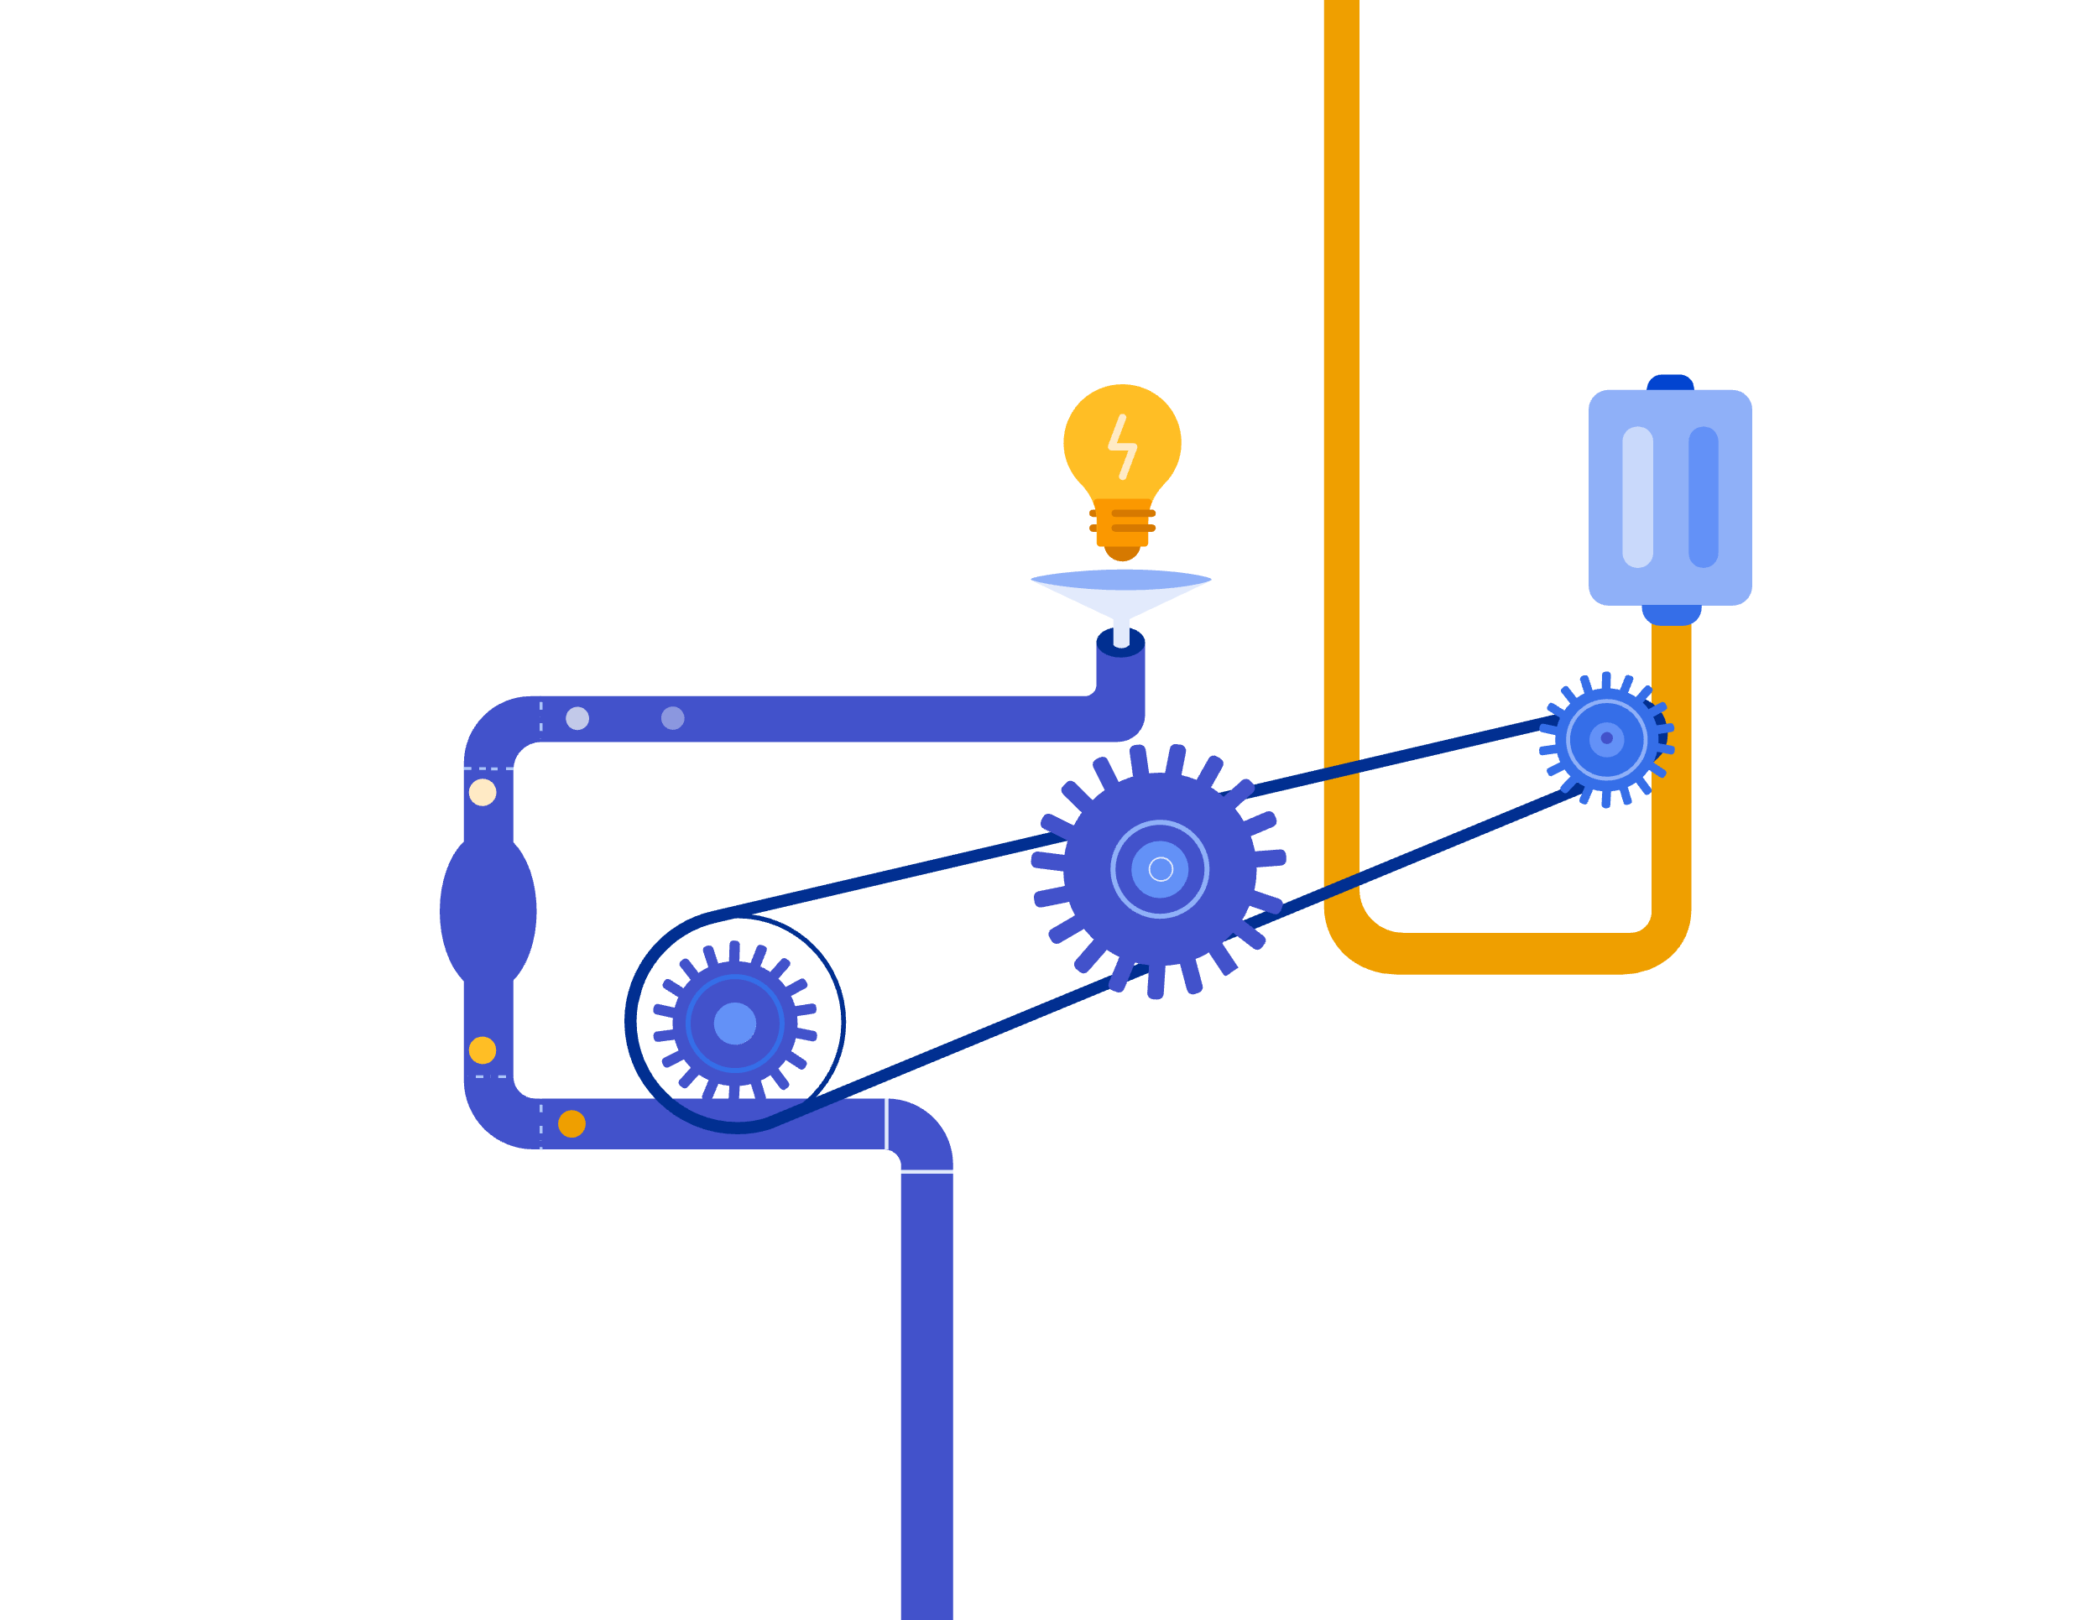

Slide 3
ACCOUNT-BASED MARKETING (ABM) STRATEGY CONTENTS
Objective and Goals
Target Accounts
Buyer Personas
Content Strategy
Channel Strategy
Engagement Tactics
Coordination Plan
Budget and Resources
KPIs and Metrics
Timeline
Review and Feedback Loop

Slide 4
Objective and Goals
With ABM, you can clearly define your purpose and achieve measurable outcomes.
OBJECTIVE
GOALS
text
text

Slide 5
Target Accounts
Gather your criteria for account selection and make a list of specific target companies.
TARGET STATEMENT
Text
Score of 0 – 10
Account Selection Criteria | ICP Fit % | Current Need | Potential Revenue | Decision-Maker Inclination | Buying History | Prioritization Score | Ranking
Text

Slide 6



Buyer Personas
Include detailed profiles of decision-makers within target accounts.
Eco-Ellie
Text
Persona Two
Text
Persona Three
Text

Slide 7

ICP I Ideal Customer Profile
INDUSTRY
LOCATION / MARKET
INVESTMENT
GOAL
Text
Text
Text
Text
COMPANY AGE
13 Years
TYPE OF BUSINESS
REVENUE
BUDGET
Text
Text
Text
WORK STYLE
Text
COMPANY SIZE
WHERE USERS SPEND TIME
Text
Text
TECH STACK
PAIN POINT
Text
Text

Slide 8
Content Strategy
Include customized content that’s tailored to resonate with each buyer persona.
STRATEGY STATEMENT
Text
Buyer Persona | Custom Content
Persona One | Text
Persona Two
Persona Three
Persona Four
Persona Five

Slide 9

Channel Strategy
Identify the most effective channels to reach the target accounts.
CHANNEL STRATEGY STATEMENT
text
Target Accounts | Most Effective Channels
Account One
Account Two
Account Three
Account Four
Account Five
Channel One
Channel Two
Channel Three
Channel Four
Channel One
Channel Two
Channel Three
Channel Two
Channel Three
Channel Four
Channel One

Slide 10

Engagement Tactics
Use specific tactics for engaging target accounts, such as personalizing emails or events.
Define Problem Consider Solutions Evaluate Vendors Decide
Initial Research
Social Media
Social Network
Web Research
Buyer Committee
Buyer Contact
Evaluation
Validation
Decision
OBJECTIVES
Make Aware and Educate | Engage and Educate | Connect and Educate | Identify and Talk | Sell | Sell | Differentiate | Close | Close
TACTICS
MESSAGE / THEMES | TARGET AUDIENCE | PAID | OWNED | EARNED
Text | Text | Text | Text | Text

Slide 11


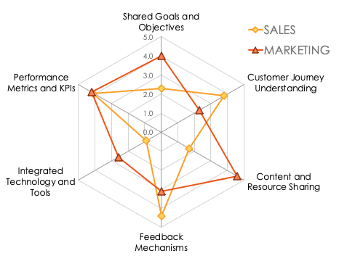
Coordination Plan
Ensure alignment between sales and marketing teams throughout the ABM process.
COORDINATION STATEMENT
Text
ALIGNMENT INDEX DATA
RADAR CHART
Enter a score of 0 to 5.0
ALIGNMENT METRIC |  | SALES |  | MARKETING
Shared Goals and Objectives |  | 2.3 |  | 4.0
Customer Journey Understanding |  | 3.8 |  | 2.3
Content and Resource Sharing |  | 1.7 |  | 4.6
Feedback Mechanisms |  | 4.4 |  | 3.1
Integrated Technology and Tools |  | 0.9 |  | 2.6
Performance Metrics and KPIs |  | 4.1 |  | 4.2
AVERAGE SCORES |  | 2.9 |  | 3.5
OVERALL % |  | 57% |  | 69%
You can build an alignment index data and radar chart with Smartsheet’s ABM Sales and Marketing Alignment Template.

Slide 12
Budget and Resources
Allocate the budget and necessary resources for executing the ABM strategy.
BUDGET STATEMENT
Text
EXPENSE ITEM | Annual Budget Allocation | YTD Consumption | YTD Remaining
Staff Salaries
External ABM Consultant Charges
ABM Trainings
Vertical Account Research
Account Development
Messaging Development
Web Development
Content Creation
Events, Roundtables, Etc.
Direct Mail
Digital Ads
Sales Engagement Platform
TOTAL | $0 | 0 | 0

Slide 13
KPIs and Metrics
Use KPIs to measure and evaluate the success of the ABM initiative. Track metrics like the following: the number of engaged target accounts; the conversion rate from engagement to partnership; and the overall revenue increase from targeted accounts.
Relationship / Reputation / Revenue
MONTHS
METRIC | METRIC TYPE | JAN | FEB | MAR | APR | MAY | JUN
Impressions
Clicks
Number of Engaged Target Accounts
Number of Meetings Booked
Number of Executive-Level Leaders Connected
Opportunities
Overall Increased Revenue $
NPS Score Only for Existing Accounts Expansion
Number of Advocates Only for Existing Accounts Expansion

Slide 14
Timeline
Show the phase/milestone (and relevant deadline) to guide the execution of the strategy.
Q1
Q2
Q3
Q4
Phase /
Milestone
 | 1 | 2 | 3 | 4 | 5 | 6 | 7 | 8 | 9 | 10 | 11 | 12 | 13 | 14 | 15 | 16 | 17 | 18 | 19 | 20 | 21 | 22 | 23 | 24
Identify High-Value Prospects
Engage Target Accounts
Deepen Engagements
Start Partnerships
Secure Partnerships
Evaluate Campaign
Week

Slide 15
Timeline
Show the phase/milestone (and relevant deadline) to guide the execution of the strategy.
MILESTONE | PHASE | Owner | Expected Start | Deadline
Text | 1 |  | 00/00/0000 | 00/00/0000

Slide 16
Review and Feedback Loop
Review the ABM strategy’s progress regularly, adapting the strategy as necessary.
Text

Slide 17
DISCLAIMER Any articles, templates, or information provided by Smartsheet on the website are for reference only. While we strive to keep the information up to date and correct, we make no representations or warranties of any kind, express or implied, about the completeness, accuracy, reliability, suitability, or availability with respect to the website or the information, articles, templates, or related graphics contained on the website. Any reliance you place on such information is therefore strictly at your own risk.

