Slide 1


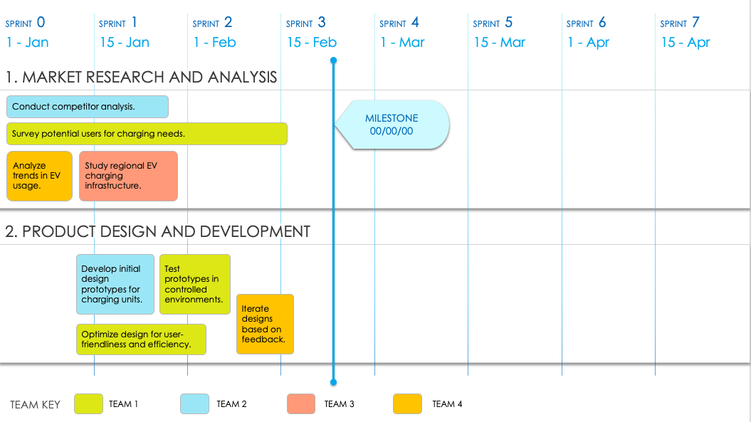
AGILE PRODUCT ROADMAP TEMPLATE
This easy-to-use Agile product roadmap template is ideal for keeping tabs on the status and progress of product-related components. Schedule feature-development details for product, design, development, and quality assurance teams to prioritize key initiatives and present the big picture of expected deliverables. This Agile-specific template helps your team stay focused on brief development iterations and enables you to list key milestones and major deliverables within a flexible timeline.
TO USE THIS TEMPLATE:
Adjust number of Sprints to meet your plan.
Enter Sprint Start Dates.
Apply Teams or Team Members to the Team Key.
Duplicate the initial slide with Dates and Teams to represent each Phase / Category.
Enter Tasks and Milestones.

Slide 2
SPRINT 0
SPRINT 1
SPRINT 2
SPRINT 3
SPRINT 4
SPRINT 5
SPRINT 6
SPRINT 7
00/00
00/00
00/00
00/00
00/00
00/00
00/00
00/00
1. TEXT
MILESTONE
00/00/00
2. TEXT
TEAM KEY
TEAM 1
TEAM 2
TEAM 3
TEAM 4

Slide 3
DISCLAIMER Any articles, templates, or information provided by Smartsheet on the website are for reference only. While we strive to keep the information up to date and correct, we make no representations or warranties of any kind, express or implied, about the completeness, accuracy, reliability, suitability, or availability with respect to the website or the information, articles, templates, or related graphics contained on the website. Any reliance you place on such information is therefore strictly at your own risk.

