Slide 1


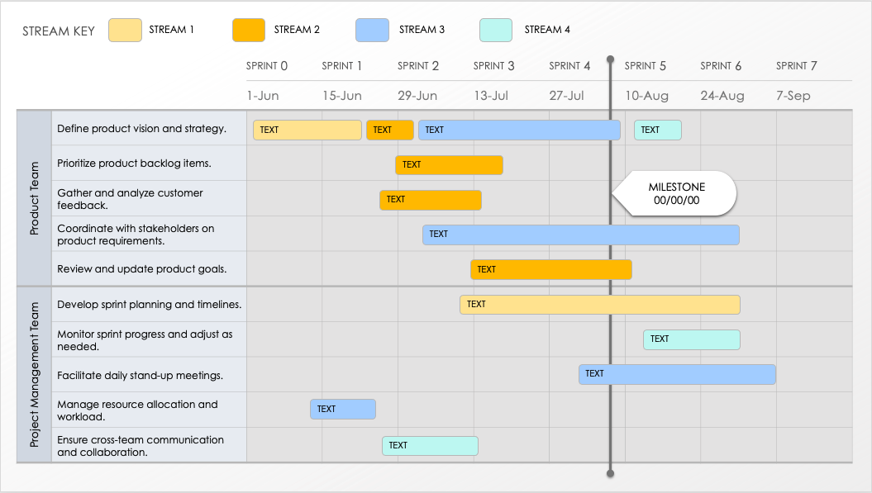
AGILE SCRUM PRODUCT ROADMAP TEMPLATE
Effectively track your team’s development goals with this scrum product roadmap template. Enter feature and user requirements, prototype, feature design, user acceptance testing, and other sprint-by-sprint product-roadmap tasks to keep tabs on each team’s development goals and accomplishments. Timebox sprint details into two-week or month-long periods with this simple-to-use, customizable template. This template is perfect for Agile teams that follow scrum methodology and need to plan and track progress across sprints.
TO USE THIS TEMPLATE:
Adjust number of Sprints to meet your plan.
Enter Sprint Start Dates.
Apply Streams to the Stream Key.
Duplicate the initial slide with Dates and Teams to represent each Phase / Category.
Enter Tasks and Milestones.

Slide 2
STREAM KEY
STREAM 1
STREAM 2
STREAM 3
STREAM 4
 |  | SPRINT 0 | SPRINT 1 | SPRINT 2 | SPRINT 3 | SPRINT 4 | SPRINT 5 | SPRINT 6 | SPRINT 7
 |  | 00/00 | 00/00 | 00/00 | 00/00 | 00/00 | 00/00 | 00/00 | 00/00
TEXT
TEXT
MILESTONE
00/00/00
TEXT
TEXT
TEXT
TEXT
TEXT
TEXT
TEXT
TEXT

Slide 3
DISCLAIMER Any articles, templates, or information provided by Smartsheet on the website are for reference only. While we strive to keep the information up to date and correct, we make no representations or warranties of any kind, express or implied, about the completeness, accuracy, reliability, suitability, or availability with respect to the website or the information, articles, templates, or related graphics contained on the website. Any reliance you place on such information is therefore strictly at your own risk.

