Slide 1


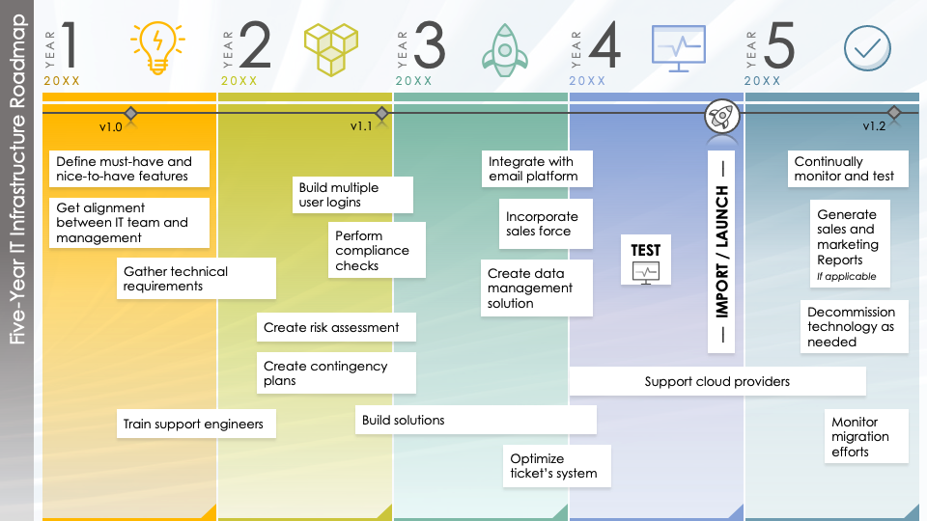
Five-Year IT Infrastructure Roadmap Template
Use this Five-Year IT Infrastructure Roadmap to outline the strategic direction and long-term objectives of the organization’s IT infrastructure.

Slide 2




1
2
3
4
5
YEAR
YEAR
YEAR
YEAR
YEAR
20XX
20XX
20XX
20XX
20XX
v1.0
v1.1
v1.2
Define must-have and nice-to-have features
Integrate with email platform
–– IMPORT / LAUNCH ––
Continually monitor and test
Build multiple user logins
Get alignment between IT team and management
Incorporate sales force
Generate sales and marketing Reports
If applicable
Perform compliance checks
Five-Year IT Infrastructure Roadmap
TEST
Gather technical requirements
Create data management solution
Decommission technology as needed
Create risk assessment
Create contingency plans
Support cloud providers
Train support engineers
Build solutions
Monitor migration efforts
Optimize ticket’s system

Slide 3
DISCLAIMER Any articles, templates, or information provided by Smartsheet on the website are for reference only. While we strive to keep the information up to date and correct, we make no representations or warranties of any kind, express or implied, about the completeness, accuracy, reliability, suitability, or availability with respect to the website or the information, articles, templates, or related graphics contained on the website. Any reliance you place on such information is therefore strictly at your own risk.

