Slide 1


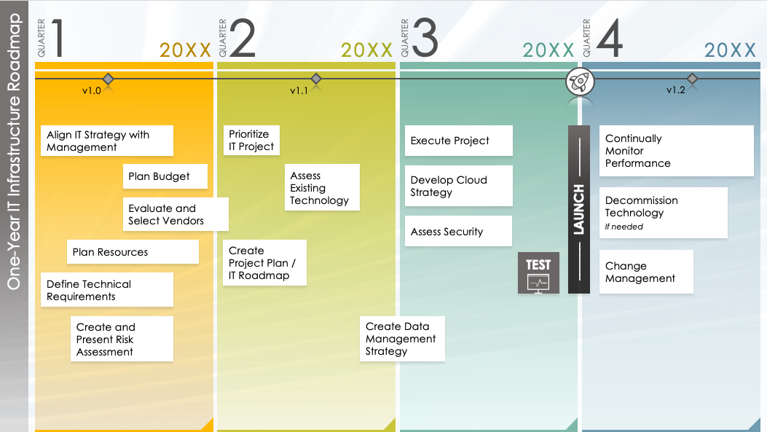
One-Year IT Infrastructure Roadmap Template
Use this One-Year IT Infrastructure Roadmap to help you visualize planned initiatives and upgrades within the next year.

Slide 2

1
2
3
4
QUARTER
20XX
QUARTER
20XX
QUARTER
20XX
QUARTER
20XX
v1.0
v1.1
v1.2
Align IT Strategy with Management
Prioritize IT Project
Execute Project
–––––– LAUNCH ––––––
Continually
Monitor
Performance
Plan Budget
Assess Existing Technology
Develop Cloud Strategy
Decommission
Technology
If needed
Evaluate and Select Vendors
One-Year IT Infrastructure Roadmap
Assess Security
Plan Resources
Create Project Plan / IT Roadmap
TEST
Change
Management
Define Technical Requirements
Create and Present Risk Assessment
Create Data Management Strategy

Slide 3
DISCLAIMER Any articles, templates, or information provided by Smartsheet on the website are for reference only. While we strive to keep the information up to date and correct, we make no representations or warranties of any kind, express or implied, about the completeness, accuracy, reliability, suitability, or availability with respect to the website or the information, articles, templates, or related graphics contained on the website. Any reliance you place on such information is therefore strictly at your own risk.

