Slide 1

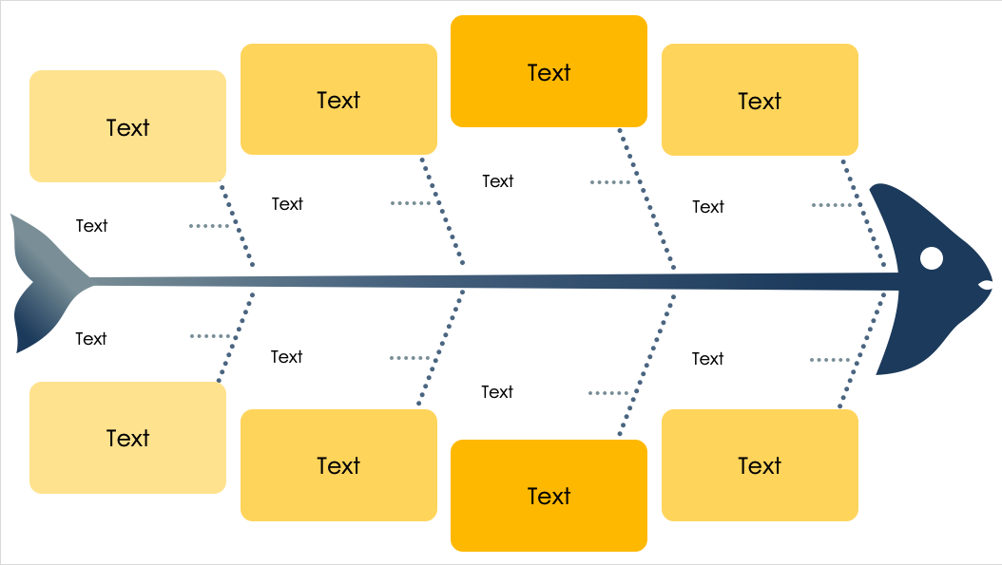
PowerPoint 8-Prong Fishbone Diagram Template
When to Use This Template: This diagram is ideal for comprehensive problem-solving sessions — such as cross-functional team discussions or multifaceted project evaluations — where multiple factors contribute to the central issue. The template enables a detailed exploration of complex issues, such as organizational changes or product failures.
Notable Template Features: With eight distinct bones, this diagram allows for a thorough root cause analysis. The template accommodates a broad range of ideas, ensuring that no potential cause is overlooked. The colorful, segmented layout aids in visual organization and helps with sorting brainstormed ideas into relevant categories.

Slide 2
Text
Text
Text
Text
Text
Text
Text
Text
Text
Text
Text
Text
Text
Text
Text
Text

Slide 3
DISCLAIMER Any articles, templates, or information provided by Smartsheet on the website are for reference only. While we strive to keep the information up to date and correct, we make no representations or warranties of any kind, express or implied, about the completeness, accuracy, reliability, suitability, or availability with respect to the website or the information, articles, templates, or related graphics contained on the website. Any reliance you place on such information is therefore strictly at your own risk.

