Slide 1

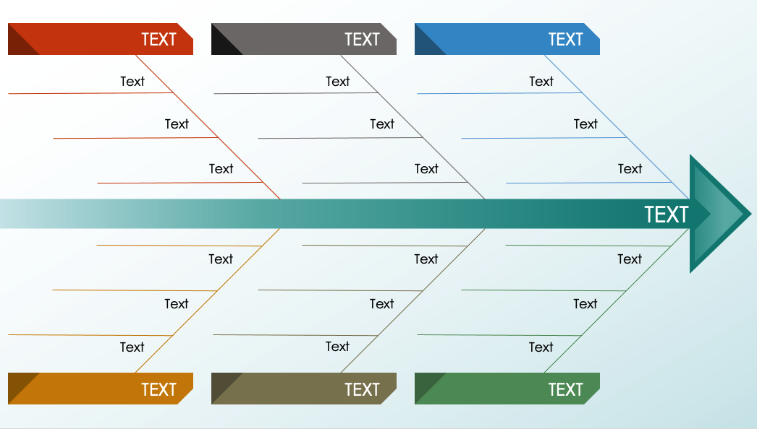
PowerPoint Arrow Fishbone Diagram Template
When to Use This Template: Project managers and team leaders can use this fishbone diagram template during brainstorming sessions to identify potential causes of a problem. The template serves as a visual aid for teams to categorize contributing factors to an issue. Consultants might also find this template useful when conducting organizational diagnostics or process improvements.
Notable Template Features: The template features a dynamic, arrow-shaped design that visually directs attention toward the main problem statement or goal. It provides multiple text boxes for entering detailed descriptions. The color-coded sections also simplify the task of distinguishing between categories, making it intuitive for the team to follow and participate in the discussion.

Slide 2
TEXT
TEXT
TEXT
Text
Text
Text
Text
Text
Text
Text
Text
Text
TEXT
Text
Text
Text
Text
Text
Text
Text
Text
Text
TEXT
TEXT
TEXT

Slide 3
DISCLAIMER Any articles, templates, or information provided by Smartsheet on the website are for reference only. While we strive to keep the information up to date and correct, we make no representations or warranties of any kind, express or implied, about the completeness, accuracy, reliability, suitability, or availability with respect to the website or the information, articles, templates, or related graphics contained on the website. Any reliance you place on such information is therefore strictly at your own risk.

