Slide 1

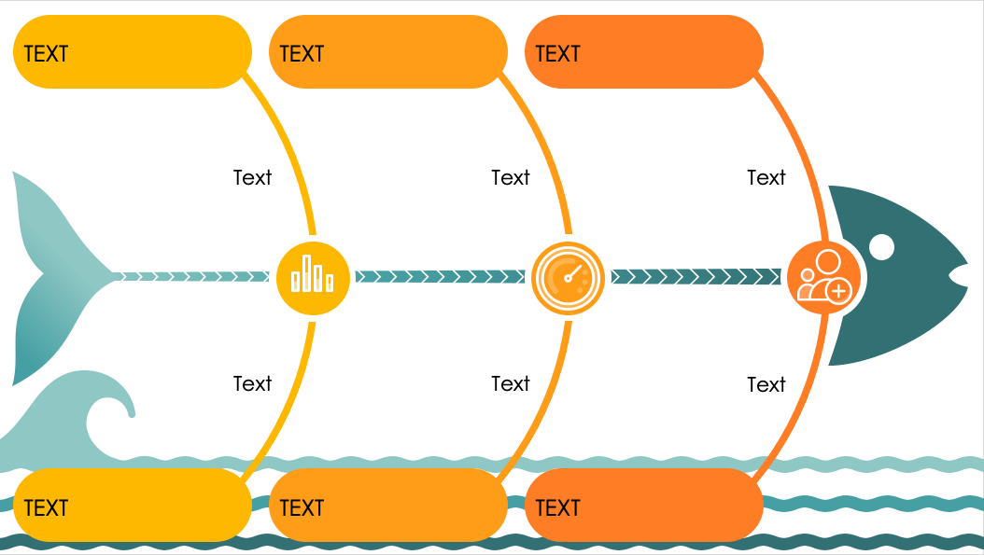
PowerPoint Symbols Fishbone Diagram Template
When to Use This Template: This fishbone chart is perfect for collaborative settings such as workshops or team meetings where visualizing the relationship between various factors and a central objective is essential. The template can be a tool for product development teams that need to trace issues back to operational, technical, or human factors. Marketing teams can use the diagram to dissect campaign elements and identify different influences on outcomes.
Notable Template Features: The diagram uses easy-to-understand symbols for categories such as human resources, processes, and research. The placement of the symbols helps you easily organize thoughts and discussions around the central problem, while the template’s colorful design enhances its visual appeal.

Slide 2


TEXT
TEXT
TEXT
Text
Text
Text
Text
Text
Text
TEXT
TEXT
TEXT

Slide 3
DISCLAIMER Any articles, templates, or information provided by Smartsheet on the website are for reference only. While we strive to keep the information up to date and correct, we make no representations or warranties of any kind, express or implied, about the completeness, accuracy, reliability, suitability, or availability with respect to the website or the information, articles, templates, or related graphics contained on the website. Any reliance you place on such information is therefore strictly at your own risk.

