Slide 1
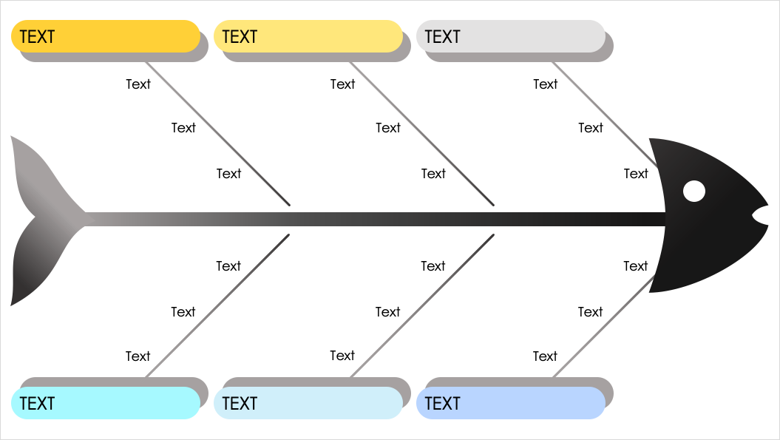
Bold Fishbone Diagram Template
When to Use This Template: Use this fishbone template in strategic planning sessions where clarity on the factors contributing to a business challenge is critical. Brainstorm with team members to drill down into specific elements of a larger problem and uncover the root causes of issues.
Notable Template Features: This template offers bold lines that clearly separate different categories or causes and enhance readability, keeping team members focused and engaged. The slide includes ample space for text so that teams can articulate and map out complex issues.

Slide 2
TEXT
TEXT
TEXT
Text
Text
Text
Text
Text
Text
Text
Text
Text
Text
Text
Text
Text
Text
Text
Text
Text
Text
TEXT
TEXT
TEXT

Slide 3
DISCLAIMER Any articles, templates, or information provided by Smartsheet on the website are for reference only. While we strive to keep the information up to date and correct, we make no representations or warranties of any kind, express or implied, about the completeness, accuracy, reliability, suitability, or availability with respect to the website or the information, articles, templates, or related graphics contained on the website. Any reliance you place on such information is therefore strictly at your own risk.

