Slide 1


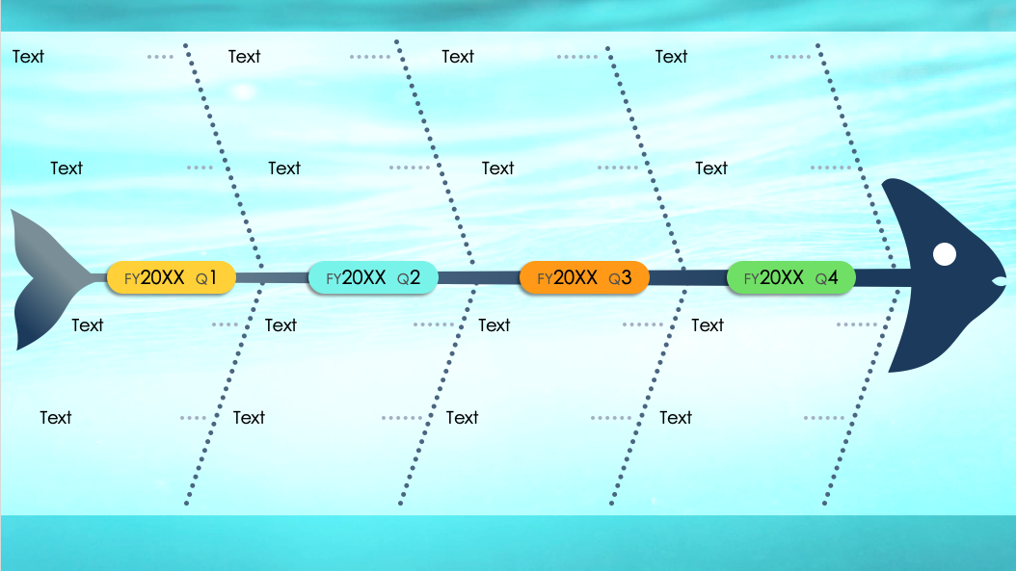
Timeline Fishbone Diagram Template
When to Use This Template: Use this timeline fishbone diagram to depict the chronological progression of projects or events. Marketing teams, for example, might use this template to trace the development of campaigns over several years. Project managers can highlight key milestones and deadlines within a project's lifecycle. The timeline can also be used for problem analysis, such as mapping out causal factors across various time points.
Notable Template Features: This template offers a color-coded system for quick year-over-year comparison. The branching points provide space for detailed annotations of significant events or stages. Additionally, the design can accommodate a range of data points without compromising readability.

Slide 2
PowerPoint Timeline Fishbone Diagram Template
Text
Text
Text
Text
Text
Text
Text
Text
FY20XX Q1
FY20XX Q2
FY20XX Q3
FY20XX Q4
Text
Text
Text
Text
Text
Text
Text
Text

Slide 3
DISCLAIMER Any articles, templates, or information provided by Smartsheet on the website are for reference only. While we strive to keep the information up to date and correct, we make no representations or warranties of any kind, express or implied, about the completeness, accuracy, reliability, suitability, or availability with respect to the website or the information, articles, templates, or related graphics contained on the website. Any reliance you place on such information is therefore strictly at your own risk.

