Slide 1

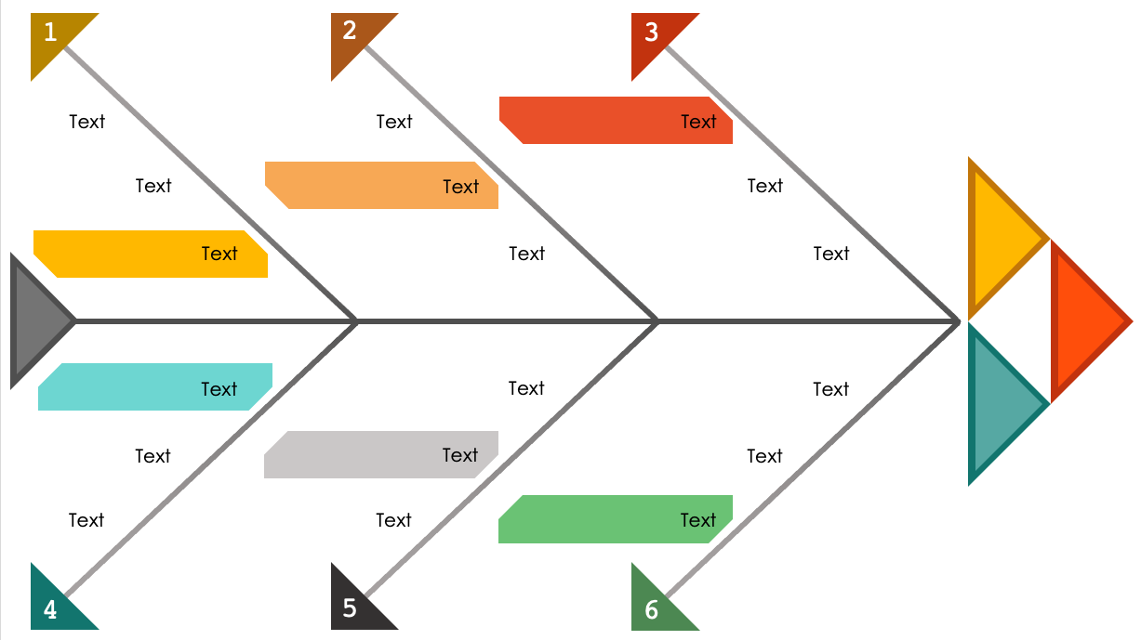
Triangles Fishbone Diagram Template
When to Use This Template: This fishbone chart is ideal for project management, strategic planning, and process improvement. Use this template to present a cause-and-effect analysis in settings such as stakeholder meetings or team debriefs.
Notable Template Features: This diagram incorporates triangles to differentiate between levels of hierarchy within root causes. This geometric approach adds an aesthetic dimension and assists the audience in following the flow of information from minor to major causes.

Slide 2
1
2
3
Text
Text
Text
Text
Text
Text
Text
Text
Text
Text
Text
Text
Text
Text
Text
Text
Text
Text
4
5
6

Slide 3
DISCLAIMER Any articles, templates, or information provided by Smartsheet on the website are for reference only. While we strive to keep the information up to date and correct, we make no representations or warranties of any kind, express or implied, about the completeness, accuracy, reliability, suitability, or availability with respect to the website or the information, articles, templates, or related graphics contained on the website. Any reliance you place on such information is therefore strictly at your own risk.

