Slide 1
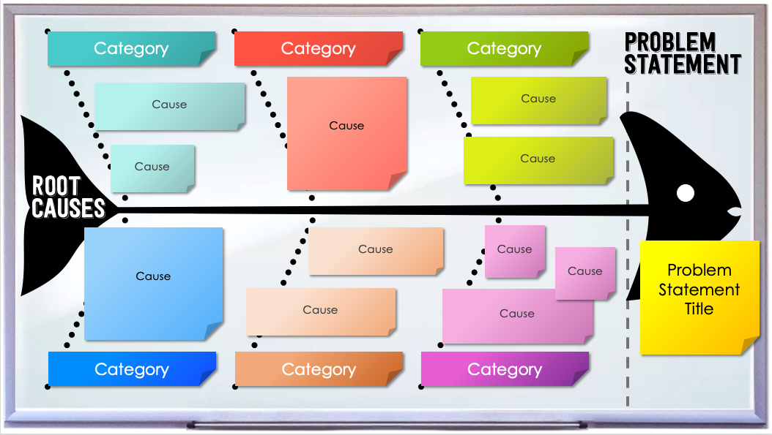
WHITEBOARD FISHBONE DIAGRAM TEMPLATE
When to Use This Template:
Teams who want a dynamic approach to root cause analysis can use this fishbone template for interactive problem-solving sessions that require brainstorming and collaboration.
Notable Template Features:
Styled like a whiteboard, this template uses color-coded sticky notes to represent potential causes, adding a layer of visual organization that simplifies complex discussions. The layout encourages an engaging, cooperative approach to identifying issues.

Slide 2
Category
Category
Category
Cause
Cause
Cause
Cause
Cause
Cause
Cause
Cause
Cause
Problem Statement Title
Cause
Cause
Category
Category
Category

Slide 5
Category
Category
Category
Category
Cause
Cause
Cause
Cause
Cause
Cause
Cause
Problem Statement Title
Problem Statement Title
Category
Category
Category
Cause
Cause
Cause
Cause
Problem Statement Title
Cause
Cause

Slide 6
DISCLAIMER Any articles, templates, or information provided by Smartsheet on the website are for reference only. While we strive to keep the information up to date and correct, we make no representations or warranties of any kind, express or implied, about the completeness, accuracy, reliability, suitability, or availability with respect to the website or the information, articles, templates, or related graphics contained on the website. Any reliance you place on such information is therefore strictly at your own risk.

