Slide 1

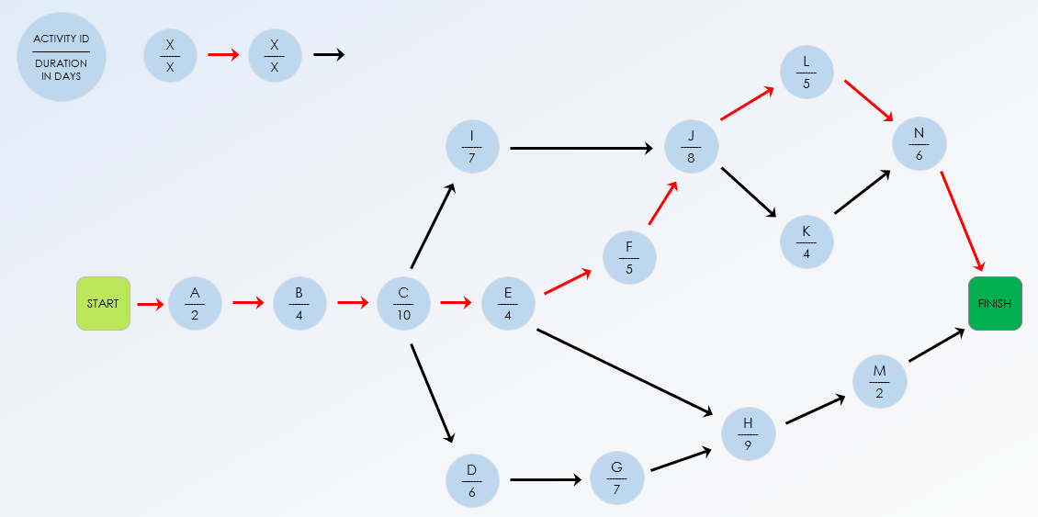
Critical Path Chart Template

Slide 2
Critical Path Chart Template
ID | PREDECESSOR ACTIVITIES enter separately in columns |  |  |  |  |  | DURATION in days | ACTIVITY DESCRIPTION
A | - | - | - | - | - | - | 2 | Activity 1
B | A |  |  |  |  |  | 4 | Activity 2
C | B |  |  |  |  |  | 10 | Activity 3
D | C |  |  |  |  |  | 6 | Activity 4
E | C |  |  |  |  |  | 4 | Activity 5
F | E |  |  |  |  |  | 5 | Activity 6
G | D |  |  |  |  |  | 7 | Activity 7
H | E | G |  |  |  |  | 9 | Activity 8
I | C |  |  |  |  |  | 7 | Activity 9
J | F | I |  |  |  |  | 8 | Activity 10
K | J |  |  |  |  |  | 4 | Activity 11
L | J |  |  |  |  |  | 5 | Activity 12
M | H |  |  |  |  |  | 2 | Activity 13
N | K | L |  |  |  |  | 6 | Activity 14

Slide 3
ACTIVITY ID
–––––––––––
DURATION IN DAYS
X
–––––––
X
X
–––––––
X
L
–––––––
5
I
–––––––
7
J
–––––––
8
N
–––––––
6
K
–––––––
4
F
–––––––
5
START
A
–––––––
2
B
–––––––
4
C
–––––––
10
E
–––––––
4
FINISH
M
–––––––
2
H
–––––––
9
D
–––––––
6
G
–––––––
7
CRITICAL PATH
Use red arrows to illustrate the critical path.

Slide 4
DISCLAIMER Any articles, templates, or information provided by Smartsheet on the website are for reference only. While we strive to keep the information up to date and correct, we make no representations or warranties of any kind, express or implied, about the completeness, accuracy, reliability, suitability, or availability with respect to the website or the information, articles, templates, or related graphics contained on the website. Any reliance you place on such information is therefore strictly at your own risk.

