Slide 1

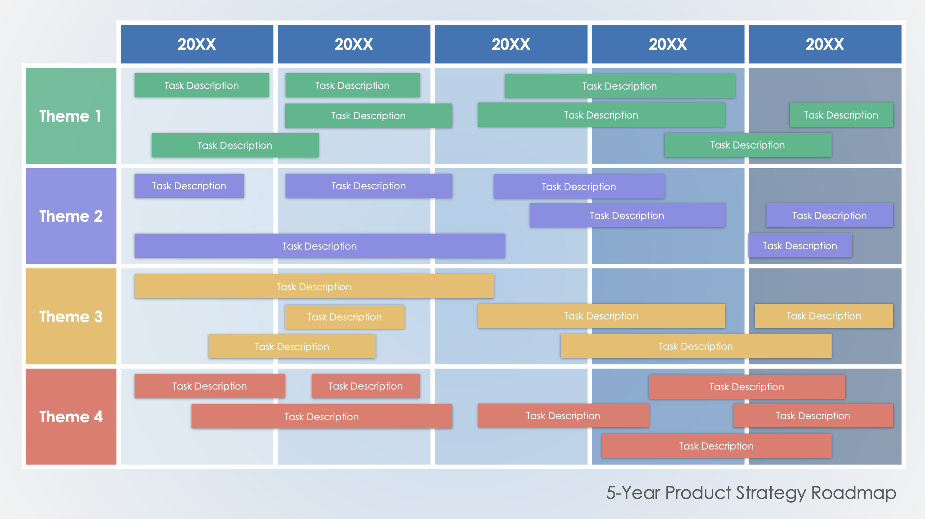
PowerPoint 5-Year Product Strategy
Roadmap Template
When to Use This Template: Senior management and strategic planners can outline and communicate long-term strategic goals and major themes over a five-year period.
Notable Template Features: This template provides a high-level overview of strategic initiatives, ideal for long-term planning and vision alignment.

Slide 2
 | 20XX | 20XX | 20XX | 20XX | 20XX
Theme 1
Theme 2
Theme 3
Theme 4
Task Description
Task Description
Task Description
Task Description
Task Description
Task Description
Task Description
Task Description
Task Description
Task Description
Task Description
Task Description
Task Description
Task Description
Task Description
Task Description
Task Description
Task Description
Task Description
Task Description
Task Description
Task Description
Task Description
Task Description
Task Description
Task Description
Task Description
Task Description
5-Year Product Strategy Roadmap

Slide 3
DISCLAIMER Any articles, templates, or information provided by Smartsheet on the website are for reference only. While we strive to keep the information up to date and correct, we make no representations or warranties of any kind, express or implied, about the completeness, accuracy, reliability, suitability, or availability with respect to the website or the information, articles, templates, or related graphics contained on the website. Any reliance you place on such information is therefore strictly at your own risk.

