Slide 1

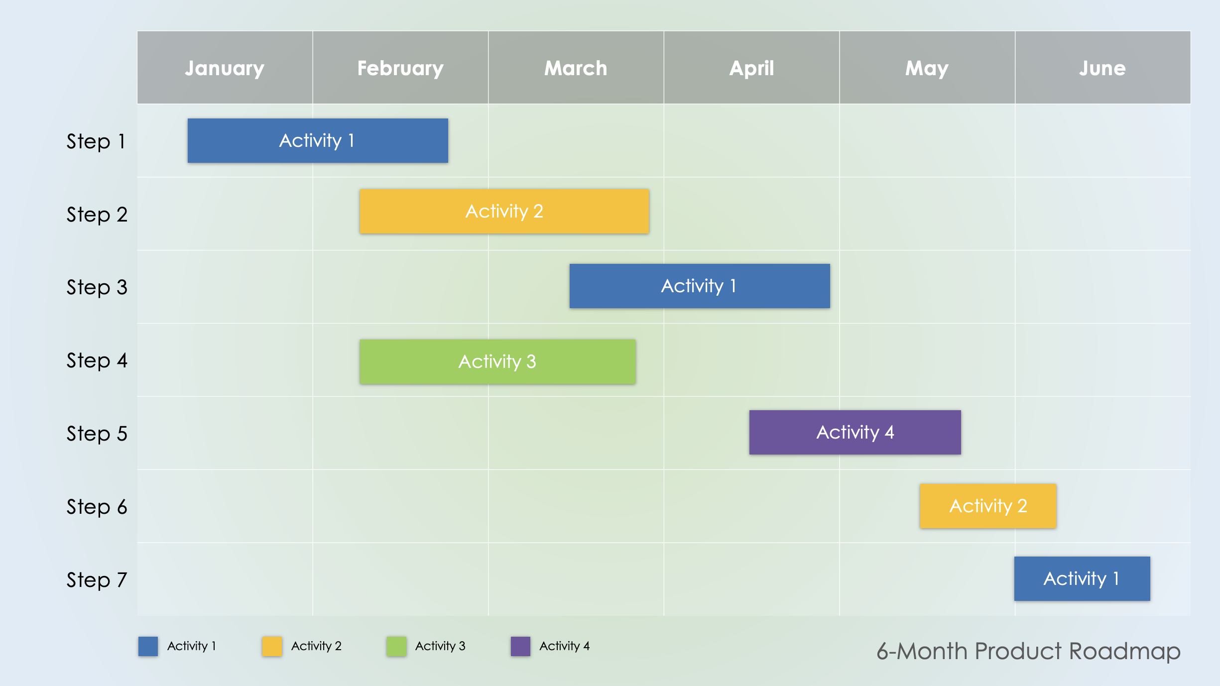
PowerPoint 6-Month Product Roadmap Template
When to Use This Template: Product managers can use this template to communicate the high-level goals, initiatives, and timeline of a product over a six-month period.
Notable Template Features: This template shows a monthly timeline, which can be edited to other timeframes.

Slide 2
 | January | February | March | April | May | June
Step 1
Step 2
Step 3
Step 4
Step 5
Step 6
Step 7
Activity 1
Activity 2
Activity 1
Activity 3
Activity 4
Activity 2
Activity 1
Activity 1
Activity 2
Activity 3
Activity 4
6-Month Product Roadmap

Slide 3
DISCLAIMER Any articles, templates, or information provided by Smartsheet on the website are for reference only. While we strive to keep the information up to date and correct, we make no representations or warranties of any kind, express or implied, about the completeness, accuracy, reliability, suitability, or availability with respect to the website or the information, articles, templates, or related graphics contained on the website. Any reliance you place on such information is therefore strictly at your own risk.

