Slide 1



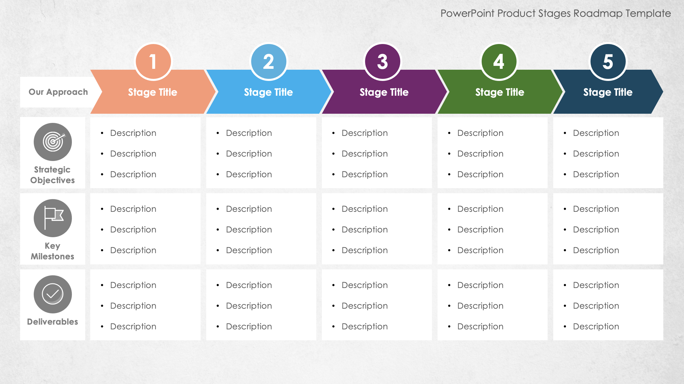
PowerPoint Product Stages Roadmap Template
When to Use This Template: Use this template to outline the key phases of a project or product development process. Project managers, product developers, and business strategists can use it to present the sequential stages of their project to stakeholders, as well as in kickoff meetings, strategy sessions, and progress reviews to provide a comprehensive overview of the project's lifecycle and key deliverables.
Notable Template Features: The template includes arrows to represent the phases of a product roadmap. For each product development phase, enter key details about your strategic objectives, activities, and deliverables. The visual structure of this customizable template enables you to easily communicate complex processes, making it an effective tool for project planning and communication.

Slide 2



PowerPoint Product Stages Roadmap Template
1
2
3
4
5
Stage Title
Stage Title
Stage Title
Stage Title
Stage Title
Our Approach
Description
Description
Description
Description
Description
Description
Description
Description
Description
Description
Description
Description
Description
Description
Description
Strategic
Objectives
Description
Description
Description
Description
Description
Description
Description
Description
Description
Description
Description
Description
Description
Description
Description
Key Milestones
Description
Description
Description
Description
Description
Description
Description
Description
Description
Description
Description
Description
Description
Description
Description
Deliverables

Slide 3
DISCLAIMER Any articles, templates, or information provided by Smartsheet on the website are for reference only. While we strive to keep the information up to date and correct, we make no representations or warranties of any kind, express or implied, about the completeness, accuracy, reliability, suitability, or availability with respect to the website or the information, articles, templates, or related graphics contained on the website. Any reliance you place on such information is therefore strictly at your own risk.

