Slide 1


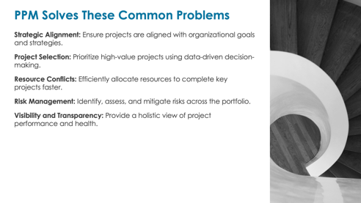
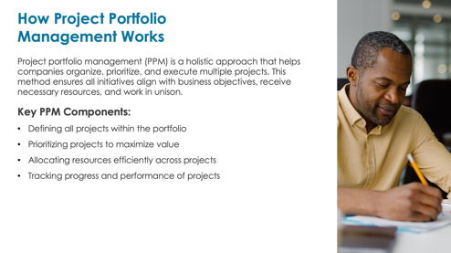

Business Case for Project Portfolio Management Presentation Template
When to Use This Template: Use this template to present a business case for implementing PPM within an organization. It outlines the benefits, solutions to common challenges, and steps for implementing PPM, making it suitable for convincing stakeholders of its value and guiding the implementation process.

Slide 2

Project Portfolio Management
The Business Case

Slide 3

How Project Portfolio
Management Works
Project portfolio management (PPM) is a holistic approach that helps companies organize, prioritize, and execute multiple projects. This method ensures all initiatives align with business objectives, receive necessary resources, and work in unison.
Key PPM Components:
Defining all projects within the portfolio
Prioritizing projects to maximize value
Allocating resources efficiently across projects
Tracking progress and performance of projects

Slide 4

PPM Solves These Common Problems
Strategic Alignment: Ensure projects are aligned with organizational goals and strategies.
Project Selection: Prioritize high-value projects using data-driven decision-making.
Resource Conflicts: Efficiently allocate resources to complete key projects faster.
Risk Management: Identify, assess, and mitigate risks across the portfolio.
Visibility and Transparency: Provide a holistic view of project performance and health.

Slide 5

PPM’s Many Benefits, Part 1
Strategic Alignment: Projects align with the organization’s goals.
Improved Project Selection: Projects are selected based on business value.
Better Project ROI: Better project selection and execution raise ROI.
Resource Optimization: Resources are allocated to prioritized projects.
Faster Project Completion: Prioritization leads to faster completion of
key projects.
Budget Alignment: Centralized management ensures alignment with
department budgets.

Slide 6

PPM’s Many Benefits, Part 2
Project Transparency: PPM software provides clear, real-time project visibility through dashboards.
Collaborative Decision-Making: Transparency creates a collaborative environment.
Adaptability to Market Changes: Aligning strategy with market conditions enhances adaptability.
Risk Management: Clear processes strengthen risk management efforts.
Performance Measurement: Focused metrics drive consistent performance evaluation.
Accountability for Results: Built-in accountability ensures ownership of outcomes.
Better Long-Term Planning: Strategic alignment enables
longer-term thinking.
Competitive Advantage: Effective PPM provides a competitive edge.

Slide 7

Overcoming PPM Challenges
High Initial Investment:
Assess and compare tools and staffing to ensure cost-effectiveness.
Potentially Long Implementation:
Develop a clear implementation plan. Use Lean methodologies for flexibility.
Ongoing Administrative Costs:
Automate PPM processes.
Regularly optimize tasks to
reduce costs.
Potential for Bureaucracy:
Streamline processes.
Empower project managers with decision-making authority.
Resistance to Change:
Communicate benefits clearly.
Provide training and support.
Required Skill Sets:
Offer targeted training programs.
Hire or develop talent with
needed skills.
Risk of Inflexibility:
Use adaptable and scalable frameworks.
Foster a culture of continuous improvement.

Slide 8

Potential Future State with PPM
Optimized Portfolio: Achieve a well-balanced portfolio with projects that drive maximum value.
Enhanced Agility: Improve the ability to respond quickly to market changes and new opportunities.
Data-Driven Culture: Foster a culture of data-driven decision-making and continuous improvement.
Strategic Growth: Enable strategic growth by aligning projects with long-term business objectives.
Sustained Success: Ensure the sustained success of your project portfolio through continuous monitoring and improvement.

Slide 9

Potential Next Steps
Assessment: Evaluate current project management practices and costs, and compare them with the projected setup costs and ROI of PPM.
Commitment: Leadership decides to commit to the PPM structure.
Planning: Develop a detailed implementation plan with a clear budget, milestones, and deliverables.
Tool Selection: Select PPM tools that best meet the organization’s needs.
Training: Provide comprehensive training for all stakeholders to ensure smooth adoption.
Pilot Implementation: Launch a pilot program to test and refine processes.
Full Rollout: Gradually roll out the PPM system across the organization.
Continuous Improvement: Establish a feedback loop to continually improve PPM
practices.

Slide 10
DISCLAIMER Any articles, templates, or information provided by Smartsheet on the website are for reference only. While we strive to keep the information up to date and correct, we make no representations or warranties of any kind, express or implied, about the completeness, accuracy, reliability, suitability, or availability with respect to the website or the information, articles, templates, or related graphics contained on the website. Any reliance you place on such information is therefore strictly at your own risk.

