Slide 1


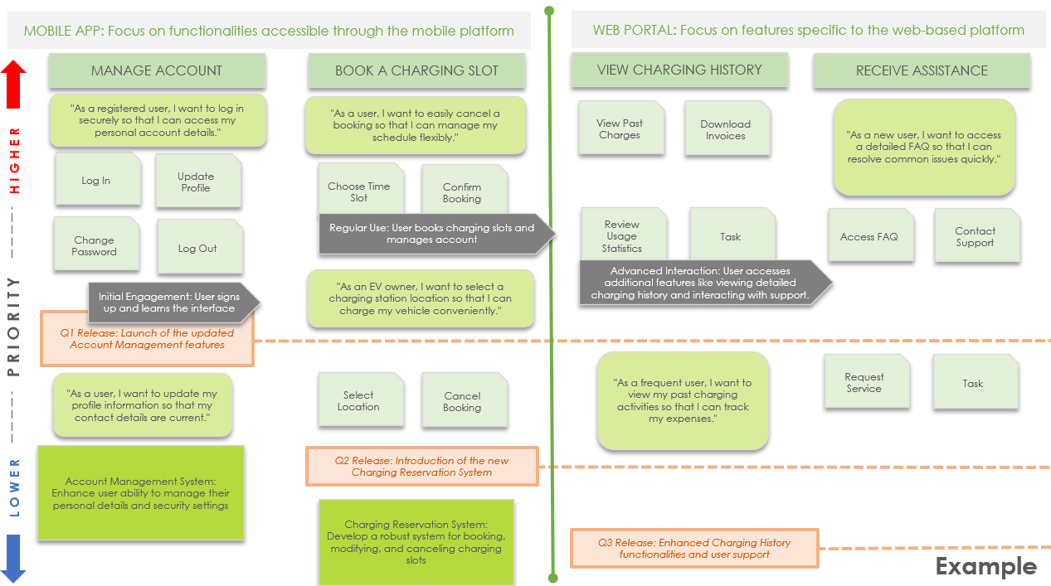
Agile Scrum User Story Map Template Example

Slide 2
MOBILE APP: Focus on functionalities accessible through the mobile platform
WEB PORTAL: Focus on features specific to the web-based platform
MANAGE ACCOUNT
BOOK A CHARGING SLOT
VIEW CHARGING HISTORY
RECEIVE ASSISTANCE
"As a registered user, I want to log in securely so that I can access my personal account details."
"As a user, I want to easily cancel a booking so that I can manage my schedule flexibly."
View Past Charges
Download Invoices
"As a new user, I want to access a detailed FAQ so that I can resolve common issues quickly."
Log In
Update Profile
Choose Time Slot
Confirm Booking
Change Password
Log Out
Regular Use: User books charging slots and manages account
Review Usage Statistics
Task
Access FAQ
Contact Support
"As an EV owner, I want to select a charging station location so that I can charge my vehicle conveniently."
Advanced Interaction: User accesses additional features like viewing detailed charging history and interacting with support.
LOWER PRIORITY HIGHER
Initial Engagement: User signs up and learns the interface
Q1 Release: Launch of the updated Account Management features
"As a frequent user, I want to view my past charging activities so that I can track my expenses."
Request Service
Task
"As a user, I want to update my profile information so that my contact details are current."
Select Location
Cancel Booking
Account Management System: Enhance user ability to manage their personal details and security settings
Q2 Release: Introduction of the new Charging Reservation System
Charging Reservation System: Develop a robust system for booking, modifying, and canceling charging slots
Q3 Release: Enhanced Charging History functionalities and user support
Example

Slide 3
PRIORITIZATION
Often included as a vertical orientation of user stories within tasks to show which stories are more critical and should be developed first.
SWIMLANE
SWIMLANE
ACTIVITY 1
ACTIVITY 2
USER ACTIVITIES
These are high-level tasks that users need to perform with the product. These are broad categories of functionality, such as "Manage Account" or "Make a Purchase."
Story 1
USER STORIES
These are specific features or requirements that support the user tasks. They are expressed from the perspective of the user and fit the typical user story format: "As a [type of user], I want [a specific feature] so that [I can accomplish a specific goal].” Each story should be actionable and testable.
Task
SWIMLANES
These "lanes" can represent different user personas or application platforms (mobile, web, etc.), providing a clear view of who needs what and where.
Task
Task
Task
USER TASKS
These are sub-tasks that fall under each user activity. These tasks break down the activities into more manageable components. For example, under "Manage Account," tasks might include "Log In," "Update Profile," or "Change Password."
LOWER PRIORITY HIGHER
Release Milestone
JOURNEY STAGES
Some story maps include the different stages of a user’s journey, from initial engagement through long-term usage. This can help in understanding and designing for the user experience throughout their interaction with the product.
Journey Stage A
RELEASE MILESTONES
These are points on the user story map where you plan to release a version of the product to users. They help the team focus on delivering a cohesive set of features that provide value at each release.
Release Milestone
Epic A
EPICS
These are large user stories that cannot be completed in a single sprint and must be broken down into smaller tasks. Epics are typically aligned with user activities or major features.
Agile Scrum User Story Map Legend

Slide 4
SWIMLANE TITLE
SWIMLANE TITLE
ACTIVITY 1
ACTIVITY 2
ACTIVITY 3
ACTIVITY 4
Story 1
Story 2
Story 1
Story 2
Story 1
Story 2
Story 1
Story 2
Task A
Task B
Task A
Task B
Task A
Task B
Task A
Task B
Task C
Task D
Task C
Task D
Task C
Task D
Task C
Task D
LOWER PRIORITY HIGHER
Release Milestone
Epic A
Epic B
Epic A
Epic B
Epic A
Epic B
Epic A
Epic B
Journey Stage A
Journey Stage B
Release Milestone

Slide 5
DISCLAIMER Any articles, templates, or information provided by Smartsheet on the website are for reference only. While we strive to keep the information up to date and correct, we make no representations or warranties of any kind, express or implied, about the completeness, accuracy, reliability, suitability, or availability with respect to the website or the information, articles, templates, or related graphics contained on the website. Any reliance you place on such information is therefore strictly at your own risk.

