Slide 1

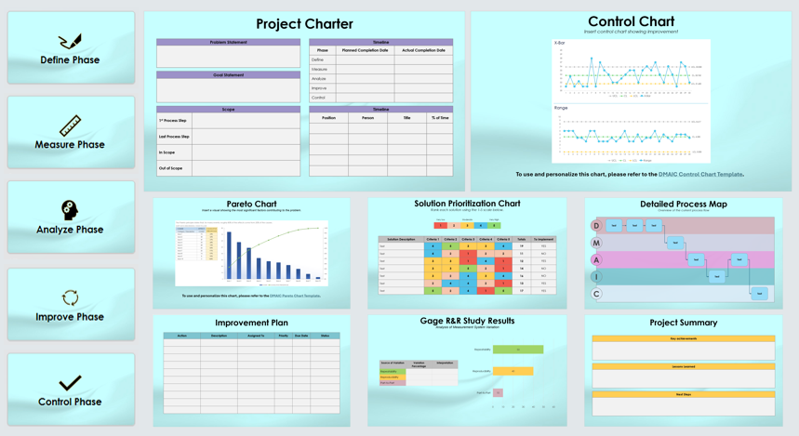
DMAIC Presentation Template
When To Use This Template:
Create a comprehensive DMAIC report with this presentation template. Use the template throughout the course of a DMAIC project, particularly at key milestones, to present progress, findings, and results to stakeholders.
Notable Templates Features:
This template provides slides for each DMAIC phase, including a project charter, SIPOC, baseline data, a root cause analysis, and improvement plans. Visuals such as process maps and fishbone diagrams help users organize and communicate data effectively.

Slide 2

Define Phase

Slide 3
Project Charter
Problem Statement
Timeline
Phase | Planned Completion Date | Actual Completion Date
Define
Measure
Analyze
Improve
Control
Goal Statement
Scope
1st Process Step
Last Process Step
In Scope
Out of Scope
Timeline
Position | Person | Title | % of Time

Slide 4
Voice of the Customer (VOC)
Customer Requirements | Survey / Interview Data | Voice of the Customer Analysis

Slide 5
SIPOC
Process Title
S | I | P | O | C
SUPPLIERS | INPUT | PROCESS | OUTPUT | CUSTOMER
who is providing input to a process | resource provided by supplier for incorporation to process | steps taken to convert input to output | resource resulting from process | receiver of newly created output
Suppliers Customer Requirements | Input Customer Requirements | Process Customer Requirements | Output Customer Requirements | Customer Customer Requirements

Slide 6
Detailed Process Map
Overview of the current process flow
D
Text
Text
Text
M
Text
A
Text
Text
I
Text
C
Text

Slide 7

Measure Phase

Slide 8
Data Collection Plan
Performance Measure | Operational Definitions | Who Will Collect Data? | When and Where?

Slide 9
Baseline Performance
Chart or image to illustrate baseline data

Slide 10
Gage R&R Study Results
Analysis of Measurement System Variation
Source of Variation | Variation Percentage | Interpretation
Repeatability
Reproducibility
Part-to-Part

Slide 11

Analyze Phase

Slide 12
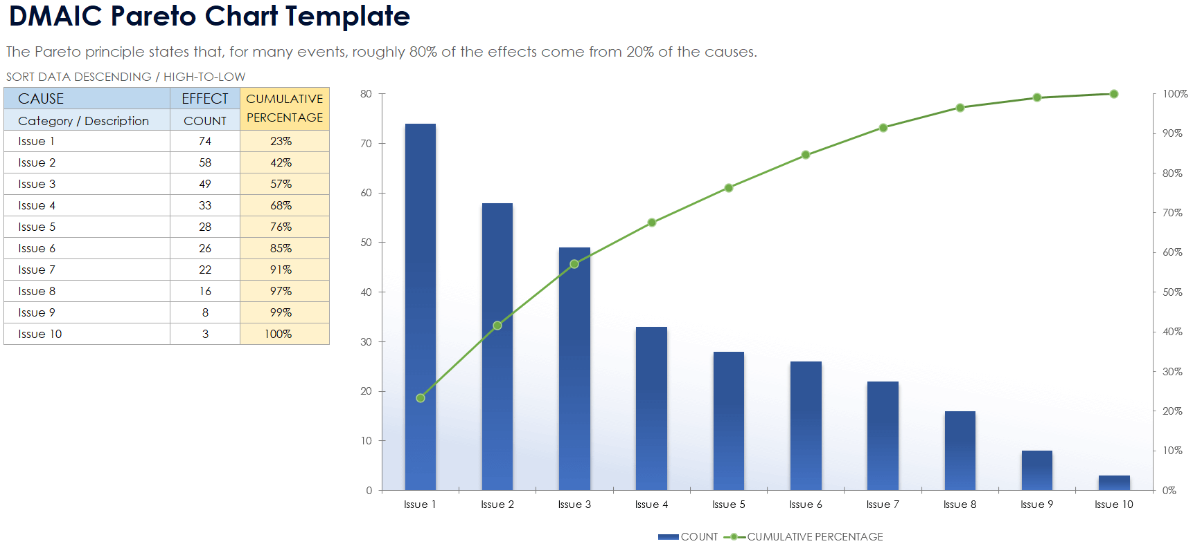
Pareto Chart
Visual showing the most significant factors contributing to the problem
To use and personalize this chart, please refer to the DMAIC Pareto Chart Template.

Slide 13
Fishbone Diagram
TEXT
TEXT
TEXT
Text
Text
Text
Text
Text
Text
Text
Text
Text
Text
Text
Text
Text
Text
Text
Text
Text
Text
TEXT
TEXT
TEXT

Slide 14
Process Map
Overview of the current process flow
D
Text
M
Text
Text
Text
A
Text
Text
I
Text
C
Text

Slide 15
Hypothesis Confirmation
Probable Root Cause | Hypothesis | True / False | Proof

Slide 16
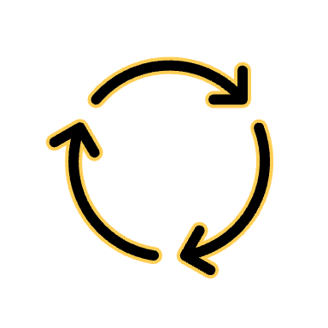
Improve Phase

Slide 17
Solution Prioritization Chart
Each solution ranked on a scale of1–5
Very low |  | Moderate |  | Very High
1 | 2 | 3 | 4 | 5
Solution Description | Criteria 1 | Criteria 2 | Criteria 3 | Criteria 4 | Criteria 5 | Totals | To Implement
Text | 4 | 5 | 3 | 3 | 4 | 19 | YES
Text | 4 | 2 | 1 | 2 | 2 | 11 | NO
Text | 3 | 3 | 1 | 4 | 1 | 12 | YES
Text | 3 | 3 | 5 | 2 | 1 | 14 | NO
Text | 3 | 2 | 4 | 3 | 4 | 16 | NO
Text | 2 | 4 | 4 | 2 | 1 | 13 | YES
Text | 5 | 2 | 4 | 1 | 5 | 17 | YES

Slide 18
Improvement Plan
Action | Description | Assigned To | Priority | Due Date | Status

Slide 19
Improved Process Map
Updated process flow reflecting improvements
D
Text
M
A
Text
Text
I
Text
Text
Text
Text
C
Text

Slide 20

Control Phase

Slide 21
Control Plan
Process Step | Control Method | Metrics | Monitoring Frequency | Data Collection Plan | Response Plan | Documentation / Reporting | Person Responsible

Slide 22
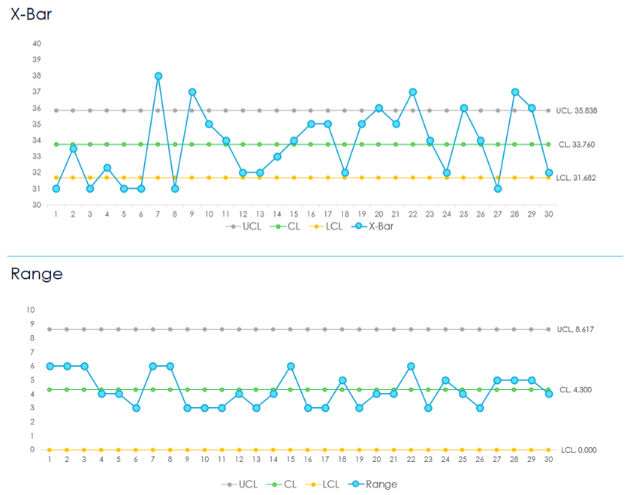
Control Chart
Control chart showing improvement
To use and personalize this chart, please refer to the DMAIC Control Chart Template.

Slide 23
Project Summary
Key achievements
Lessons Learned
Next Steps

Slide 24
DISCLAIMER Any articles, templates, or information provided by Smartsheet on the website are for reference only. While we strive to keep the information up to date and correct, we make no representations or warranties of any kind, express or implied, about the completeness, accuracy, reliability, suitability, or availability with respect to the website or the information, articles, templates, or related graphics contained on the website. Any reliance you place on such information is therefore strictly at your own risk.

