Slide 1


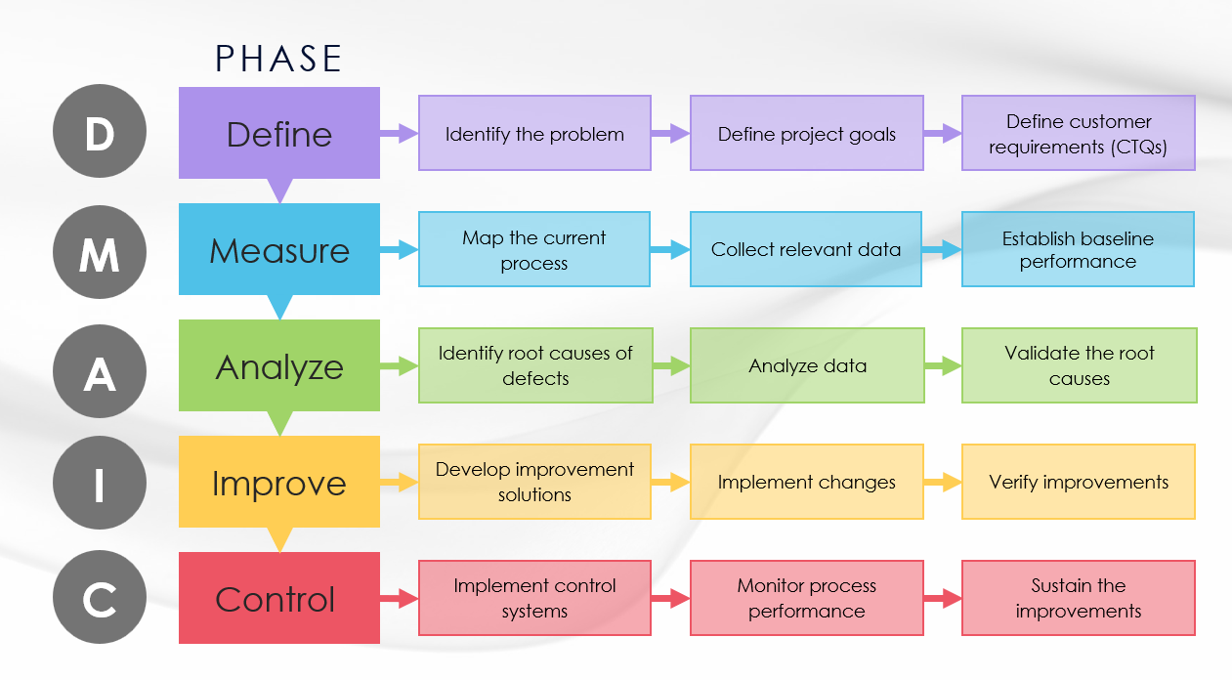
DMAIC Process Flowchart Template
When To Use This Template:
Use this flowchart template at the beginning of a project to provide an overview of the DMAIC methodology and a visual representation of the project's structure.
Notable Templates Features:
This template uses flowchart shapes to illustrate the DMAIC process. The flowchart includes example activities for each DMAIC phase, which you can edit to suit your specific project.

Slide 2
PHASE
D
Define
Identify the problem
Define project goals
Define customer requirements (CTQs)
M
Measure
Map the current process
Collect relevant data
Establish baseline performance
A
Analyze
Identify root causes of defects
Analyze data
Validate the root causes
I
Improve
Develop improvement solutions
Implement changes
Verify improvements
C
Control
Implement control systems
Monitor process performance
Sustain the improvements

Slide 3
DISCLAIMER Any articles, templates, or information provided by Smartsheet on the website are for reference only. While we strive to keep the information up to date and correct, we make no representations or warranties of any kind, express or implied, about the completeness, accuracy, reliability, suitability, or availability with respect to the website or the information, articles, templates, or related graphics contained on the website. Any reliance you place on such information is therefore strictly at your own risk.

