Slide 1

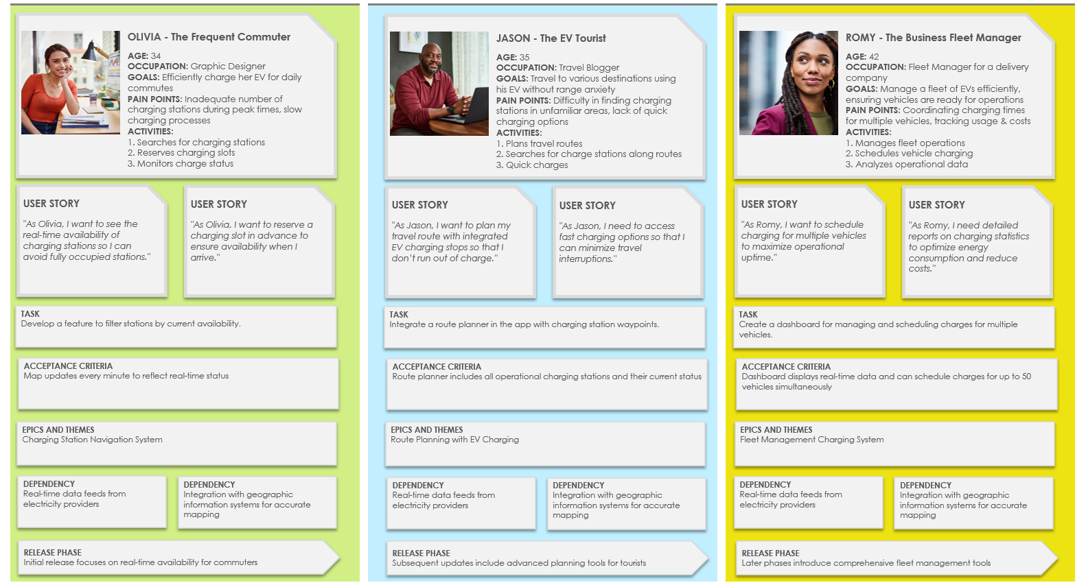
Persona-Based User Story Map Template

Slide 2

PERSONA OVERVIEW |  | PERSONA OVERVIEW |  | PERSONA OVERVIEW
        NAME - Persona
        AGE: 00
        OCCUPATION: Title
        GOALS: Description
        PAIN POINTS: Description
        ACTIVITIES:
        1. Activity
        2. Activity
        3. Activity
        NAME - Persona
        AGE: 00
        OCCUPATION: Title
        GOALS: Description
        PAIN POINTS: Description
        ACTIVITIES:
        1. Activity
        2. Activity
        3. Activity
        NAME - Persona
        AGE: 00
        OCCUPATION: Title
        GOALS: Description
        PAIN POINTS: Description
        ACTIVITIES:
        1. Activity
        2. Activity
        3. Activity
USER STORY
“Story …”
USER STORY
“Story …”
USER STORY
“Story …”
USER STORY
“Story …”
USER STORY
“Story …”
USER STORY
“Story …”
TASK
Description
TASK
Description
TASK
Description
ACCEPTANCE CRITERIA
Description
ACCEPTANCE CRITERIA
Description
ACCEPTANCE CRITERIA
Description
EPICS AND THEMES
Description
EPICS AND THEMES
Description
EPICS AND THEMES
Description
DEPENDENCY
Description
DEPENDENCY
Description
DEPENDENCY
Description
DEPENDENCY
Description
DEPENDENCY
Description
DEPENDENCY
Description
RELEASE PHASE
Description
RELEASE PHASE
Description
RELEASE PHASE
Description

Slide 3



EXAMPLE
PERSONA OVERVIEW |  | PERSONA OVERVIEW |  | PERSONA OVERVIEW
        OLIVIA - The Frequent Commuter
        AGE: 34
        OCCUPATION: Graphic Designer
        GOALS: Efficiently charge her EV for daily commutes
        PAIN POINTS: Inadequate number of charging stations during peak times, slow charging processes
        ACTIVITIES:
        1. Searches for charging stations
        2. Reserves charging slots
        3. Monitors charge status
        JASON - The EV Tourist
        AGE: 35
        OCCUPATION: Travel Blogger
        GOALS: Travel to various destinations using his EV without range anxiety
        PAIN POINTS: Difficulty in finding charging stations in unfamiliar areas, lack of quick charging options
        ACTIVITIES:
        1. Plans travel routes
        2. Searches for charge stations along routes
        3. Quick charges
        ROMY - The Business Fleet Manager
        AGE: 42
        OCCUPATION: Fleet Manager for a delivery company
        GOALS: Manage a fleet of EVs efficiently, ensuring vehicles are ready for operations
        PAIN POINTS: Coordinating charging times for multiple vehicles, tracking usage & costs
        ACTIVITIES:
        1. Manages fleet operations
        2. Schedules vehicle charging
        3. Analyzes operational data
USER STORY
"As Olivia, I want to see the real-time availability of charging stations so I can avoid fully occupied stations."
USER STORY
"As Olivia, I want to reserve a charging slot in advance to ensure availability when I arrive."
USER STORY
"As Jason, I want to plan my travel route with integrated EV charging stops so that I don’t run out of charge."
USER STORY
"As Jason, I need to access fast charging options so that I can minimize travel interruptions."
USER STORY
""As Romy, I want to schedule charging for multiple vehicles to maximize operational uptime."
USER STORY
"As Romy, I need detailed reports on charging statistics to optimize energy consumption and reduce costs."
TASK
Develop a feature to filter stations by current availability.
TASK
Integrate a route planner in the app with charging station waypoints.
TASK
Create a dashboard for managing and scheduling charges for multiple vehicles.
ACCEPTANCE CRITERIA
Map updates every minute to reflect real-time status
ACCEPTANCE CRITERIA Route planner includes all operational charging stations and their current status
ACCEPTANCE CRITERIA Dashboard displays real-time data and can schedule charges for up to 50 vehicles simultaneously
EPICS AND THEMES
Charging Station Navigation System
EPICS AND THEMES
Route Planning with EV Charging
EPICS AND THEMES
Fleet Management Charging System
DEPENDENCY
Real-time data feeds from electricity providers
DEPENDENCY
Integration with geographic information systems for mapping
DEPENDENCY
Real-time data feeds from electricity providers
DEPENDENCY
Integration with geographic information systems for mapping
DEPENDENCY
Real-time data feeds from electricity providers
DEPENDENCY
Integration with geographic information systems for mapping
RELEASE PHASE
Initial release focuses on real-time availability for commuters
RELEASE PHASE
Subsequent updates include advanced planning tools for tourists
RELEASE PHASE
Later phases introduce comprehensive fleet management tools

Slide 4
DISCLAIMER Any articles, templates, or information provided by Smartsheet on the website are for reference only. While we strive to keep the information up to date and correct, we make no representations or warranties of any kind, express or implied, about the completeness, accuracy, reliability, suitability, or availability with respect to the website or the information, articles, templates, or related graphics contained on the website. Any reliance you place on such information is therefore strictly at your own risk.

