Slide 1


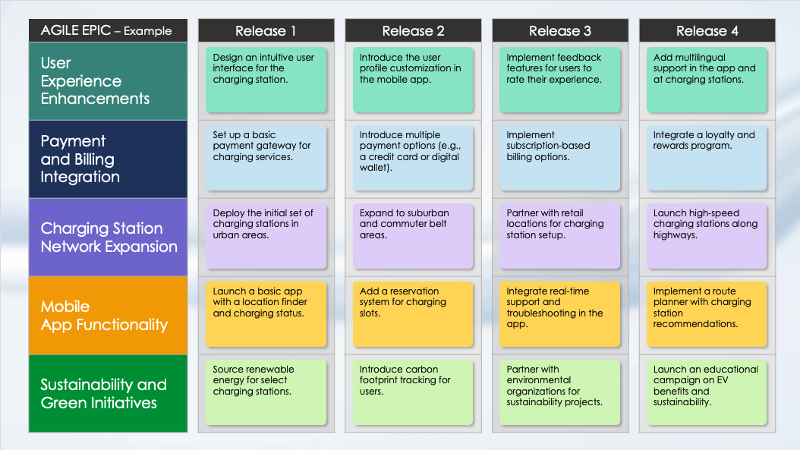
Agile Epic Roadmap Slide Template – Example
When to Use This Template: Use this Agile epic roadmap slide template to present the planning and tracking of your Agile epics across multiple releases to team members and stakeholders. The template is particularly useful for conveying project timelines and progress in a clear, visual format.
Notable Template Features: Available with or without sample text, this template includes release-by-release columns that help you organize and track epics. This format enables you to present projects clearly and to ensure that you’ve aligned all stakeholders concerning progress and upcoming milestones.

Slide 2
AGILE EPIC – Example |  | Release 1 |  | Release 2 |  | Release 3 |  | Release 4
User Experience Enhancements
Payment and Billing Integration
Charging Station Network Expansion
Mobile App Functionality
Sustainability and Green Initiatives
Design an intuitive user interface for the charging station.
Introduce the user profile customization in the mobile app.
Implement feedback features for users to rate their experience.
Add multilingual support in the app and at charging stations.
Set up a basic payment gateway for charging services.
Introduce multiple payment options (e.g., a credit card or digital wallet).
Implement subscription-based billing options.
Integrate a loyalty and rewards program.
Deploy the initial set of charging stations in urban areas.
Expand to suburban and commuter belt areas.
Partner with retail locations for charging station setup.
Launch high-speed charging stations along highways.
Launch a basic app with a location finder and charging status.
Add a reservation system for charging slots.
Integrate real-time support and troubleshooting in the app.
Implement a route planner with charging station recommendations.
Source renewable energy for select charging stations.
Introduce carbon footprint tracking for users.
Partner with environmental organizations for sustainability projects.
Launch an educational campaign on EV benefits and sustainability.

Slide 3
AGILE EPIC |  | Release 1 |  | Release 2 |  | Release 3 |  | Release 4
Epic 1
Epic 2
Epic 3
Epic 4
Epic 5
Release Task
Release Task
Release Task
Release Task
Release Task
Release Task
Release Task
Release Task
Release Task
Release Task
Release Task
Release Task
Release Task
Release Task
Release Task
Release Task
Release Task
Release Task
Release Task
Release Task

Slide 4
AGILE EPIC |  | Release 1 |  | Release 2 |  | Release 3 |  | Release 4
Epic 1
Epic 2
Epic 3
Epic 4
Epic 5
Release Task
Release Task
Release Task
Release Task
Release Task
Release Task
Release Task
Release Task
Release Task
Release Task
Release Task
Release Task
Release Task
Release Task
Release Task
Release Task
Release Task
Release Task
Release Task
Release Task

Slide 5
AGILE EPIC | Release 1 | Release 2 | Release 3 | Release 4 | Release 5 | Release 6
Epic 1
Epic 2
Epic 3
Epic 4
Epic 5
Release Task
Release Task
Release Task
Release Task
Release Task
Release Task
Release Task
Release Task
Release Task
Release Task
Release Task
Release Task
Release Task
Release Task
Release Task
Release Task
Release Task
Release Task
Release Task
Release Task
Release Task
Release Task
Release Task
Release Task
Release Task
Release Task
Release Task
Release Task
Release Task
Release Task

Slide 6
AGILE EPIC | Release 1 | Release 2 | Release 3 | Release 4 | Release 5 | Release 6
Epic 1
Epic 2
Epic 3
Epic 4
Epic 5
Epic 6
Release Task
Release Task
Release Task
Release Task
Release Task
Release Task
Release Task
Release Task
Release Task
Release Task
Release Task
Release Task
Release Task
Release Task
Release Task
Release Task
Release Task
Release Task
Release Task
Release Task
Release Task
Release Task
Release Task
Release Task
Release Task
Release Task
Release Task
Release Task
Release Task
Release Task
Release Task
Release Task
Release Task
Release Task
Release Task
Release Task

Slide 7
DISCLAIMER Any articles, templates, or information provided by Smartsheet on the website are for reference only. While we strive to keep the information up to date and correct, we make no representations or warranties of any kind, express or implied, about the completeness, accuracy, reliability, suitability, or availability with respect to the website or the information, articles, templates, or related graphics contained on the website. Any reliance you place on such information is therefore strictly at your own risk.

