Slide 1

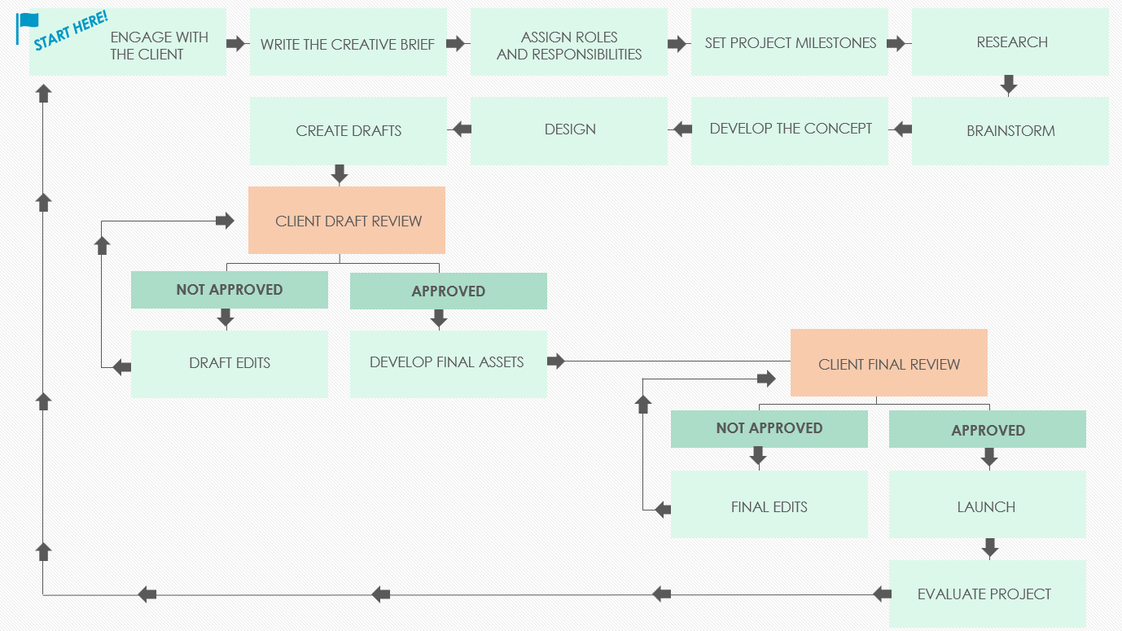
Creative Agency Workflow

Slide 2

START HERE!
ENGAGE WITH
THE CLIENT
ASSIGN ROLES
AND RESPONSIBILITIES
WRITE THE CREATIVE BRIEF
SET PROJECT MILESTONES
RESEARCH
CREATE DRAFTS
DESIGN
DEVELOP THE CONCEPT
BRAINSTORM
CLIENT DRAFT REVIEW
NOT APPROVED
APPROVED
DRAFT EDITS
DEVELOP FINAL ASSETS
CLIENT FINAL REVIEW
NOT APPROVED
APPROVED
FINAL EDITS
LAUNCH
EVALUATE PROJECT

Slide 3
DISCLAIMER Any articles, templates, or information provided by Smartsheet on the website are for reference only. While we strive to keep the information up to date and correct, we make no representations or warranties of any kind, express or implied, about the completeness, accuracy, reliability, suitability, or availability with respect to the website or the information, articles, templates, or related graphics contained on the website. Any reliance you place on such information is therefore strictly at your own risk.

