Slide 1
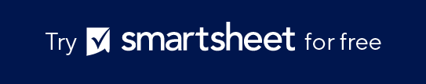
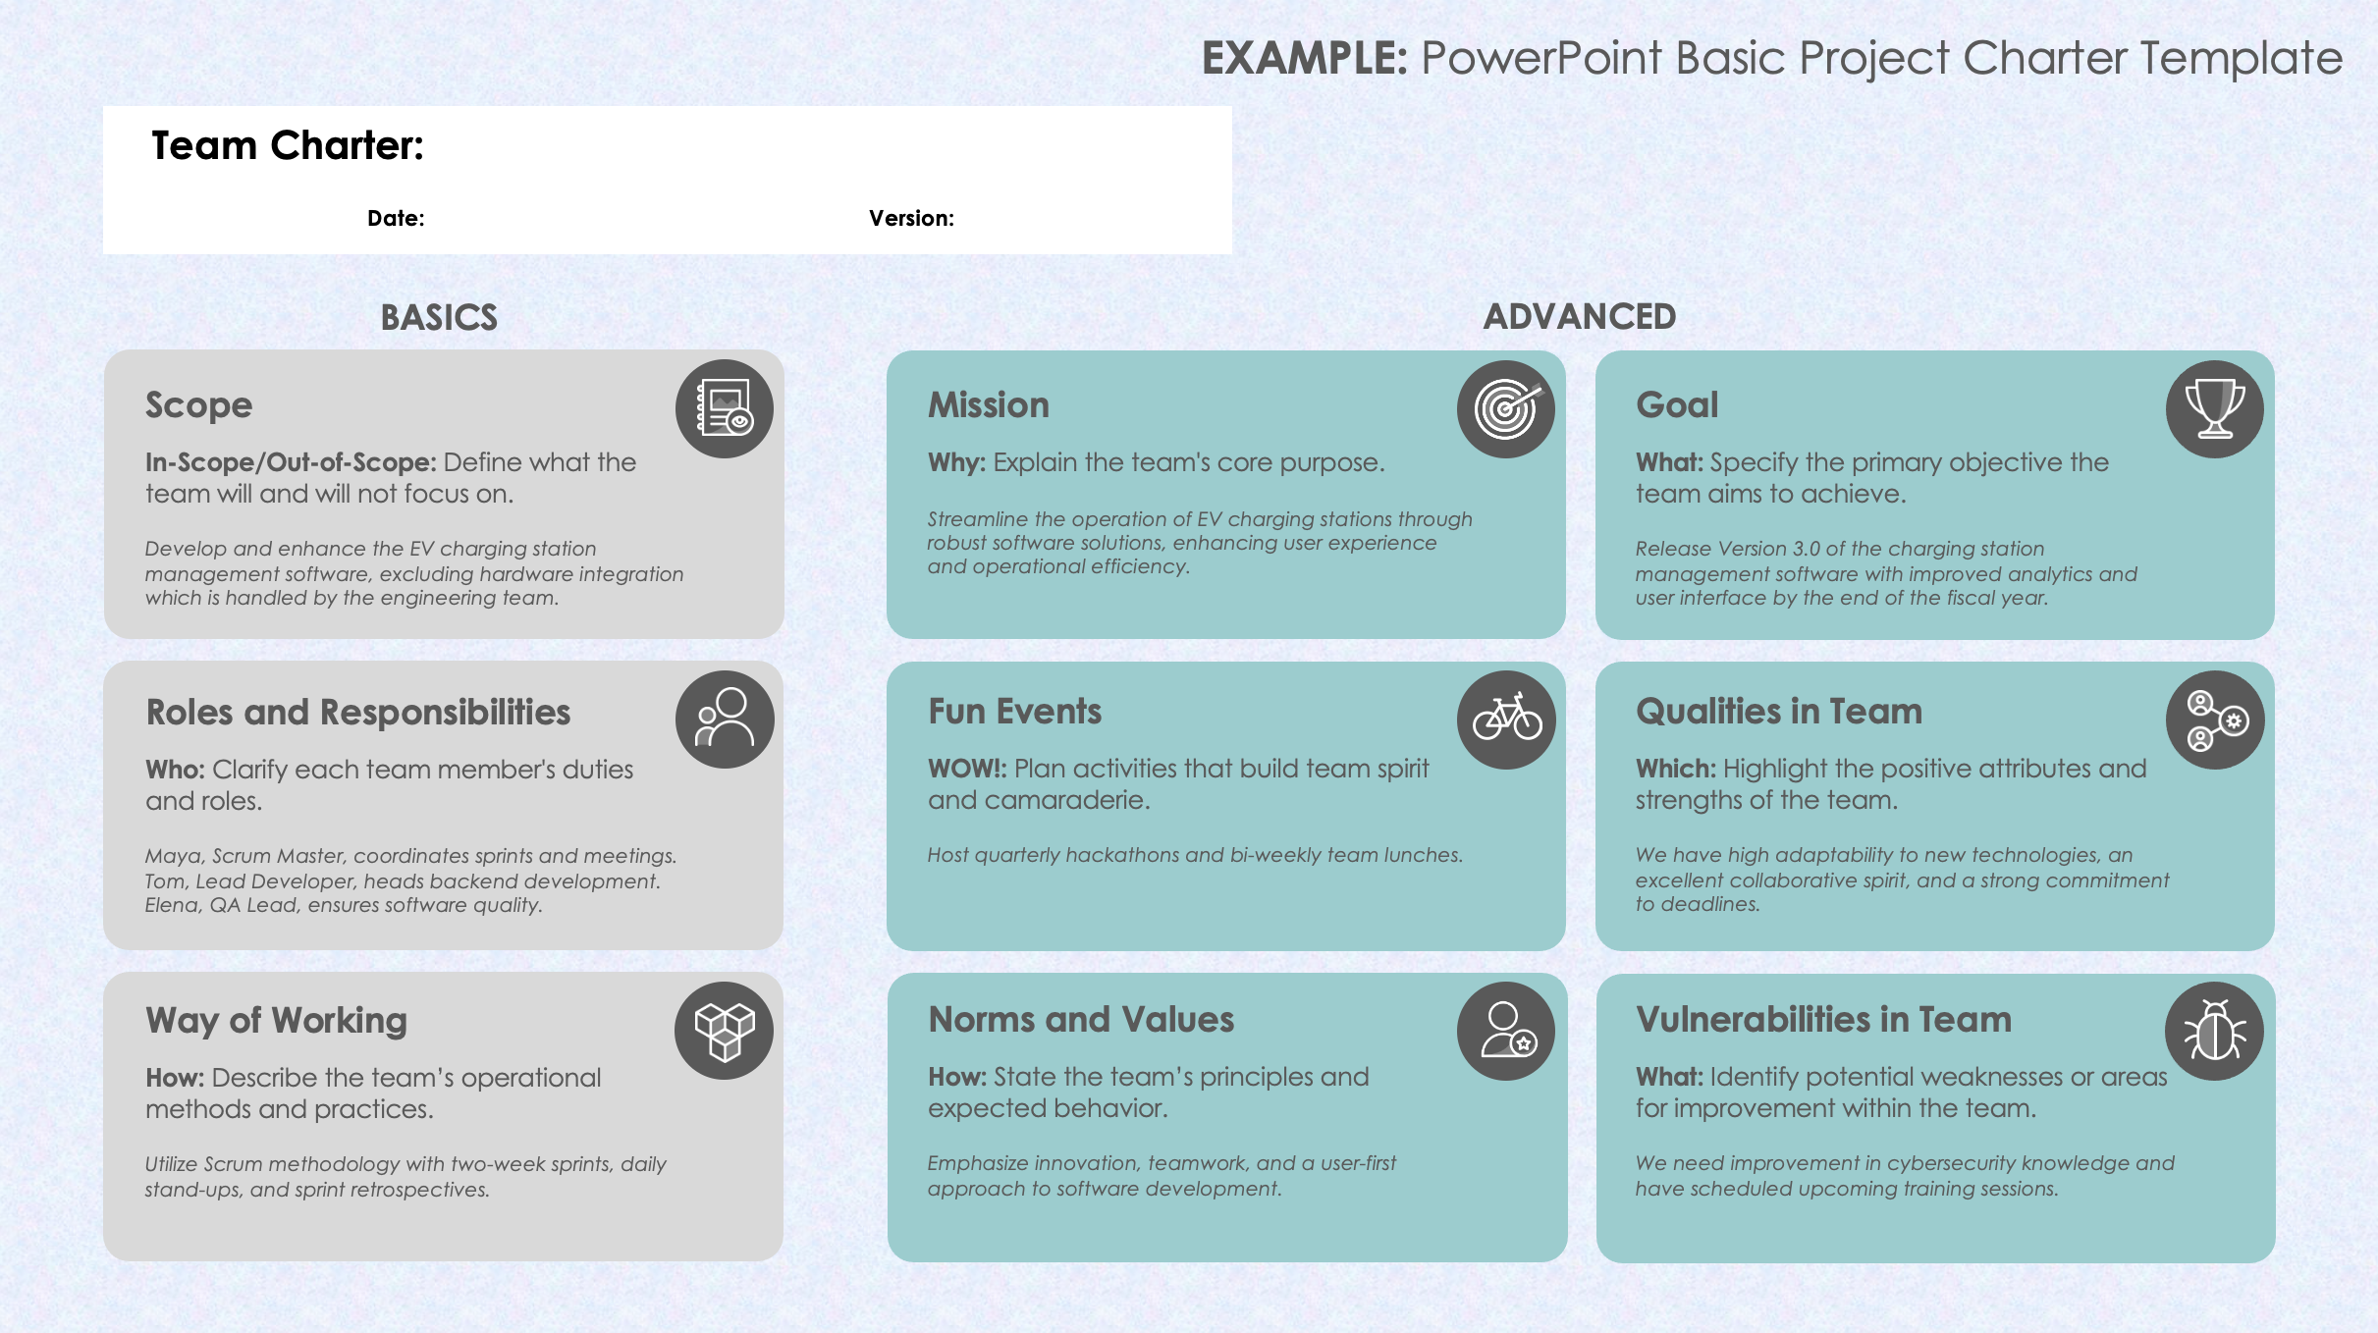
PowerPoint Basic
Project Charter Template

Slide 2









EXAMPLE: PowerPoint Basic Project Charter Template
Team Charter:
Date: |  | Version:
BASICS
ADVANCED
Scope
Mission
Goal
In-Scope/Out-of-Scope: Define what the
team will and will not focus on.
Develop and enhance the EV charging station management software, excluding hardware integration which is handled by the engineering team.
Why: Explain the team's core purpose.
Streamline the operation of EV charging stations through robust software solutions, enhancing user experience and operational efficiency.
What: Specify the primary objective the team aims to achieve.
Release Version 3.0 of the charging station management software with improved analytics and user interface by the end of the fiscal year.
Roles and Responsibilities
Fun Events
Qualities in Team
Who: Clarify each team member's duties
and roles.
Maya, Scrum Master, coordinates sprints and meetings. Tom, Lead Developer, heads backend development. Elena, QA Lead, ensures software quality.
WOW!: Plan activities that build team spirit
and camaraderie.
Host quarterly hackathons and bi-weekly team lunches.
Which: Highlight the positive attributes and strengths of the team.
We have high adaptability to new technologies, an excellent collaborative spirit, and a strong commitment to deadlines.
Way of Working
Norms and Values
Vulnerabilities in Team
How: Describe the team’s operational methods and practices.
Utilize Scrum methodology with two-week sprints, daily stand-ups, and sprint retrospectives.
How: State the team’s principles and
expected behavior.
Emphasize innovation, teamwork, and a user-first approach to software development.
What: Identify potential weaknesses or areas for improvement within the team.
We need improvement in cybersecurity knowledge and have scheduled upcoming training sessions.

Slide 3
PowerPoint Basic Project Charter Template
Team Charter:
Date: |  | Version:
BASICS
ADVANCED
Scope
Mission
Goal
In-Scope/Out-of-Scope: Define what the
team will and will not focus on.
Focusing on product development, excluding market analysis.
Why: Explain the team's core purpose.
Create a user-centric software solution that enhances client productivity.
What: Specify the primary objective the team aims to achieve.
Launch the new application by Q3, achieving a customer satisfaction score of at least 80%.
Roles and Responsibilities
Fun Events
Qualities in Team
Who: Clarify each team member's duties
and roles.
John leads design and Lisa oversees testing.
WOW!: Plan activities that build team spirit
and camaraderie.
Hold monthly team outings and weekly virtual game nights.
Which: Highlight the positive attributes and strengths of the team.
We have creativity, technical expertise, and strong problem-solving skills.
Way of Working
Norms and Values
Vulnerabilities in Team
How: Describe the team’s operational methods and practices.
We hold Agile sprints with bi-weekly reviews.
How: State the team’s principles and
expected behavior.
We value respect, transparency, and proactive communication in all interactions.
What: Identify potential weaknesses or areas for improvement within the team.
We have limited experience with cloud integration, requiring external training.

Slide 4
DISCLAIMER Any articles, templates, or information provided by Smartsheet on the website are for reference only. While we strive to keep the information up to date and correct, we make no representations or warranties of any kind, express or implied, about the completeness, accuracy, reliability, suitability, or availability with respect to the website or the information, articles, templates, or related graphics contained on the website. Any reliance you place on such information is therefore strictly at your own risk.

