Slide 1


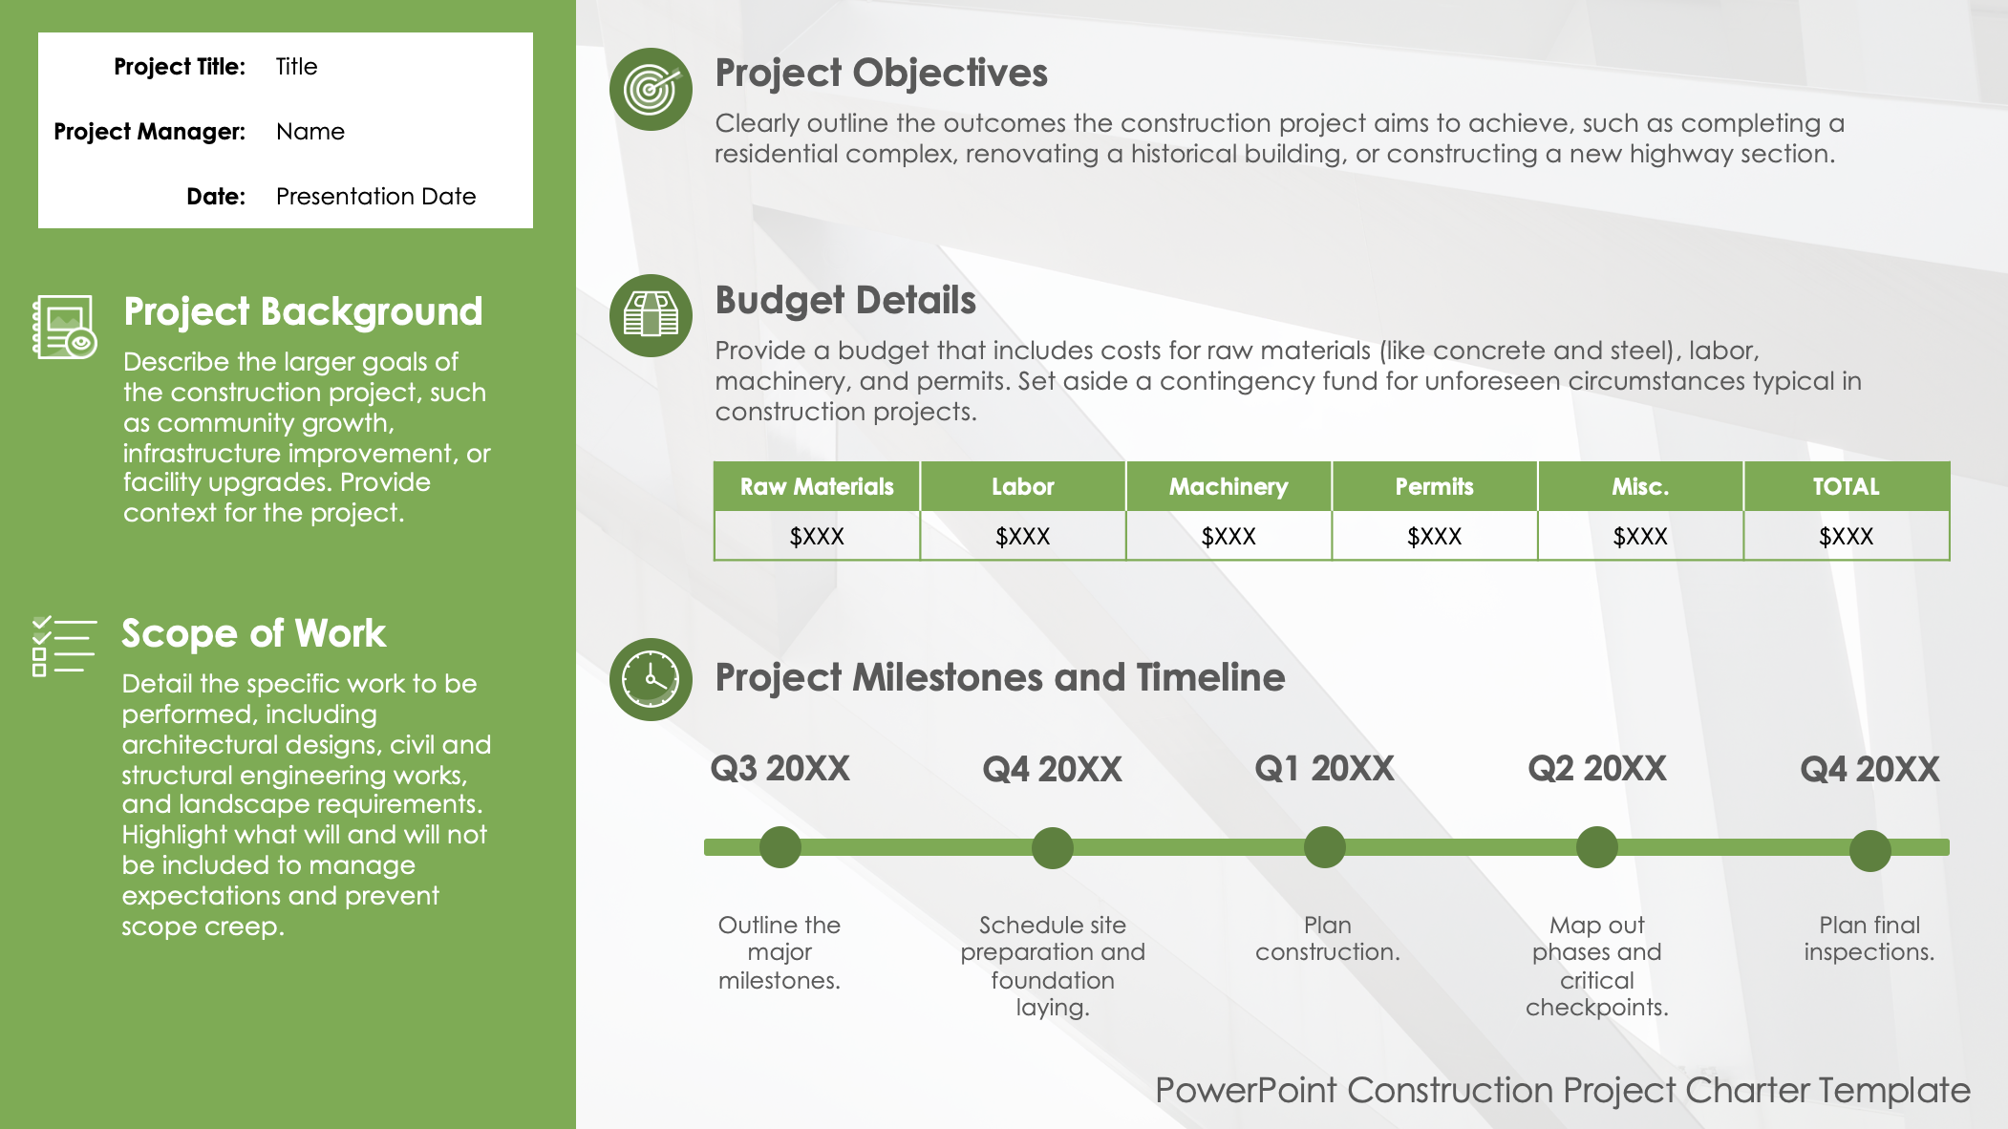
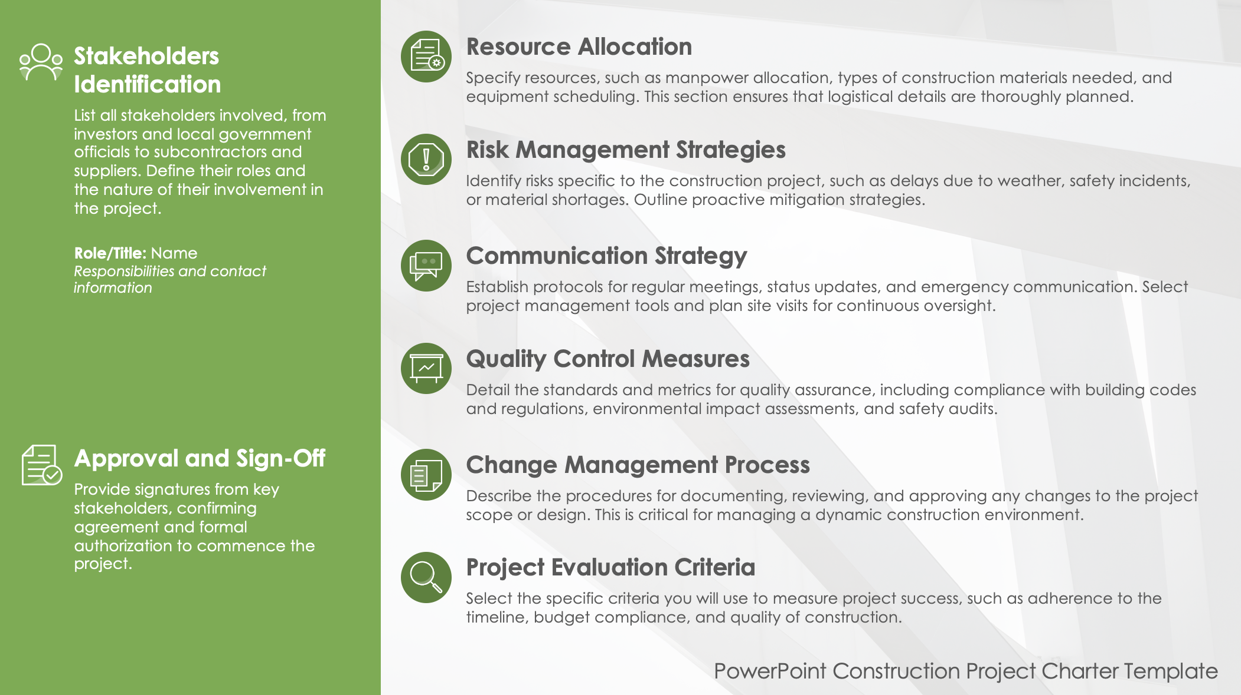
PowerPoint Construction Project Charter Template

Slide 2





Project Title: | Title
Project Manager: | Name
Date: | Presentation Date
Project Objectives
Clearly outline the outcomes the construction project aims to achieve, such as completing a residential complex, renovating a historical building, or constructing a new highway section.
Project Background
Describe the larger goals of the construction project, such as community growth, infrastructure improvement, or facility upgrades. Provide context for the project.
Budget Details
Provide a budget that includes costs for raw materials (like concrete and steel), labor, machinery, and permits. Set aside a contingency fund for unforeseen circumstances typical in construction projects.
Raw Materials | Labor | Machinery | Permits | Misc. | TOTAL
$XXX | $XXX | $XXX | $XXX | $XXX | $XXX
Scope of Work
Detail the specific work to be performed, including architectural designs, civil and structural engineering works, and landscape requirements. Highlight what will and will not be included to manage expectations and prevent scope creep.
Project Milestones and Timeline
Q3 20XX
Q4 20XX
Q1 20XX
Q2 20XX
Q4 20XX
Outline the major milestones.
Schedule site preparation and foundation laying.
Plan construction.
Map out phases and critical checkpoints.
Plan final inspections.
PowerPoint Construction Project Charter Template

Slide 3








Stakeholders Identification
List all stakeholders involved, from investors and local government officials to subcontractors and suppliers. Define their roles and the nature of their involvement in the project.
Role/Title: Name
Responsibilities and contact information
Resource Allocation
Specify resources, such as manpower allocation, types of construction materials needed, and equipment scheduling. This section ensures that logistical details are thoroughly planned.
Risk Management Strategies
Identify risks specific to the construction project, such as delays due to weather, safety incidents, or material shortages. Outline proactive mitigation strategies.
Communication Strategy
Establish protocols for regular meetings, status updates, and emergency communication. Select project management tools and plan site visits for continuous oversight.
Quality Control Measures
Detail the standards and metrics for quality assurance, including compliance with building codes and regulations, environmental impact assessments, and safety audits.
Approval and Sign-Off
Provide signatures from key stakeholders, confirming agreement and formal authorization to commence the project.
Change Management Process
Describe the procedures for documenting, reviewing, and approving any changes to the project scope or design. This is critical for managing a dynamic construction environment.
Project Evaluation Criteria
Select the specific criteria you will use to measure project success, such as adherence to the timeline, budget compliance, and quality of construction.
PowerPoint Construction Project Charter Template

Slide 4
DISCLAIMER Any articles, templates, or information provided by Smartsheet on the website are for reference only. While we strive to keep the information up to date and correct, we make no representations or warranties of any kind, express or implied, about the completeness, accuracy, reliability, suitability, or availability with respect to the website or the information, articles, templates, or related graphics contained on the website. Any reliance you place on such information is therefore strictly at your own risk.

