Slide 1


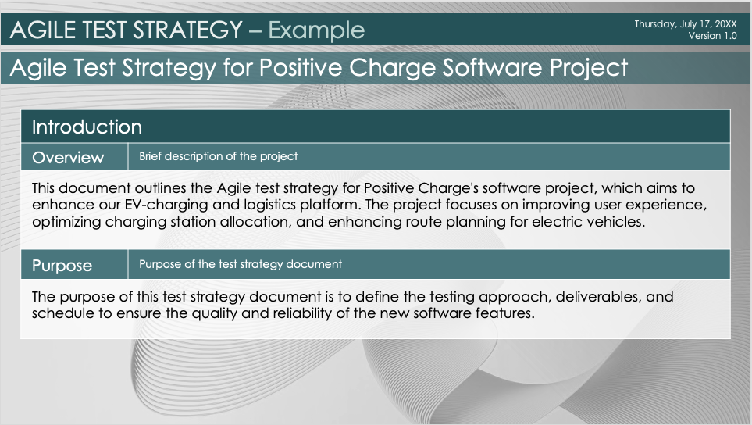
Agile Test Strategy Template
When to Use This Template: This Agile test strategy template works well for any Agile project that requires a detailed, structured approach to testing activities. It is especially useful for defining the scope, approach, and deliverables of the testing process.
Notable Template Features: This template includes sections to document testing approach, test environment setup, and tools and automation, to provide a holistic view of the testing strategy. It also outlines roles and responsibilities and includes a detailed communication plan for effective stakeholder engagement.

Slide 2
AGILE TEST STRATEGY
00/00/0000
Version 0.0
[ Project Name ]
Introduction
Overview | Brief description of the project
Purpose | Purpose of the test strategy document

Slide 3

AGILE TEST STRATEGY
Scope
In-Scope Items | Components and features to be tested
Out-of-Scope Items | Purpose of the test strategy document | Items not covered by this strategy

Slide 4
AGILE TEST STRATEGY
Testing Approach
Types of Testing
Functional, non-functional, regression, etc.
Agile Methodology
Specific Agile practices like sprints, stand-ups
Test Levels
Unit, integration, system, acceptance

Slide 5
AGILE TEST STRATEGY
Testing Approach
Test Environment
Test Deliverables
List of documents and reports to be delivered
Setup
Description of the test environment
Requirements
Hardware and software specifications

Slide 6

AGILE TEST STRATEGY
Tools and Automation
Testing Tools | Tools to be used, e.g., Selenium, JIRA
Automation Strategy | Purpose of the test strategy document | Approach to test automation

Slide 7


AGILE TEST STRATEGY
Test Data Management
Data Approach | Management of test data
Privacy and Security | Purpose of the test strategy document | Considerations for data privacy

Slide 8
AGILE TEST STRATEGY
Defect Management
Reporting Process |  | Defect reporting and tracking process
Tools | Tools used for defect management | Purpose of the test strategy document

Slide 9
AGILE TEST STRATEGY
Roles and Responsibilities
List of roles in the testing team and responsibilities of each role
ROLE | RESPONSIBILITIES
Test Manager
Test Engineers
Automation Engineers
Product Owner

Slide 10

AGILE TEST STRATEGY
Schedule
Timeline | Timeline for testing activities
ACTIVITIES | DATE

Slide 11
AGILE TEST STRATEGY
Schedule
Milestones | Key milestones and deadlines
KEY MILESTONE | DATE

Slide 12
AGILE TEST STRATEGY
Risks and Mitigation
POTENTIAL RISKS | MITIGATION STRATEGIES

Slide 13
AGILE TEST STRATEGY
Communication Plan
Channels
Frequency
Stakeholders

Slide 14
AGILE TEST STRATEGY
Risks and Mitigation
Exit Criteria
Criteria for concluding the testing phase and metrics for success
CRITERIA | SUCCESS METRICS

Slide 15
AGILE TEST STRATEGY
Risks and Mitigation
Conclusion
Summary and next steps

Slide 16
DISCLAIMER Any articles, templates, or information provided by Smartsheet on the website are for reference only. While we strive to keep the information up to date and correct, we make no representations or warranties of any kind, express or implied, about the completeness, accuracy, reliability, suitability, or availability with respect to the website or the information, articles, templates, or related graphics contained on the website. Any reliance you place on such information is therefore strictly at your own risk.

