Slide 1


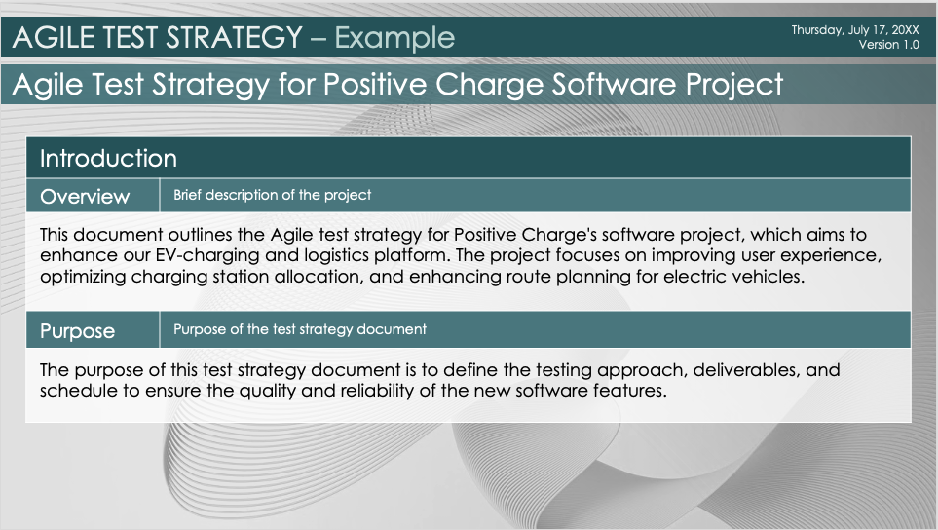
Agile Test Strategy Template – Example
When to Use This Template: This Agile test strategy template works well for any Agile project that requires a detailed, structured approach to testing activities. It is especially useful for defining the scope, approach, and deliverables of the testing process.
Notable Template Features: This template includes sections to document testing approach, test environment setup, and tools and automation, to provide a holistic view of the testing strategy. It also outlines roles and responsibilities and includes a detailed communication plan for effective stakeholder engagement.

Slide 2
AGILE TEST STRATEGY – Example
Thursday, July 17, 20XX
Version 1.0
Agile Test Strategy for Positive Charge Software Project
Introduction
Overview | Brief description of the project
This document outlines the Agile test strategy for Positive Charge's software project, which aims to enhance our EV-charging and logistics platform. The project focuses on improving user experience, optimizing charging station allocation, and enhancing route planning for electric vehicles.
Purpose | Purpose of the test strategy document
The purpose of this test strategy document is to define the testing approach, deliverables, and schedule to ensure the quality and reliability of the new software features.

Slide 3

AGILE TEST STRATEGY
Scope
In-Scope Items | Components and features to be tested
EV-charging station locator Real-time charging station availability updates Enhanced route planning with charging stops User account management features Payment gateway integration
Out-of-Scope Items | Purpose of the test strategy document | Items not covered by this strategy
Legacy systems integration Third-party API enhancements

Slide 4
AGILE TEST STRATEGY
Testing Approach
Types of Testing
Functional, non-functional, regression, etc.
Functional testing Non-functional testing (performance, security) Regression testing User Acceptance Testing (UAT)
Agile Methodology
Specific Agile practices like sprints, stand-ups
Sprints: Bi-weekly sprint cycles Daily stand-up meetings: 15-minute meetings every morning Sprint reviews and retrospectives: At the end of each sprint
Test Levels
Unit, integration, system, acceptance
Unit testing Integration testing System testing Acceptance testing

Slide 5
AGILE TEST STRATEGY
Testing Approach
Test Environment
Test Deliverables
List of documents and reports to be delivered
Test plan document Test cases and test scripts Test summary reports Defect reports UAT sign-off document
Setup
Description of the test environment
A dedicated test environment that replicates the production setup, including staging servers, databases, and network configurations.
Requirements
Hardware and software specifications
Hardware: Standard servers, load balancers Software: Latest versions of web servers, database systems, and necessary middleware

Slide 6

AGILE TEST STRATEGY
Tools and Automation
Testing Tools | Tools to be used, e.g., Selenium, JIRA
Selenium for automation testing JIRA for issue tracking and test management Postman for API testing
Automation Strategy | Purpose of the test strategy document | Approach to test automation
Automate regression test cases Continuous Integration (CI) setup with Jenkins for automated test execution

Slide 7


AGILE TEST STRATEGY
Test Data Management
Data Approach | Management of test data
Use anonymized production data for realistic test scenarios. Create synthetic data where necessary.
Privacy and Security | Purpose of the test strategy document | Considerations for data privacy
Ensure test data complies with data privacy regulations and is securely managed.

Slide 8
AGILE TEST STRATEGY
Defect Management
Reporting Process |  | Defect reporting and tracking process
Defects are logged in JIRA and prioritized based on severity and impact. Regular triage meetings to review and assign defects.
Tools | Tools used for defect management | Purpose of the test strategy document
JIRA for defect tracking

Slide 9
AGILE TEST STRATEGY
Roles and Responsibilities
List of roles in the testing team and responsibilities of each role
ROLE | RESPONSIBILITIES
Test Manager | Oversee the testing process. Ensure testing coverage and timelines.
Test Engineers | Design and execute test cases. Write and execute test cases, log defects.
Automation Engineers | Develop and maintain automated tests. Implement automation scripts.
Product Owner | Provide requirements and accept deliverables. Validate the functionality meets requirements.

Slide 10

AGILE TEST STRATEGY
Schedule
Timeline | Timeline for testing activities
ACTIVITIES | DATE
Sprint 1 | July 15 - July 28
Sprint 2 | July 29 - August 11
Sprint 3 | August 12 - August 25

Slide 11
AGILE TEST STRATEGY
Schedule
Milestones | Key milestones and deadlines
KEY MILESTONE | DATE
Sprint planning | July 15
First sprint review | July 28
Final UAT | August 25

Slide 12
AGILE TEST STRATEGY
Risks and Mitigation
POTENTIAL RISKS | MITIGATION STRATEGIES
Delays in test environment setup | Set up and validate the test environment
Unavailability of test data | Ensure data availability before testing begins
High defect rate in critical features | Prioritize and address critical defects promptly

Slide 13
AGILE TEST STRATEGY
Communication Plan
Channels
Slack for daily communication Email for formal updates Confluence for documentation
Frequency
Daily stand-ups Weekly status reports
Stakeholders
Product Owner Development team QA Team Project Manager

Slide 14
AGILE TEST STRATEGY
Risks and Mitigation
Exit Criteria
Criteria for concluding the testing phase and metrics for success
CRITERIA | SUCCESS METRICS
All test cases executed with a pass rate of 95% | Defect density
No critical defects open | Test coverage
UAT sign-off obtained | User satisfaction

Slide 15
AGILE TEST STRATEGY
Risks and Mitigation
Conclusion
Summary and next steps
This Agile test strategy provides a structured approach to ensure the quality of Positive Charge's software enhancements. Next steps include executing the defined test cases, monitoring progress, and addressing any issues that arise during the testing phases.

Slide 16
DISCLAIMER Any articles, templates, or information provided by Smartsheet on the website are for reference only. While we strive to keep the information up to date and correct, we make no representations or warranties of any kind, express or implied, about the completeness, accuracy, reliability, suitability, or availability with respect to the website or the information, articles, templates, or related graphics contained on the website. Any reliance you place on such information is therefore strictly at your own risk.

